Slide 1
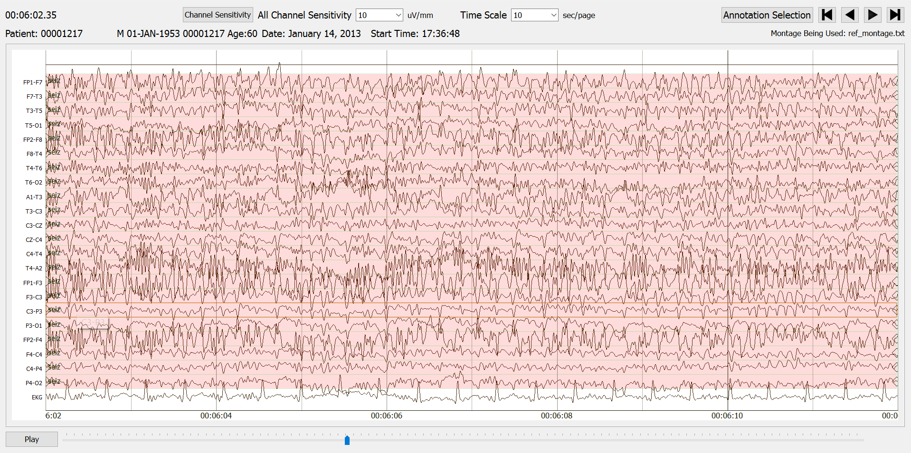
Matthew Refford
The Effects of Anticonvulsants
EEG Annotation Team
October 2018

