Slide 1
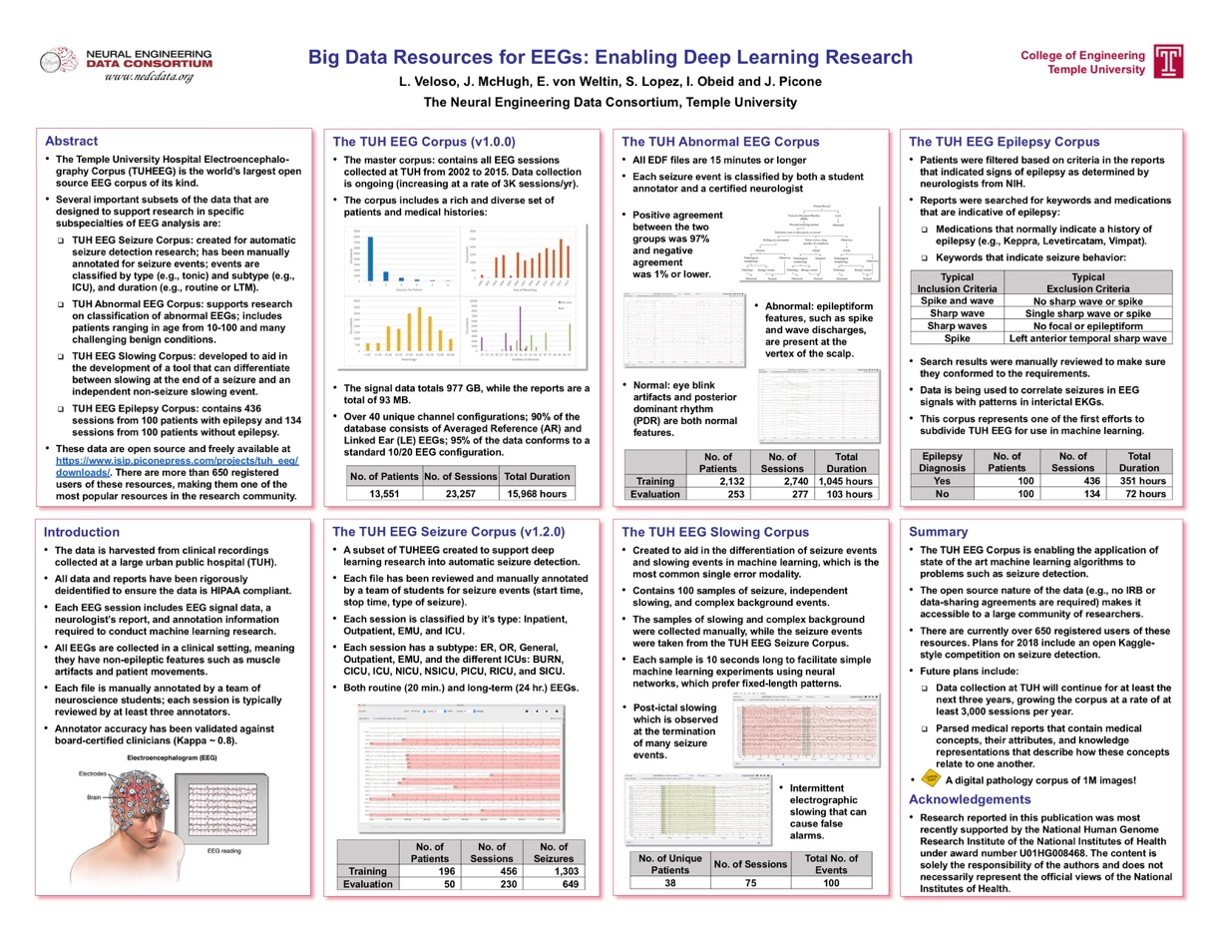
The TUH EEG Corpus
DoD Human Language Technology
Our Staff Photographer
May 2018

