Slide 1
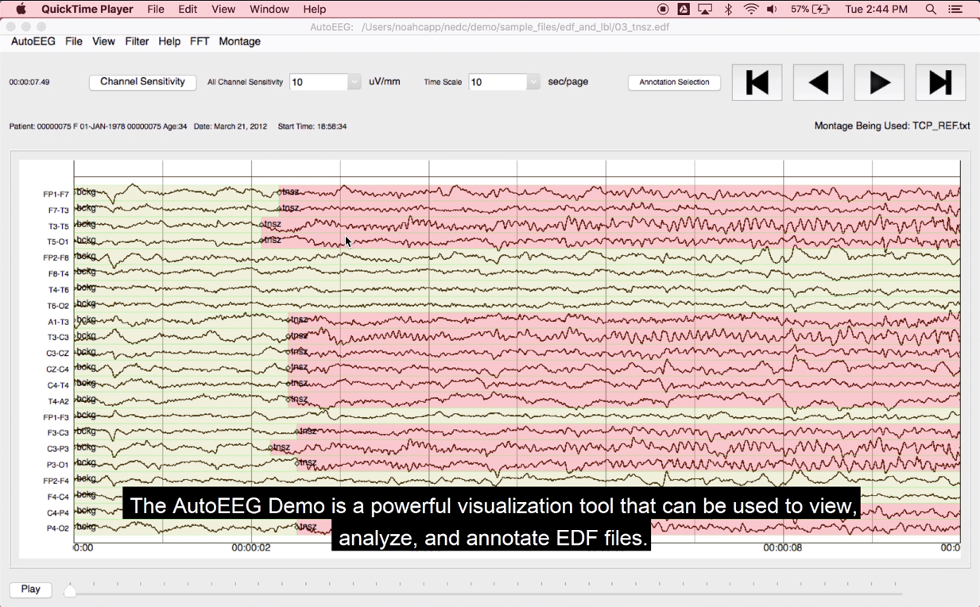
Vineetha Mathew
EEG Annotation Team The “Golden Voice”
December 2018

