Slide 1
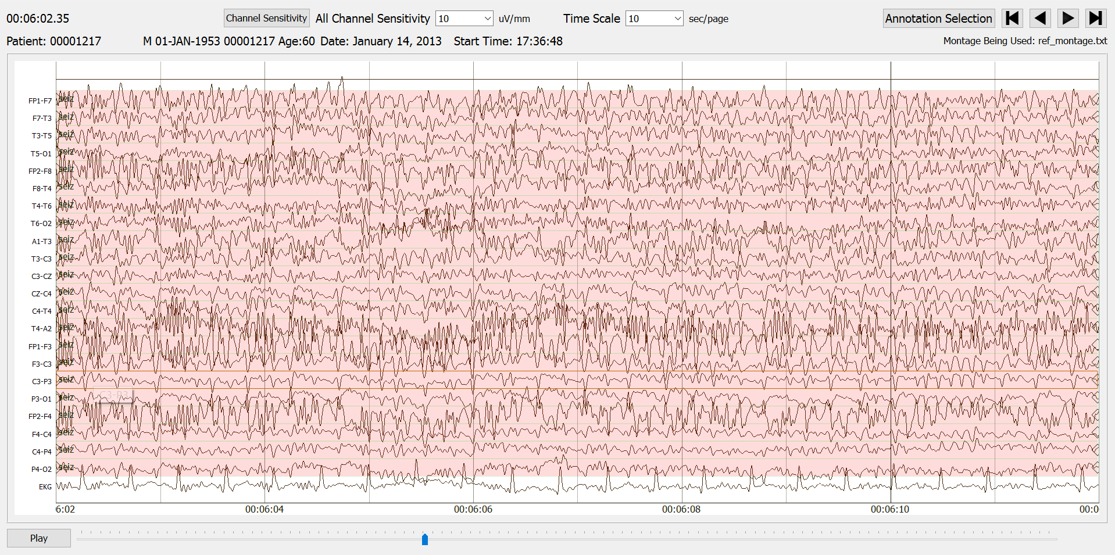
Mary Liu
EEG Data Ingestion
Temple University Hospital EEG Corpus
December 2018

