Slide 1
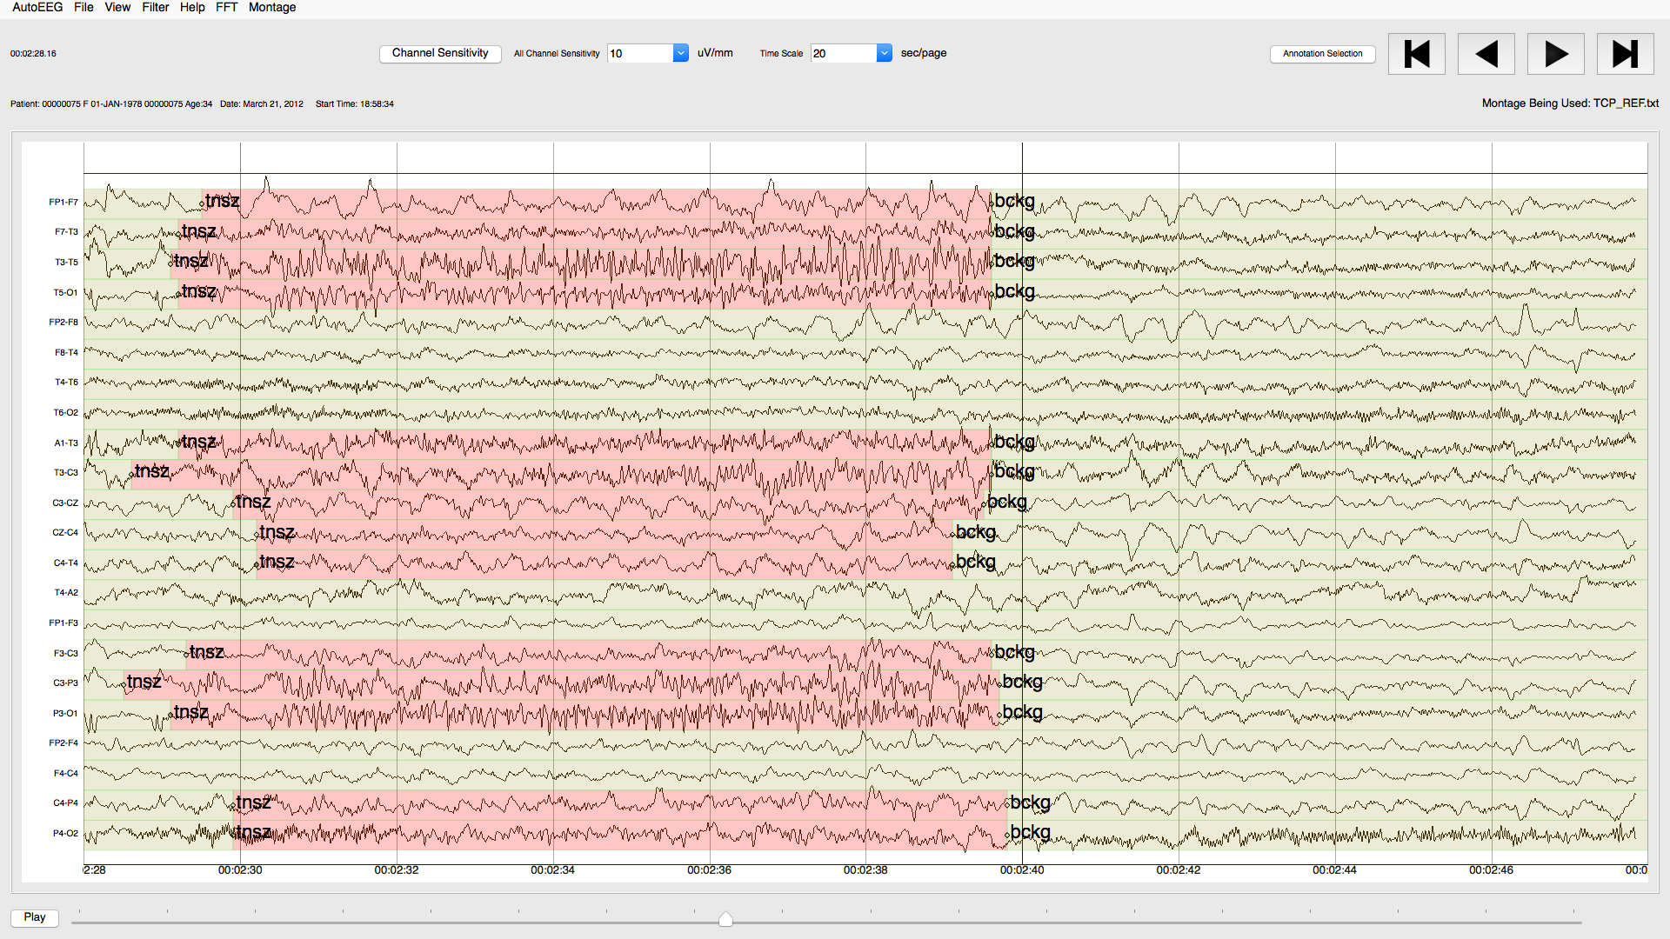
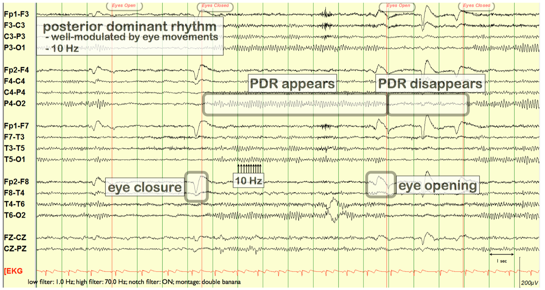
Elliott Krome: The Demo Tool
The NEDC C++ Environment
NEDC Software Engineering Team Leader
December 2018

