Slide 1
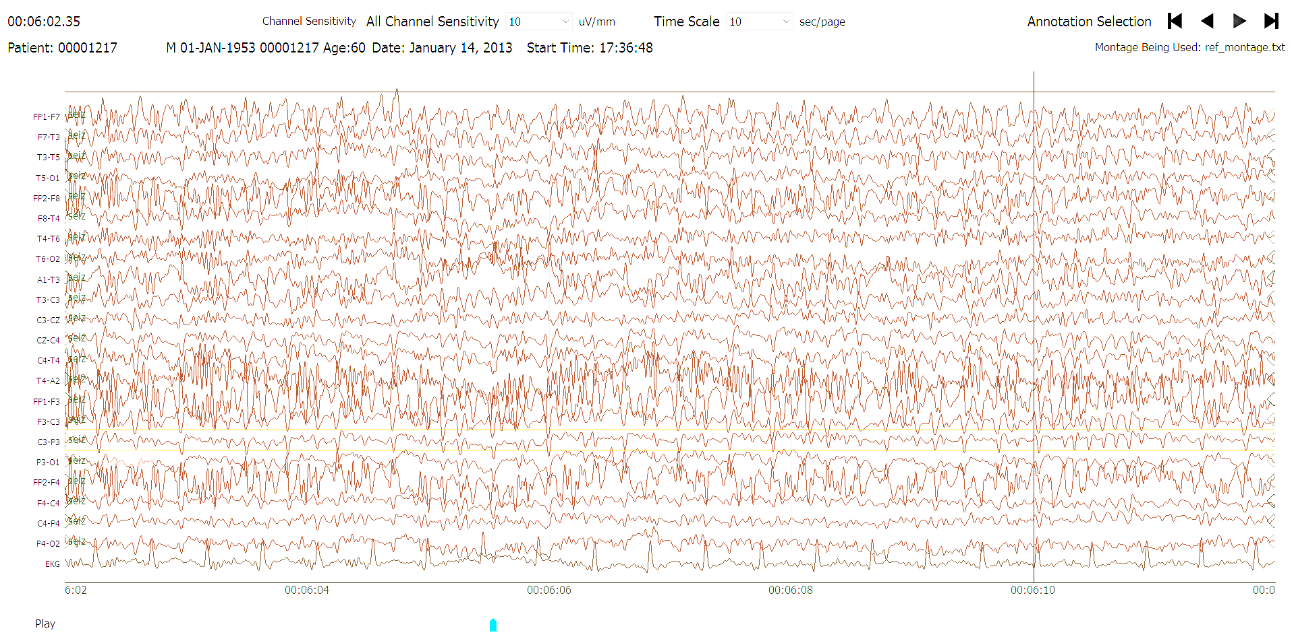
Tameem Ahsan
Electroencephalographic Slowing
EEG Annotation Team
December 2018

