Slide 1
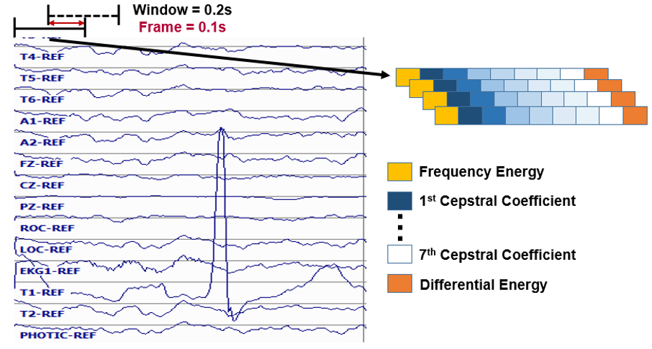
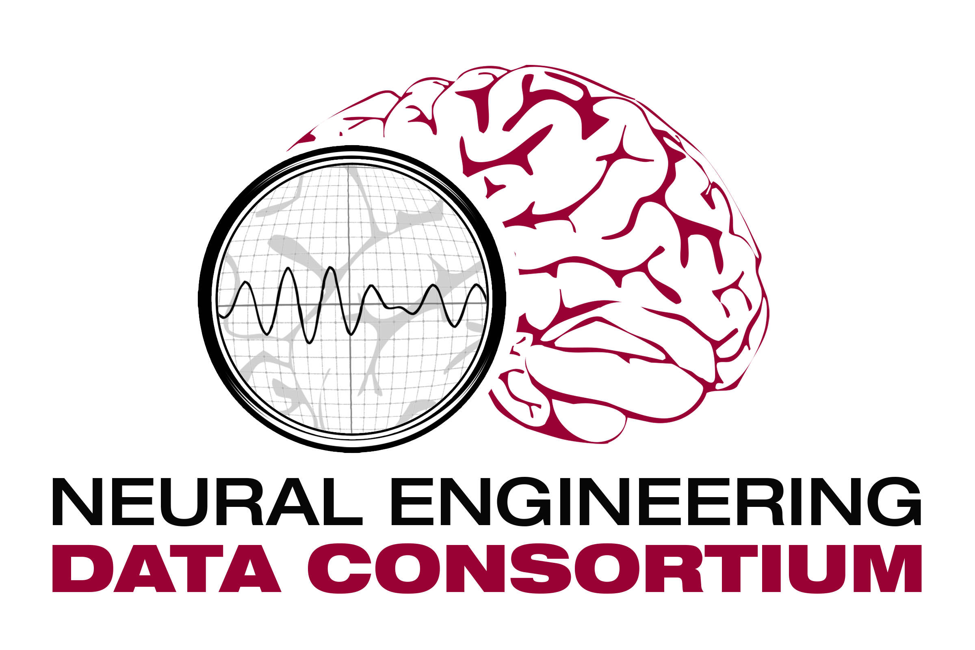
“Sleep is Overrated”
Abnormal EEG Detection
The TUH EEG Corpus
C++ DSP Code
June 2017

