Slide 1
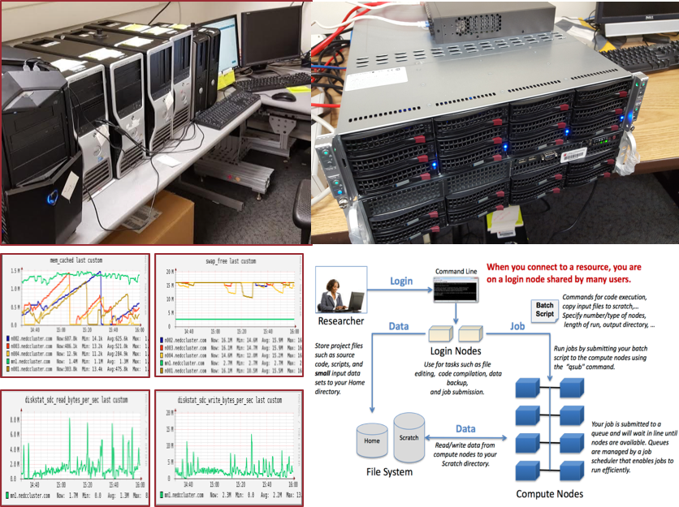
The Neuronix Cluster The TUH EEG Corpus Financial Management
May 2016

