Slide 1
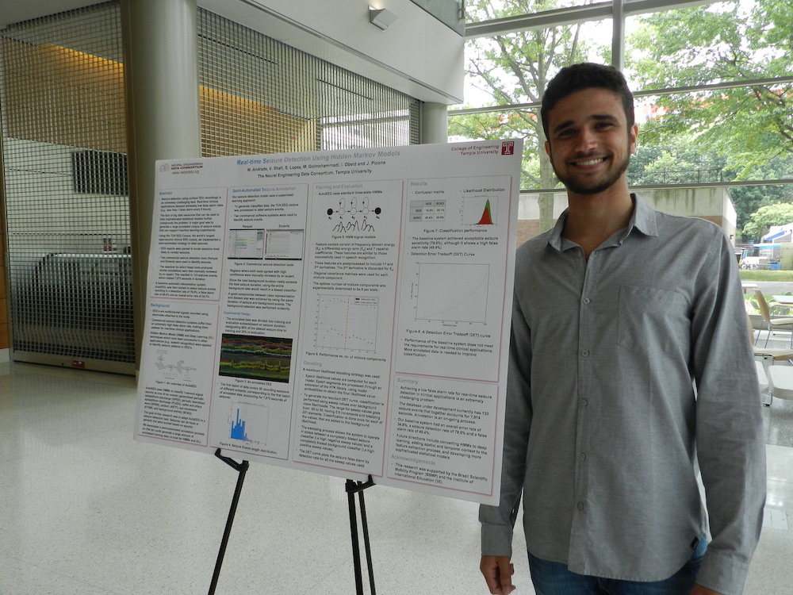
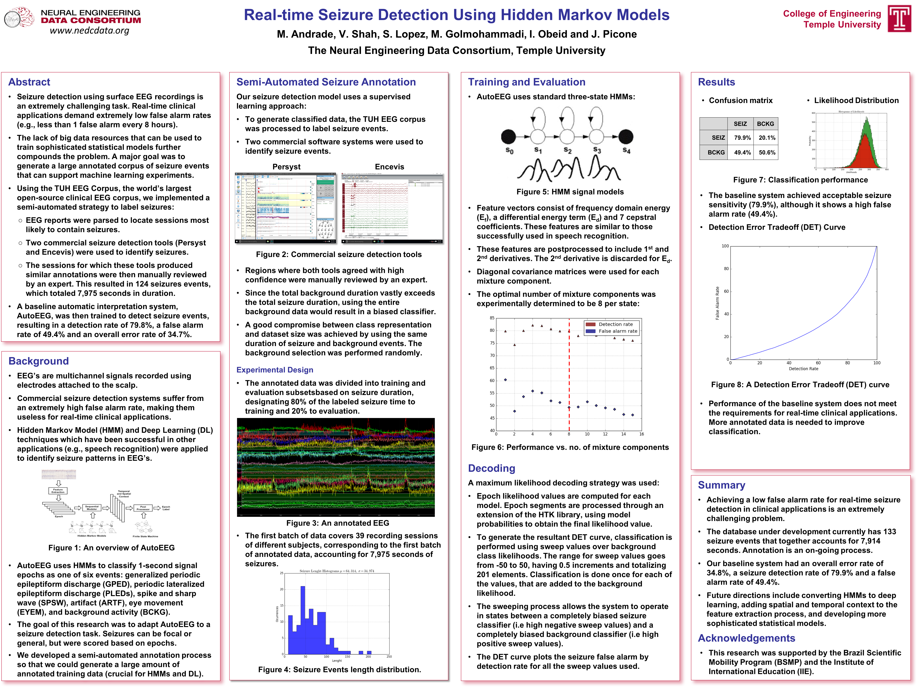
AutoEEG: Seizure Detection Persyst and Encevis
Summer 2016

