Slide 1
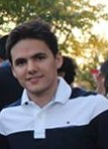
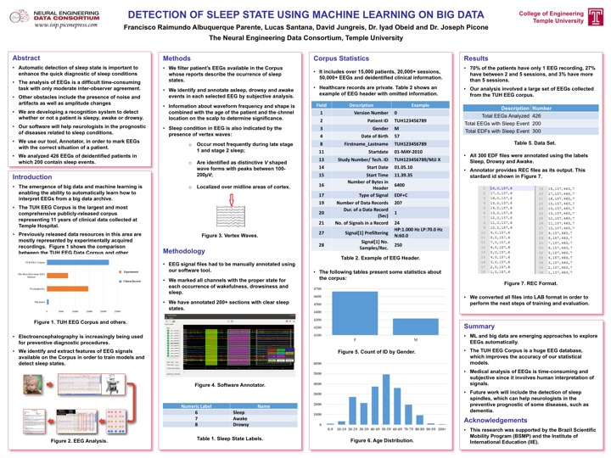
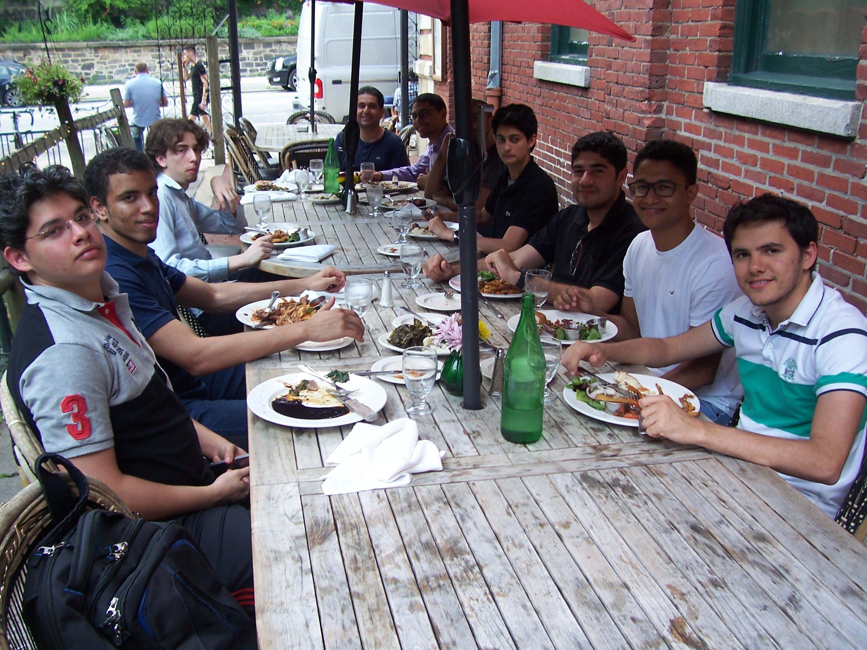
SLEEP STATE DETECTION
SPIKE DETECTION
Summer of Code 2015

Slide 2
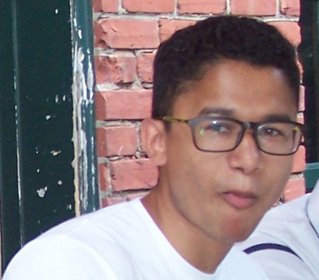
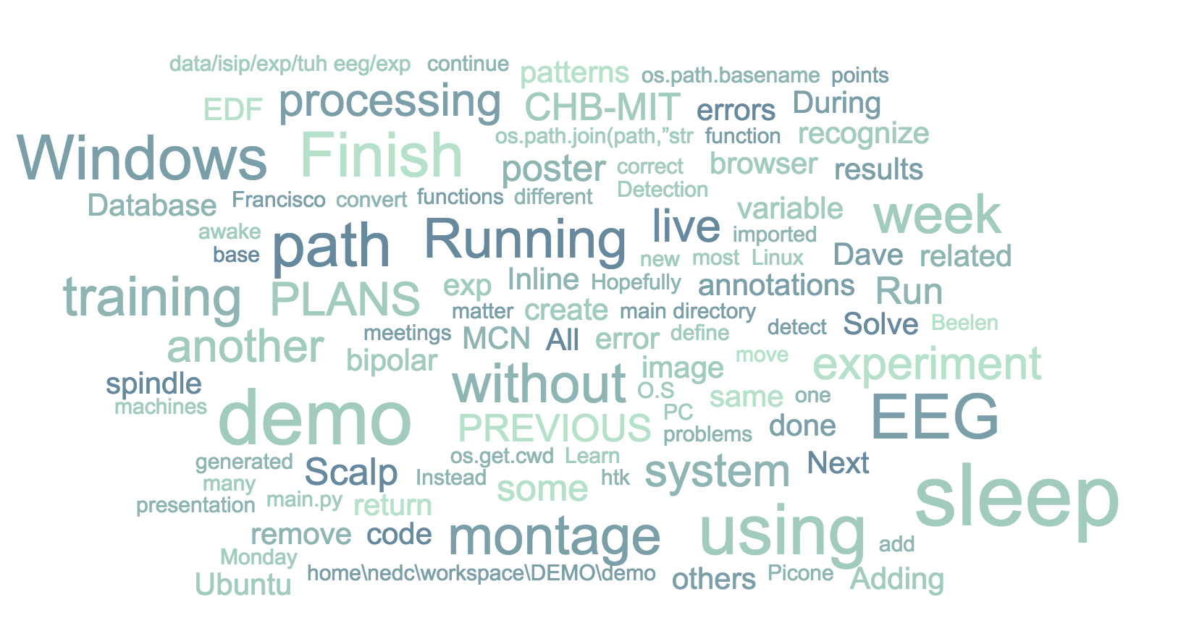
SLEEP STATE DETECTION
DISK IMAGE / DEMO SYSTEM
Summer of Code 2015

Slide 3
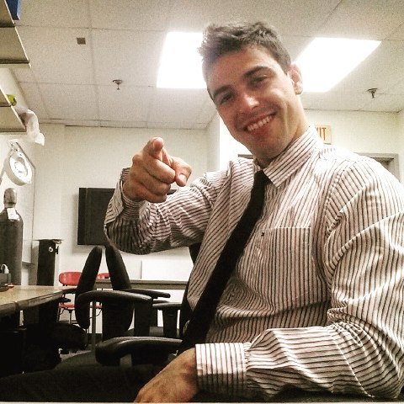
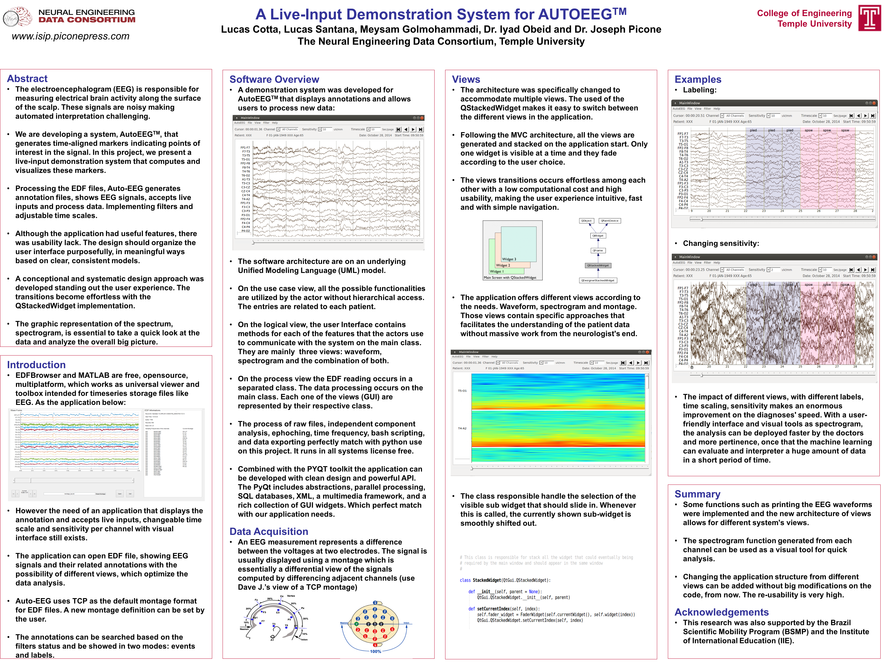
SPECTROGRAMS AUTOEEG DEMO
PHOTIC STIMULATION
Summer of Code 2015

Slide 4
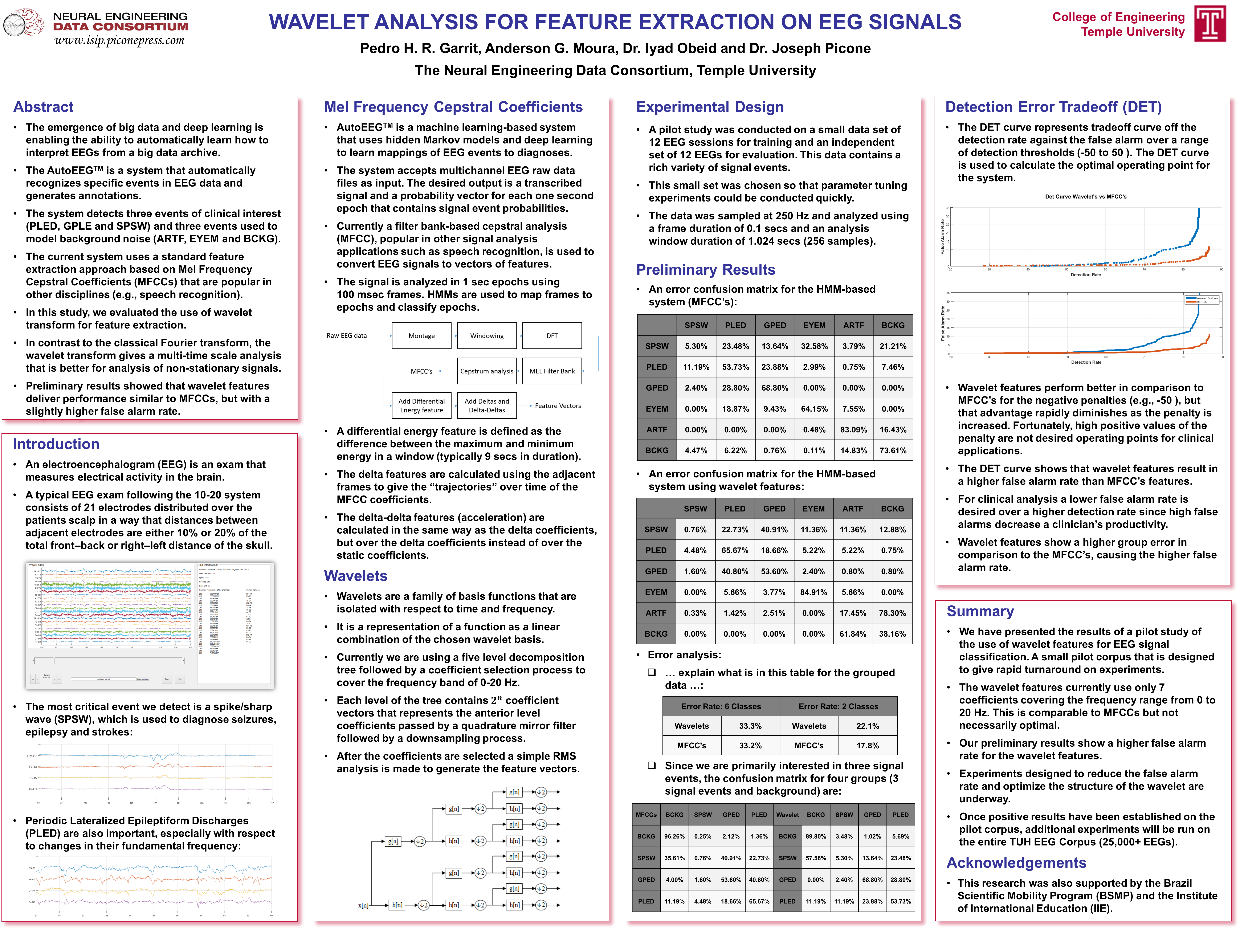
WAVELET TRANSFORMS
MATLAB TOOLBOX
Summer of Code 2015

Slide 5
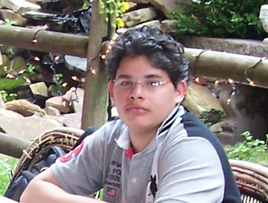
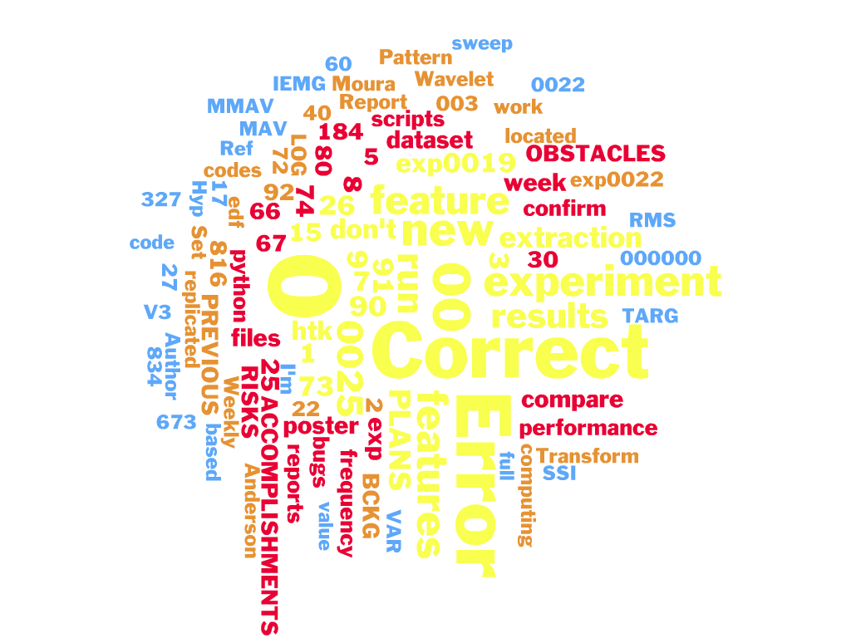
KALDI INTEGRATION
FEATURE EXTRACTION
Summer of Code 2015

Slide 6
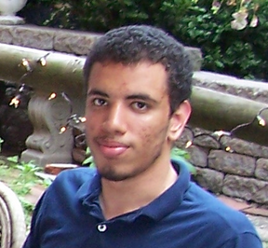
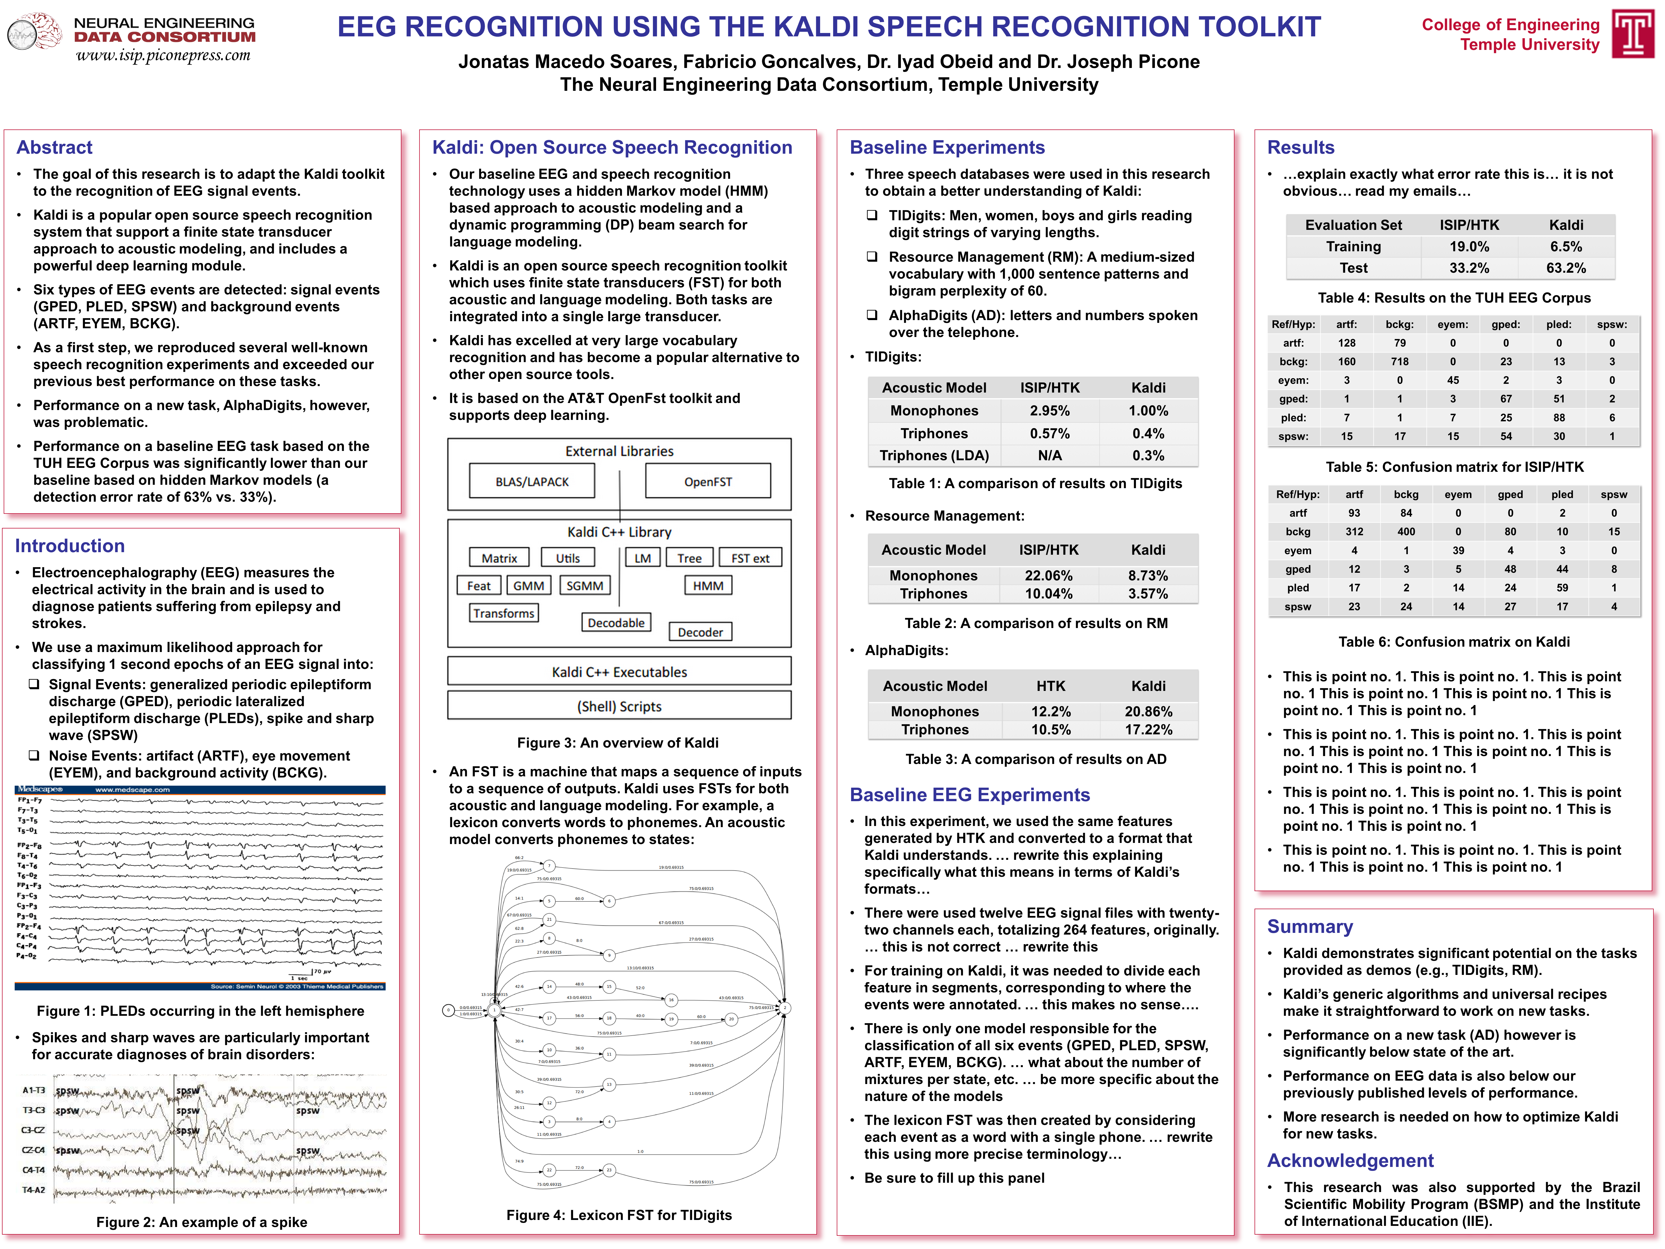
KALDI INTEGRATION
ABNORMAL EEG CLASSIFICATION
Summer of Code 2015

Slide 7
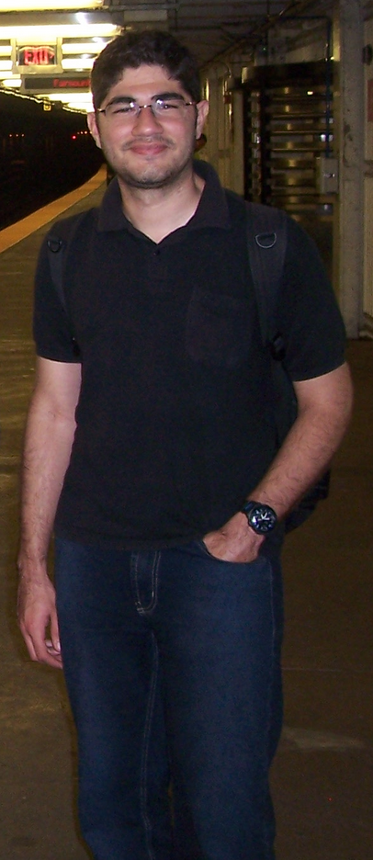
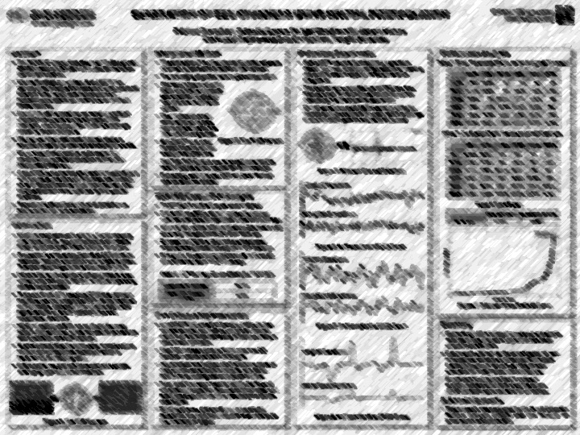
INTERPOLATION OF EEG SIGNALS
APPLICATION OF KALDI TO EEGS
Summer of Code 2015

