Slide 1
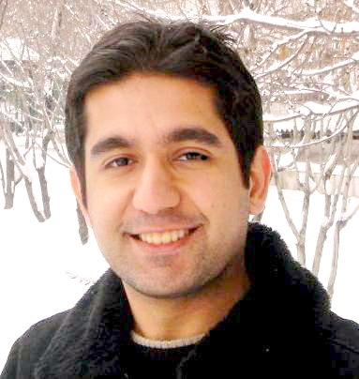
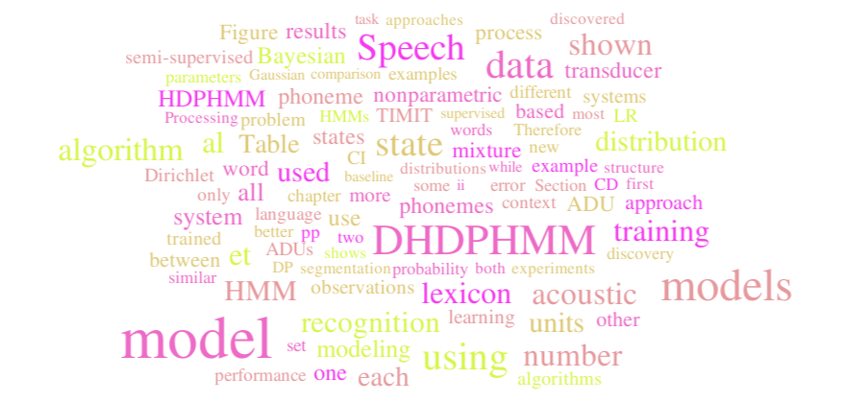
NONPARAMETRIC BAYESIAN APPROACHES FOR ACOUSTIC MODELING
June 2015

