Slide 1
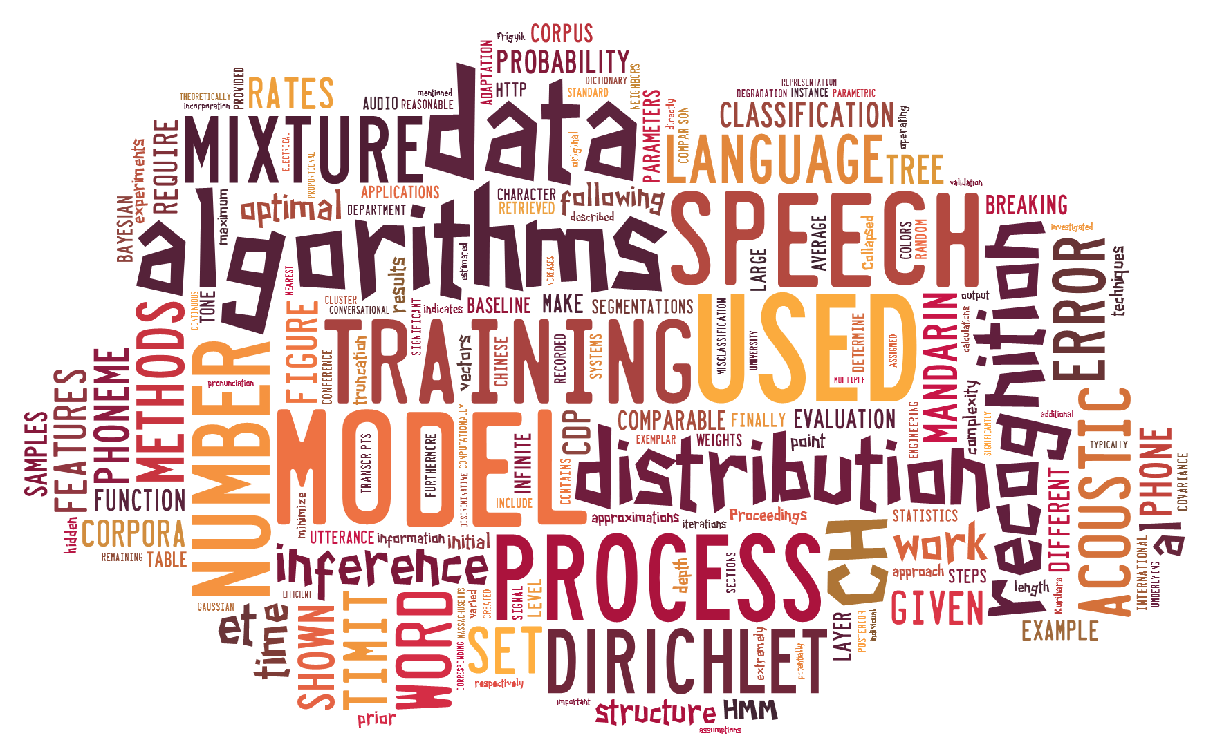
A COMPARATIVE ANALYSIS OF BAYESIAN NONPARAMETRIC VARIATIONAL INFERENCE ALGORITHMS
FOR SPEECH RECOGNITION
May 2013

