Slide 1
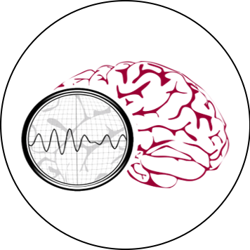
NSF PFI-TT: REAL-TIME ANALYSIS OF ELECTROENCEPHALOGRAMS
IN AN INTENSIVE CARE ENVIRONMENT
HOME OVERVIEW BIO SIGNAL
Mission Within TUH EEG . . .
DEMO VIDEO
Our real-time EEG analysis applied for intensive care
IMAGE 1
(Video)
NSF STEM Challenge
Promoting community immersion and inclusivity to all.
Intellectual merit
Broader impact
IMAGE 1
(Video)
THE NEURAL ENGINEERING DATA CONSORTIUM
HELP CONTACT US

Slide 2
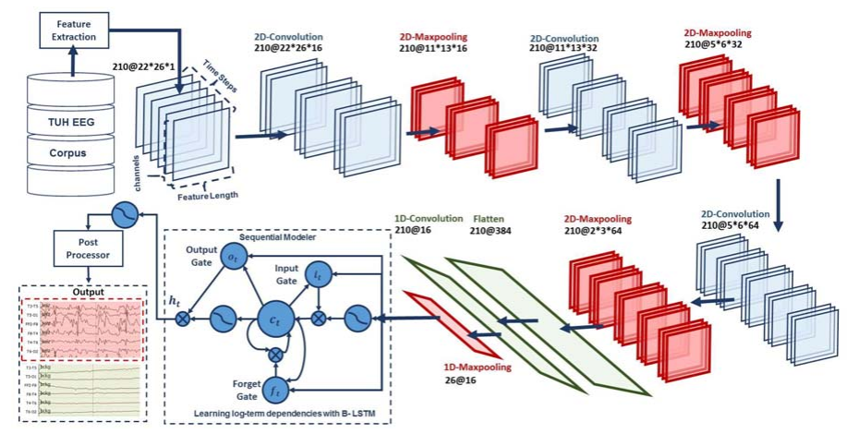
NSF PFI-TT: REAL-TIME ANALYSIS OF ELECTROENCEPHALOGRAMS
IN AN INTENSIVE CARE ENVIRONMENT
HOME OVERVIEW BIO SIGNAL
Mission Within TUH EEG . . .
DEMO VIDEO
Our real-time EEG analysis applied for intensive care
IMAGE 2
NSF STEM Challenge
Promoting community immersion and inclusivity to all.
Intellectual merit
Broader impact
IMAGE 2
THE NEURAL ENGINEERING DATA CONSORTIUM
HELP CONTACT US

Slide 3
NSF PFI-TT: REAL-TIME ANALYSIS OF ELECTROENCEPHALOGRAMS
IN AN INTENSIVE CARE ENVIRONMENT
HOME OVERVIEW BIO SIGNAL
Mission Within TUH EEG . . .
DEMO VIDEO
Our real-time EEG analysis applied for intensive care
IMAGE 3
NSF STEM Challenge
Promoting community immersion and inclusivity to all.
Intellectual merit
Broader impact
IMAGE 3
THE NEURAL ENGINEERING DATA CONSORTIUM
HELP CONTACT US

Slide 4
NSF PFI-TT: REAL-TIME ANALYSIS OF ELECTROENCEPHALOGRAMS
IN AN INTENSIVE CARE ENVIRONMENT
HOME OVERVIEW BIO SIGNAL
PROJECT SUMMARY
SIGNIFICANCE
THE NEURAL ENGINEERING DATA CONSORTIUM
HELP CONTACT US

Slide 5
NSF PFI-TT: REAL-TIME ANALYSIS OF ELECTROENCEPHALOGRAMS
IN AN INTENSIVE CARE ENVIRONMENT
HOME OVERVIEW BIO SIGNAL
BIO SIGNAL
THE NEURAL ENGINEERING DATA CONSORTIUM
HELP CONTACT US

Slide 6
NSF PFI-TT: REAL-TIME ANALYSIS OF ELECTROENCEPHALOGRAMS
IN AN INTENSIVE CARE ENVIRONMENT
HOME OVERVIEW BIO SIGNAL
CONTACT US
THE NEURAL ENGINEERING DATA CONSORTIUM
HELP CONTACT US

