Slide 1
NSF PFI-TT: REAL-TIME ANALYSIS OF ELECTROENCEPHALOGRAMS
IN AN INTENSIVE CARE ENVIRONMENT
HOME OVERVIEW DOWNLOADS ABOUT US
Mission Within TUH EEG . . .
DEMO VIDEO
Our real-time EEG analysis applied for intensive care
IMAGE 1
(Video)
What’s New?
THE NEURAL ENGINEERING DATA CONSORTIUM
HELP CONTACT US

Slide 2
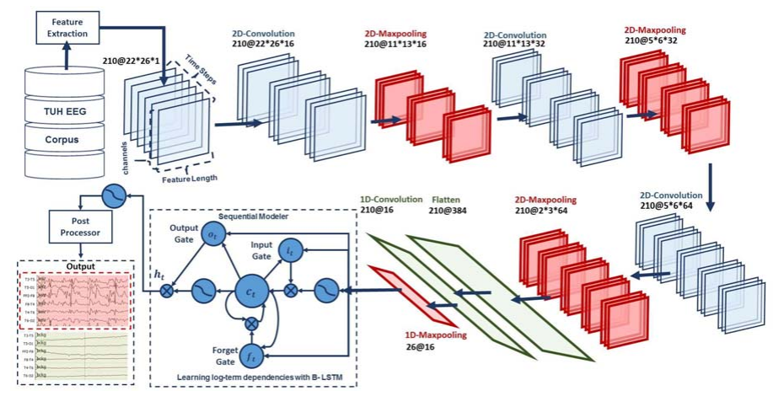
NSF PFI-TT: REAL-TIME ANALYSIS OF ELECTROENCEPHALOGRAMS
IN AN INTENSIVE CARE ENVIRONMENT
HOME OVERVIEW DOWNLOADS ABOUT US
Mission Within TUH EEG . . .
DEMO VIDEO
Our real-time EEG analysis applied for intensive care
IMAGE 2
What’s New?
THE NEURAL ENGINEERING DATA CONSORTIUM
HELP CONTACT US

Slide 3
NSF PFI-TT: REAL-TIME ANALYSIS OF ELECTROENCEPHALOGRAMS
IN AN INTENSIVE CARE ENVIRONMENT
HOME OVERVIEW DOWNLOADS ABOUT US
Mission Within TUH EEG . . .
DEMO VIDEO
Our real-time EEG analysis applied for intensive care
IMAGE 3
What’s New?
THE NEURAL ENGINEERING DATA CONSORTIUM
HELP CONTACT US

Slide 4
NSF PFI-TT: REAL-TIME ANALYSIS OF ELECTROENCEPHALOGRAMS
IN AN INTENSIVE CARE ENVIRONMENT
HOME OVERVIEW DOWNLOADS ABOUT US
PROJECT SUMMARY
SIGNIFICANCE
THE NEURAL ENGINEERING DATA CONSORTIUM
HELP CONTACT US

Slide 5
NSF PFI-TT: REAL-TIME ANALYSIS OF ELECTROENCEPHALOGRAMS
IN AN INTENSIVE CARE ENVIRONMENT
HOME OVERVIEW DOWNLOADS ABOUT US
<Symbolic link to the TUH EEG downloads page>
THE NEURAL ENGINEERING DATA CONSORTIUM
HELP CONTACT US

Slide 6
NSF PFI-TT: REAL-TIME ANALYSIS OF ELECTROENCEPHALOGRAMS
IN AN INTENSIVE CARE ENVIRONMENT
HOME OVERVIEW DOWNLOADS ABOUT US
FACULTY AND UNIVERSITIES
<Names, Faces and brief description>
GRADUATE STUDENTS
UNDERGRADUATE STUDENTS
<Scroll down>
THE NEURAL ENGINEERING DATA CONSORTIUM
HELP CONTACT US

Slide 7
NSF PFI-TT: REAL-TIME ANALYSIS OF ELECTROENCEPHALOGRAMS
IN AN INTENSIVE CARE ENVIRONMENT
HOME OVERVIEW DOWNLOADS ABOUT US
CONTACT US
THE NEURAL ENGINEERING DATA CONSORTIUM
HELP CONTACT US

