Slide 1
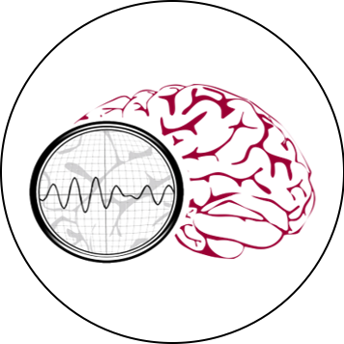
NSF PFI-TT: REAL-TIME ANALYSIS OF ELECTROENCEPHALOGRAMS
IN AN INTENSIVE CARE ENVIRONMENT
HOME OVERVIEW
DOWNLOADS ABOUT US
Mission
Demo Video
Our real-time EEG analysis applied for intensive care.
Within TUH EEG . . .
IMAGE 1
(Video)
NSF STEM Challenge
Promoting community immersion and inclusivity to all.
What’s New?
IMAGE 1
(Video)
THE NEURAL ENGINEERING DATA CONSORTIUM
HELP CONTACT US

Slide 2
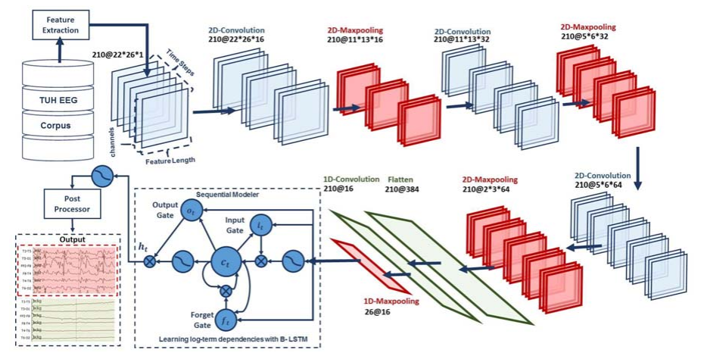
NSF PFI-TT: REAL-TIME ANALYSIS OF ELECTROENCEPHALOGRAMS
IN AN INTENSIVE CARE ENVIRONMENT
HOME OVERVIEW
DOWNLOADS ABOUT US
Mission
Demo Video
Our real-time EEG analysis applied for intensive care.
Within TUH EEG . . .
NSF STEM Challenge
Promoting community immersion and inclusivity to all.
What’s New?
IMAGE 2
THE NEURAL ENGINEERING DATA CONSORTIUM
HELP CONTACT US

Slide 3
NSF PFI-TT: REAL-TIME ANALYSIS OF ELECTROENCEPHALOGRAMS
IN AN INTENSIVE CARE ENVIRONMENT
HOME OVERVIEW
DOWNLOADS ABOUT US
Mission
Demo Video
Our real-time EEG analysis applied for intensive care.
Within TUH EEG . . .
IMAGE 3
NSF STEM Challenge
Promoting community immersion and inclusivity to all.
What’s New?
IMAGE 3
THE NEURAL ENGINEERING DATA CONSORTIUM
HELP CONTACT US

Slide 4
NSF PFI-TT: REAL-TIME ANALYSIS OF ELECTROENCEPHALOGRAMS
IN AN INTENSIVE CARE ENVIRONMENT
HOME OVERVIEW
DOWNLOADS ABOUT US
Project Summary
Significance
THE NEURAL ENGINEERING DATA CONSORTIUM
HELP CONTACT US

Slide 5
NSF PFI-TT: REAL-TIME ANALYSIS OF ELECTROENCEPHALOGRAMS
IN AN INTENSIVE CARE ENVIRONMENT
HOME OVERVIEW
DOWNLOADS ABOUT US
<Symbolic Link to the TUH EEG Downloads page>
THE NEURAL ENGINEERING DATA CONSORTIUM
HELP CONTACT US

Slide 6
NSF PFI-TT: REAL-TIME ANALYSIS OF ELECTROENCEPHALOGRAMS
IN AN INTENSIVE CARE ENVIRONMENT
HOME OVERVIEW
DOWNLOADS ABOUT US
Faculty and Universities
<Names, faces and brief description>
Graduate Students
Undergraduate Students
<Scroll Down>
THE NEURAL ENGINEERING DATA CONSORTIUM
HELP CONTACT US

