Slide 1
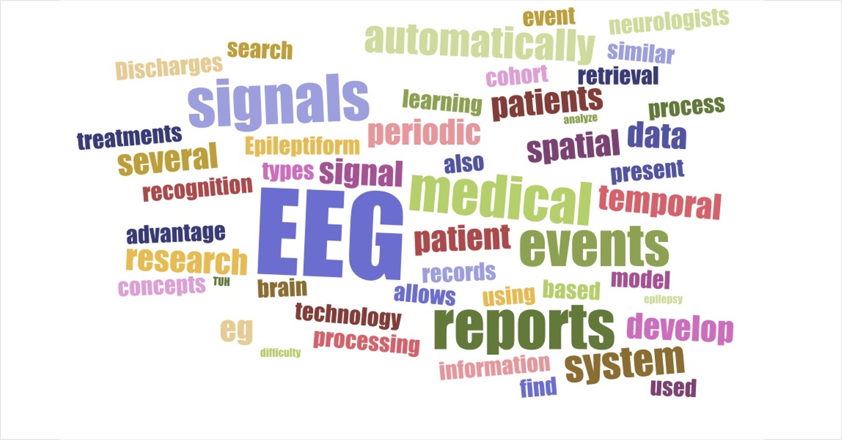
Pathologists
Open Source
Tensorflow
Electroencephalography
Python
TUH
Emacs
High Performance Cluster
Neurology
Standardization
Software
Java
Automation
Command
Line
Digital Pathology
Seizure
Open Source
Annotation
Petabyte
Open Source
Linux
grep
Deep Learning
Database
Big Data
Preprocessing
System
Hardware
Signal
Processing

