Slide 1
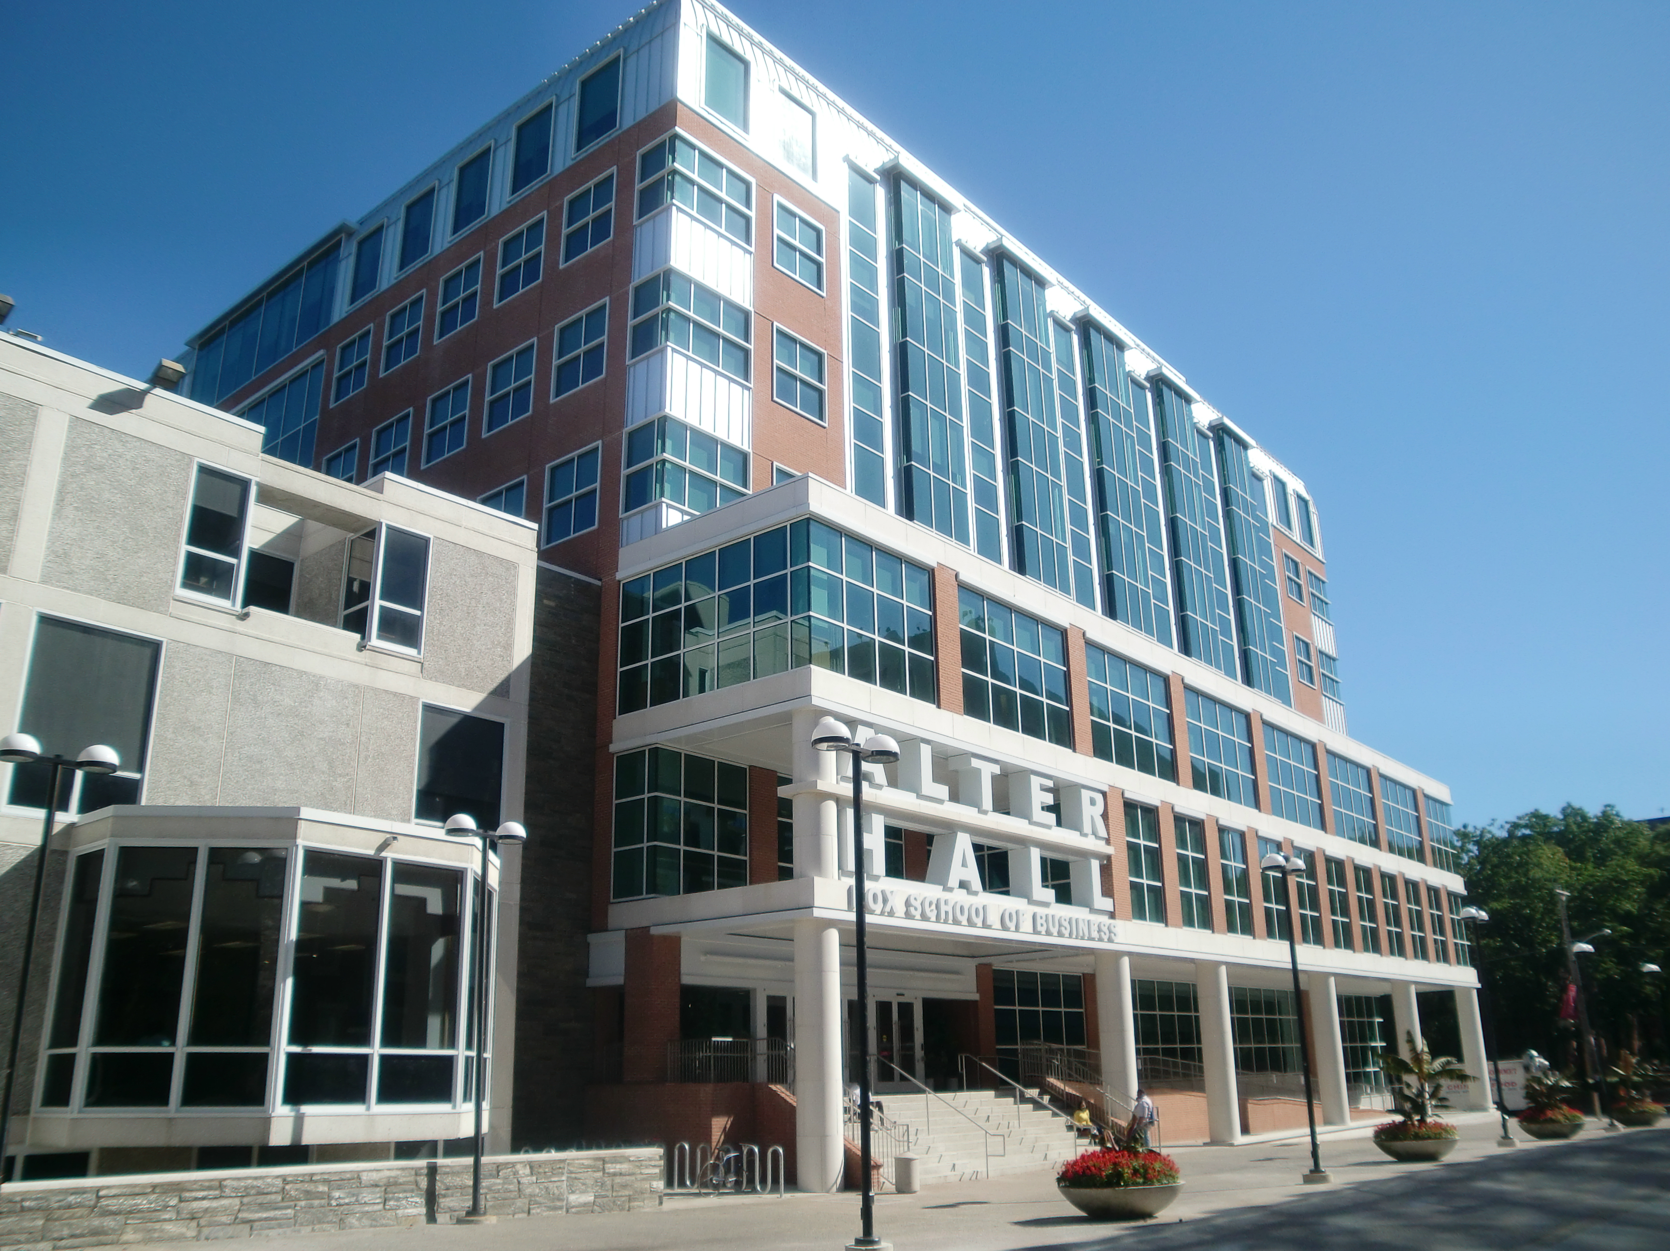
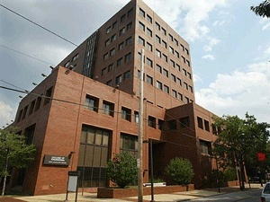
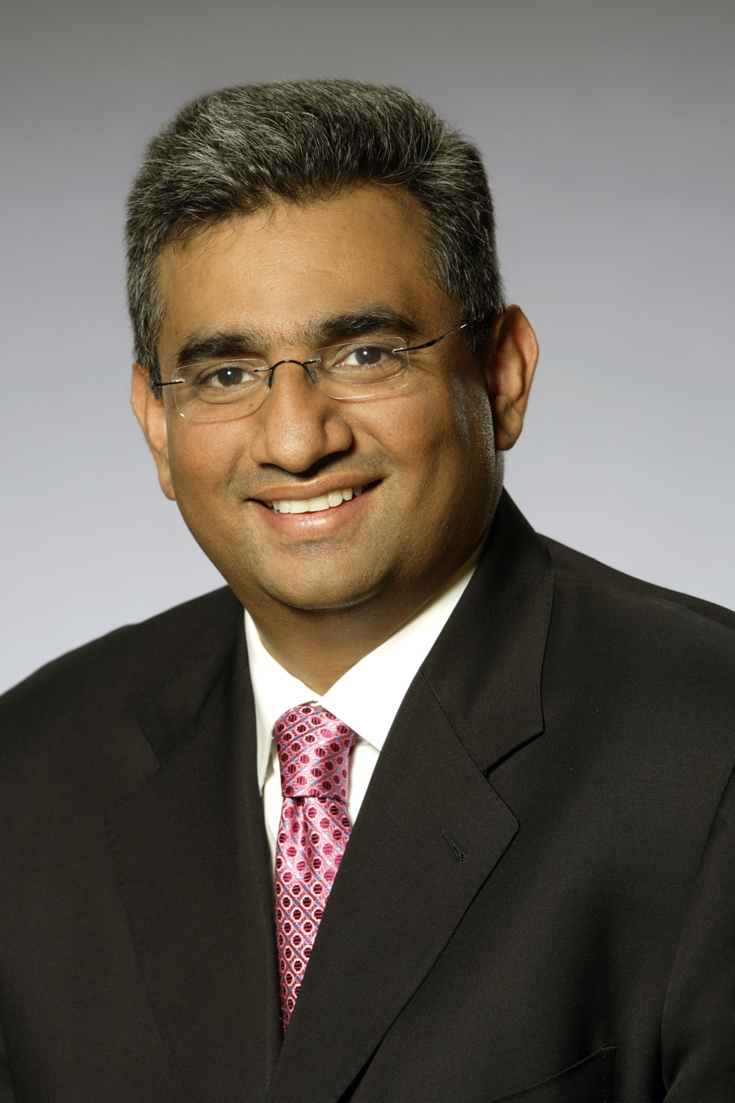
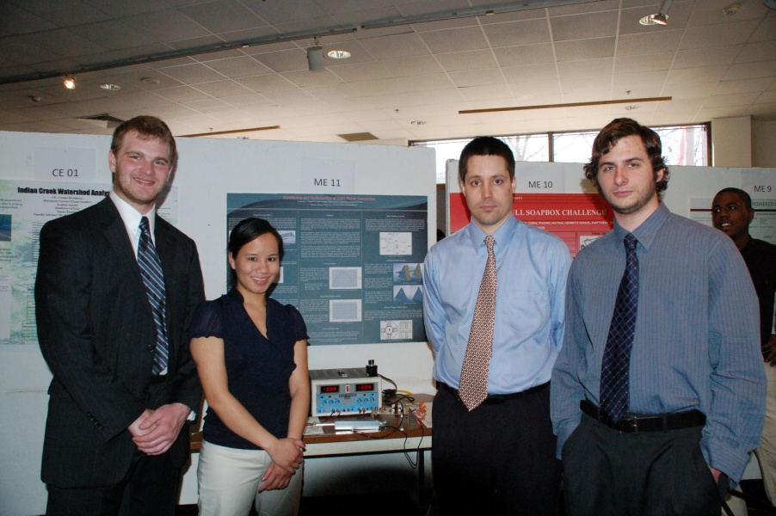
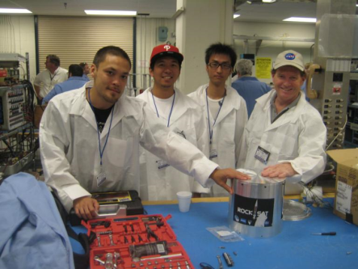
E²E Senior Design Day: From Design to Commercialization
Keynote Address:
Who: Dr. Raza Bokhari
Where: MBA Commons, Alter Hall (7th floor)
When: 11:00 AM, November 17, 2011
Senior Design Presentations:
Where: Rooms EA 102, 304, 308, 311, and 347
When: 1:00 PM to 5:00 PM, November 17, 2011
Senior Design Posters and Demonstrations:
Where: Science and Engineering Library
When: 1:00 PM to 5:00 PM, November 17, 2011
For More Details:
https://sites.google.com/a/temple.edu/coe/senior-design
http://www.isip.piconepress.com/publications/courses/temple/engr_4196/schedules/current/2011fall_dr.xlsx

