Slide 1
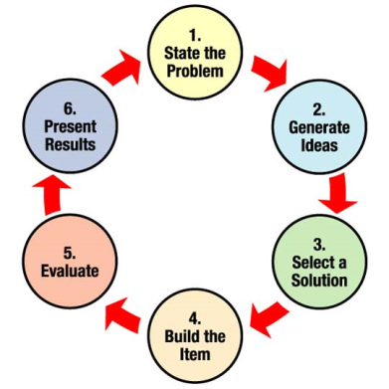
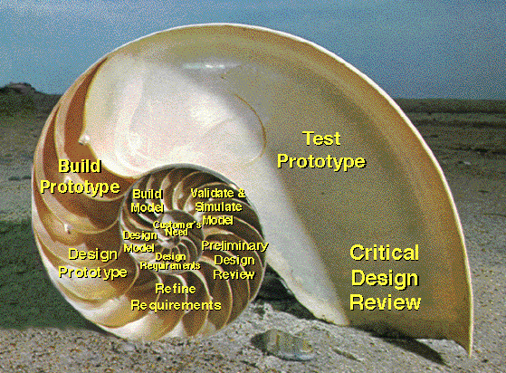


LECTURE 02: ENGINEERING DESIGN
Question: Which involves more engineering design:
a golf club or an iPod?
Objectives:
Definition of Design
The Design Process
The Project Abstract
Resources:
Wiki: Engineering Design
NASA: Design Process
EWB: Design Process
SU: Design Lecture
MIT: Design and Prototyping
S.K.: Engineering Design
URL:
Audio:
Notes:
MS Equation 3.0 was used with settings of: 18, 12, 8, 18, 12.

Slide 2
Motivation
“The scientist seeks to understand what is; the engineer seeks to create what never was”
Theodore von Karman
“The Father of Supersonic Flight”
1881 – 1963
(http://www.nmspacemuseum.org/halloffame/detail.php?id=31)

Slide 3
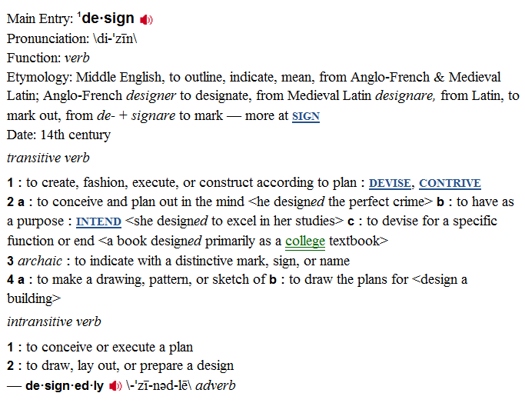

Design According to Merriam-Webster
helenloe@temple.edu

Slide 4

Design According to Wikipedia
“Design is the planning that lays the basis for
the making of every object or system. It can
be used both as a noun and as a verb and, in a
broader way, it means applied arts and
engineering.
As a verb, "to design" refers to the process of
originating and developing a plan for a product,
structure, system, or component with intention.
As a noun, "a design" is used for either the final (solution) plan (e.g. proposal, drawing, model, description) or the result of implementing that plan in the form of the final product of a design process.
This classification aside, in its broadest sense no other limitations exist and the final product can be anything from clothing to graphical user interfaces to skyscrapers. Even virtual concepts such as corporate identity and cultural traditions such as celebration of certain holidays are sometimes designed. More recently, processes (in general) have also been treated as products of design, giving new meaning to the term process design.
helenloe@temple.edu

Slide 5

Design According to ABET
In the ABET handbook on accrediting engineering
programs, it states:
“Students must be prepared for engineering practice
through the curriculum culminating in a major design
experience based on the knowledge and skills acquired
in earlier course work and incorporating engineering
standards and realistic constraints that include most of
the following considerations: economic; environmental;
sustainability; manufacturability; ethical; health and safety;
social; and political.”
In Temple’s College of Engineering, we focus on a few important aspects of design:
Multidisciplinary
Customer-driven, aggressive quantitative design constraints
Incorporation of practical considerations such as energy and sustainability
Project management
Professional communication
helenloe@temple.edu

Slide 6
The Essence of Senior Design
Senior Design is not about:
creating a unique project concept
inventing a new gadget
doing something that has never been done before
Senior Design is about:
Translating customer needs into quantitative design constraints
Optimizing a design to meet these constraints
Verifying that your design meets these constraints
Fabricating a prototype to demonstrate proof of concept.
Key elements of this class include:
Learning how to communicate your ideas to management and the customer
Appreciating the multidisciplinary aspects of engineering design
Understanding how practical constraints such as cost and sustainability influence the design process at every step.

Slide 7
Product Development Trade-offs
Performance
Schedule
Risk
Cost
Performance: ability to do the primary mission
Cost: development, operation life-cycle cost
Schedule: time to first unit, production rate
Risk: of technical and/or financial failure

Slide 8
An Iterative Design Process
Problem
Test Verification
Design Constraints
Hardware Implementation
Design
Test Verification
Test Specification
Prototyping
Simulation
Test Verification

Slide 9
The Design Methodology
Problem: recognize that a problem exists, and develop a concise statement of the problem.
Objectives: study the parameters of the problem, and convert them into engineering language you are familiar with.
Literature Survey: assimilate existing knowledge about the problem, and search for similar data (related experiments, evaluations, etc.)
Analysis: analyze the problem based on the knowledge gained from the literature survey, produce a set of design constraints, and generate test specifications to verify these design constraints.
Synthesis: manipulate the analysis to yield a family of solutions (typically through simulation and prototyping).
Evaluation: choose the best solution and verify it meets the design constraints.
Presentation: communicate the solution to your peers/management.
Note: In Senior Design I, some amount of simulation, modeling or even rapid prototyping will be required to ensure that your project is feasible!

Slide 10
The Project Abstract
150 to 200 words
Discusses what you will do, how you will do it, and why this is important.
Contains numerical or quantitative goals (e.g., improve efficiency by 25%).
Discusses your unique contributions.
Describes the implications of success.
Example:
The rich harmonic response of a vibrating string makes for a sound that is pleasing to the ear. Guitars have been amplified by resonate chambers in the body until magnetic pickups were introduced in 1928 by George Beauchamp. Magnetic pickups are widely accepted as the industry standard for the electrification of guitars. While this method provides acceptable sound quality, there are drawbacks. Magnetic pickups are highly susceptible to 60 Hz interference. It is common to pick up noise from household electrical wiring occurrence when using standard pickups. In addition, the magnet under a given string is susceptible to vibrations from adjacent strings.
An optical guitar pickup system detects the string's displacement rather than its velocity, as practiced by magnetic pickups. A small source infrared LED transmits across the string onto an phototransistor. The string's shadow casts an analog representation of the guitar's note into the detector circuit. Sensitive detector circuits with high dynamic range and high signal to noise ratio will give the needed response for an acceptable output. The lower strings yield a higher response due to the displacement based function. For this reason, each string will have a separate detector circuit, biased for the strings own characteristics. Optical devices eliminate 60Hz hums. Light pollution is combated with a metal guard enclosing the mounted transmitter and receiver pairs. Users will have control over the high and low tone knobs as well as the master volume.
More examples will follow.

Slide 11
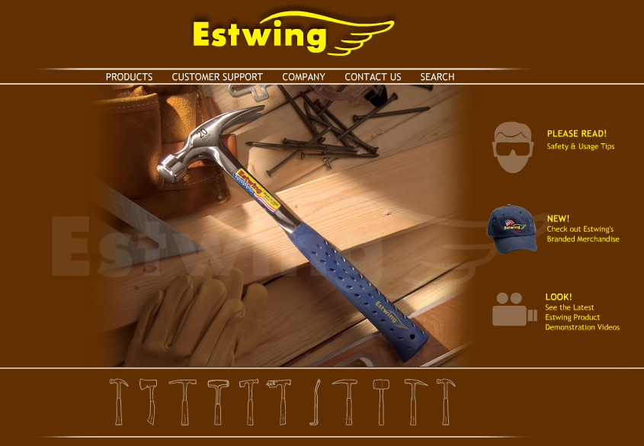

Bill and Ted’s Excellent Adventure…
Hammers

Slide 12
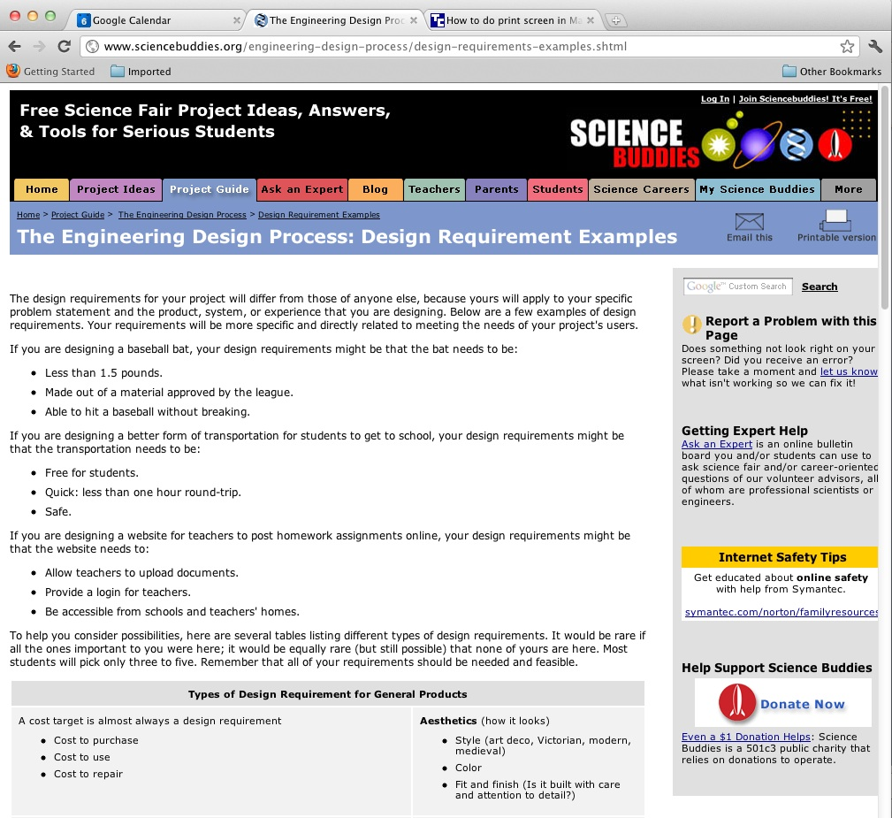
Design Constraints

Slide 13
Summary (ENGR 4169 – Professional Seminar)
You MUST have a senior design project approved by the course instructor BEFORE you enter Senior Design I.
You MUST have a faculty member in the College of Engineering agree to serve as your primary project advisor.
Good senior design projects focus more on the design aspects of the problem rather than innovation or invention.
Projects must address real-world concerns such as size, power, weight, and environmental impact.
Teams should ideally consist of 4 members spanning each department.
Finally…
Enjoy Engineering Seminar – everything you are seeing was put there for a reason ;)

Slide 14
Summary (ENGR 4196 – Senior Design Project I)
Good senior design projects focus on the design cycle (not innovation or creativity).
“It is never too early to start thinking about senior design.”

Slide 15
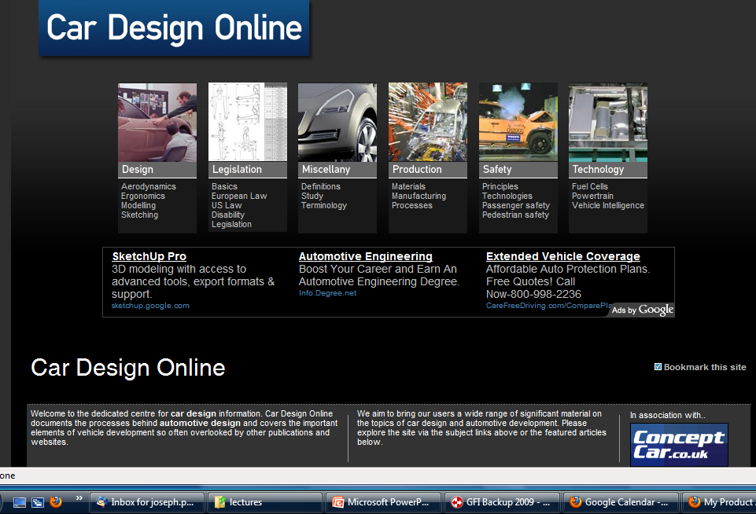
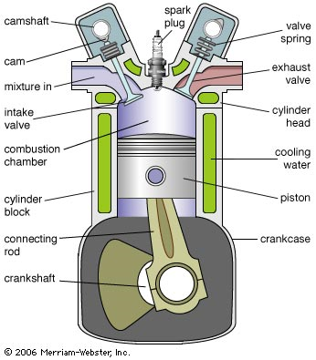
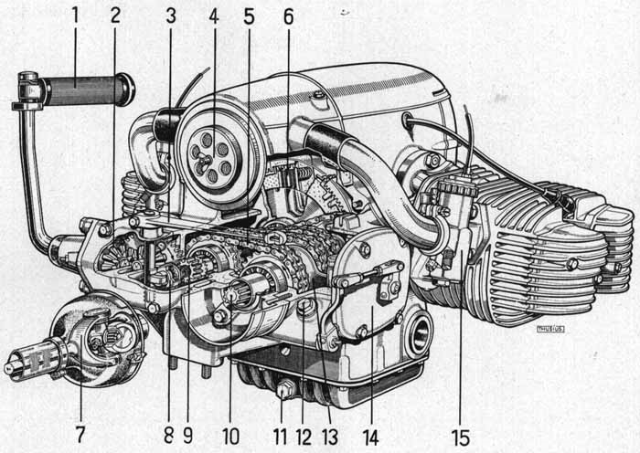
Example: How does an engineer design a car?
helenloe@temple.edu

Slide 16
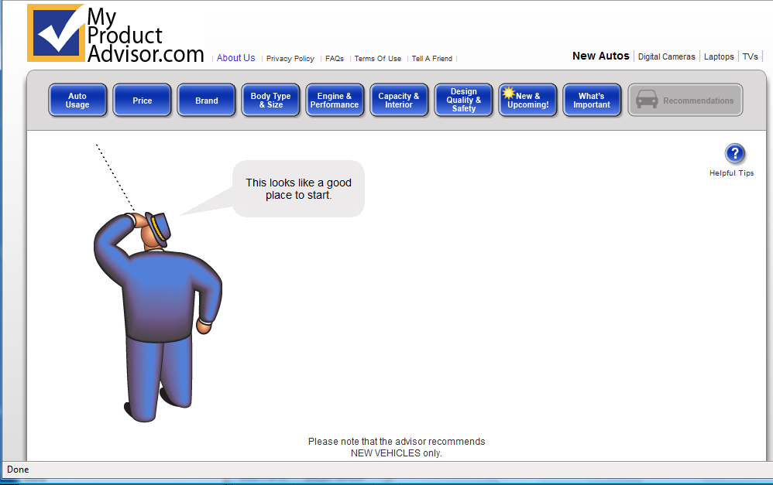
Example: Designing a Car
Consider how an engineer buys a car
helenloe@temple.edu

