Slide 1



LECTURE 04: DESIGN CONSTRAINTS¹
Question: What is a quantitative design constraint?
Objectives:
Definitions
Functional Constraints
Non-Functional Constraints
Ground Rules
Resources:
AP: System Engineering
WIKI: Design Closure
UB: Constraints
EDN: Managing Constraints
1. Notes adapted from D.F. Forliti, Department of
Mechanical and Aerospace Engineering,
State University of New York at Buffalo.
URL:
Audio:
Notes:
MS Equation 3.0 was used with settings of: 18, 12, 8, 18, 12.

Slide 2

Unobtanium
How does an engineer satisfy a seemingly impossible set of design constraints?
“It's a very common joke amongst
those people who have to try and
design things out of available materials
to say something like, "Well, to satisfy
all these design constraints, we'll just
make it out of unobtanium". It's
shorthand for the unfortunate truth
that every material has a shortcoming
and any serious design problem
involves tradeoffs.”
– Avatar 2010
For more info: http://james-camerons-avatar.wikia.com/wiki/Unobtanium

Slide 3
What is a Design Constraint?
Constraints vs. Objectives:
The distinction between constraints and objectives is straightforward: a constraint is a design target that must be met for the design to be successful. For example, a chip may be required to run at a specific frequency so it can interface with other components in a system. In contrast, an objective is a design target where more (or less) is better. For example, yield is generally an objective, which is maximized to lower manufacturing cost. For the purposes of design closure, the distinction between constraints and objectives is not important; this article uses the words interchangeably.
To read more: http://en.wikipedia.org/wiki/Design_closure
Design Constraint: a quantitative statement of a design target that must be met for the design to meet the requirements of a “customer.”
Design constraints are not an approach!
Design constraints are often set through negotiations between engineers and marketing staff. Marketing staff represent the interests of the customers.
Design constraints minimize risk and maximize accountability.

Slide 4
Product Design Constraints and Requirements
Design engineers must consider a multitude of technical, economic, social, environmental, and political constraints when they design products and processes.
There must be clear evidence in your design project that you have addressed the constraints that are relevant to your project.
Design Changes
Better Designs
Constraint Limits
Design Changes

Slide 5
Many Types of Design Constraints
Functional
Safety
Quality
Manufacturing
Timing
Economic
Ergonomic
Ecological
Aesthetic
Life-Cycle
Legal
Ethical
In senior design, we require 5 functional constraints and 5 non-functional constraints.

Slide 6

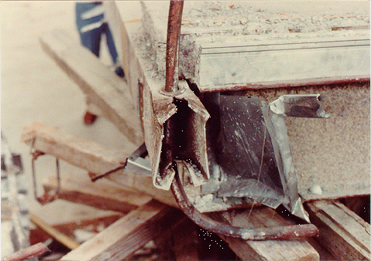

Functional Constraints
Overall Geometry – size, width, space, arrangement
Motion of parts – type, direction, velocities, acceleration, kinematics
Forces involved – load direction, magnitude, load, impact
Energy needed – heating, cooling, conversion, pressure
Materials to be used – flow, transport, properties
Control system – electrical, hydraulic, mechanical, pneumatic
Information flow – inputs, outputs, form, display

Slide 7


Safety Constraints
Operational – direct, indirect, hazard elimination
Human – warnings, training
Environmental – land, sea, air, noise, light, radiation, reaction, transport

Slide 8
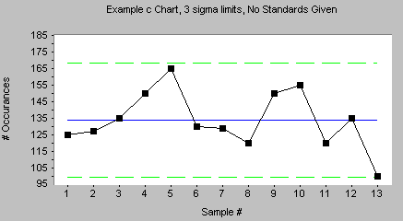


Quality Constraints
Quality assurance – regulations, standards, codes
Quality control – inspection, testing, labeling
Reliability – design life, failures, statistics

Slide 9

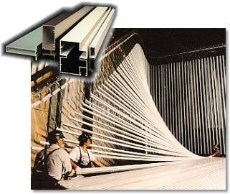
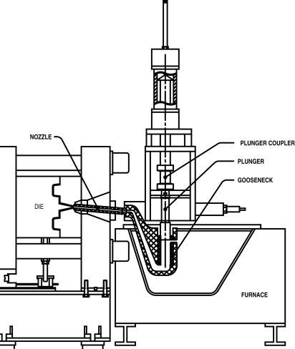

Manufacturing Constraints
Production of components – factory limitations, means of production, wastes
Purchase of components – supplier quality, reliability, quality control, inspection
Assembly – installation, foundations, bolting, welding
Transport – material handling, clearance, packaging

Slide 10
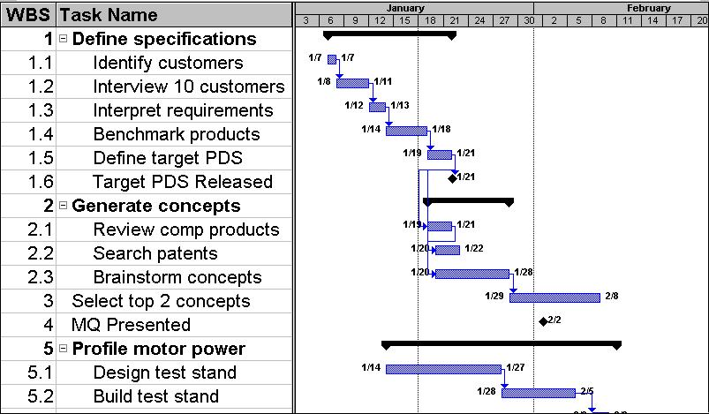
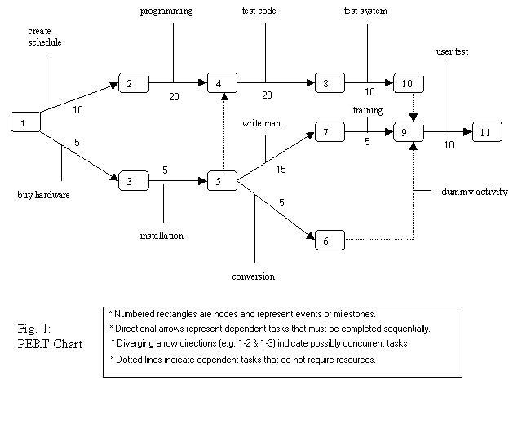
Timing / Scheduling Constraints
Design schedule – project planning, project control
Development schedule – design detailing, compliance tests
Production schedule – manufacture, assembly, packing, transport
Delivery schedule – delivery date, distribution network, supply chains

Slide 11


Economic Constraints
Marketing analysis – size of market, distribution, market segments
Design costs – design team computing, information retrieval
Development costs – design detailing, supplier costs, testing costs
Manufacturing cost – tooling, labor, overhead, assembly, inspection
Distribution costs – packing, transport, service centers, spare parts, warranty
Resources – time, budget, labor, capital, machines, material
$

Slide 12




Ergonomic Constraints
User needs – type of operation, instructions, warnings
Ergonomic design – man-machine relationships, operation, height, layout, comfort, lighting
Cybernetic design – controls, layout, clarity, interactions

Slide 13



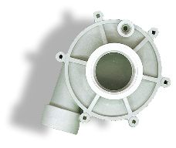
Ecological Constraints
General environmental impact – impact on natural and ocial resources
Sustainability – political and commercial consequences, implications for following generations
Material selection – solid, liquid, gas, stability, protection, toxicity
Working fluid selection – fluid, gas, flammability, toxicity

Slide 14




Aesthetic Constraints
Customer appeal – shape, color, texture, form, feel, smell, surprise and delight features
Fashion – culture, history, trends
Future expectations – rate of change in technology, trends, product families

Slide 15

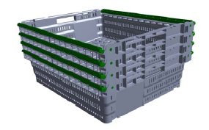
Life-Cycle Constraints
Distribution – means of transport, nature and conditions of dispatch, rules, regulations
Operation – quietness, wear, special uses, working environments
Maintenance – servicing intervals, inspection, exchange and repair, cleaning, diagnostics
Disposal – recycle, scrap

Slide 16




Legal / Ethical Constraints
Regulations – OSHA, FAA, FDA
Ethics – public safety, health, welfare and integrity
Intellectual Property – patents, trademarks, copyrights

Slide 17
Summary
Every senior design project must have:
5 functional design constraints
5 non-functional design constraints
Each design constraint will be tested and the results reported as part of your two semester senior design project.
The Design Requirements section of your report will state these constraints and then explain/justify them.
See the design document template for the format and examples. Constraints are presented in two tables and are labeled by type.
Next lecture: the design document and MS Word tools.

