Slide 1
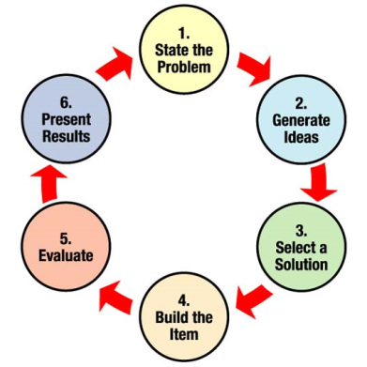
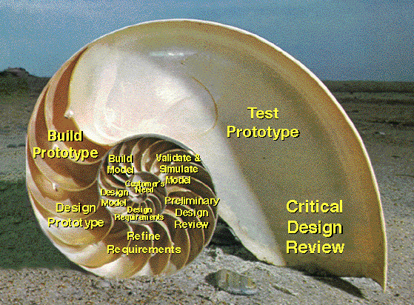


LECTURE 02: ENGINEERING DESIGN
Question: What is the difference between engineering
design and system integration? Examples?
Objectives:
Definition of Design
The Design Process
Expectations in Senior Design
Resources:
Wiki: Engineering Design
NASA: Design Process
EWB: Design Process
SU: Design Lecture
MIT: Design and Prototyping
S.K.: Engineering Design
URL:
Audio:
Notes:
MS Equation 3.0 was used with settings of: 18, 12, 8, 18, 12.

Slide 2
Motivation
“The scientist seeks to understand what is; the engineer seeks to create what never was”
Theodore von Karman
“The Father of Supersonic Flight”
1881 – 1963
(http://www.nmspacemuseum.org/halloffame/detail.php?id=31)

Slide 3
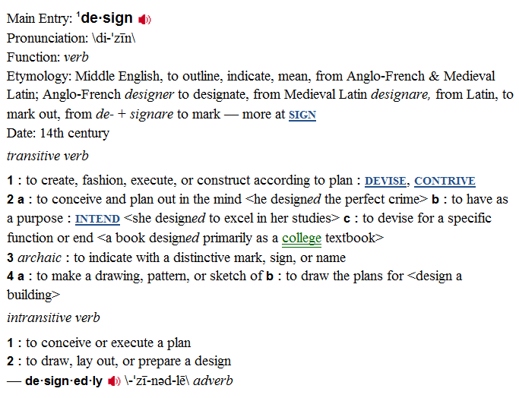

Design According to Merriam-Webster
helenloe@temple.edu

Slide 4

Design According to Wikipedia
“Design is the planning that lays the basis for
the making of every object or system. It can
be used both as a noun and as a verb and, in a
broader way, it means applied arts and
engineering.
As a verb, "to design" refers to the process of
originating and developing a plan for a product,
structure, system, or component with intention.
As a noun, "a design" is used for either the final (solution) plan (e.g. proposal, drawing, model, description) or the result of implementing that plan in the form of the final product of a design process.
This classification aside, in its broadest sense no other limitations exist and the final product can be anything from clothing to graphical user interfaces to skyscrapers. Even virtual concepts such as corporate identity and cultural traditions such as celebration of certain holidays are sometimes designed. More recently, processes (in general) have also been treated as products of design, giving new meaning to the term process design.
helenloe@temple.edu

Slide 5

Design According to ABET
In the ABET handbook on accrediting engineering
programs, it states:
“Students must be prepared for engineering practice
through the curriculum culminating in a major design
experience based on the knowledge and skills acquired
in earlier course work and incorporating engineering
standards and realistic constraints that include most of
the following considerations: economic; environmental;
sustainability; manufacturability; ethical; health and safety;
social; and political.”
In Temple’s College of Engineering, we focus on a few important aspects of design:
Multidisciplinary
Customer-driven, aggressive quantitative design constraints
Incorporation of practical considerations such as energy and sustainability
Project management
Professional communication
helenloe@temple.edu

Slide 6
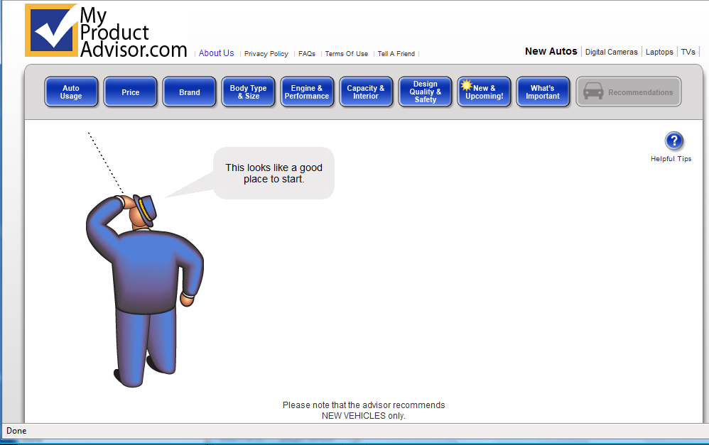
Example: Designing a Car
Consider how an engineer buys a car
helenloe@temple.edu

Slide 7
The Essence of Senior Design
Senior Design is not about:
creating a unique project concept
inventing a new gadget
doing something that has never been done before
Senior Design is about:
Translating customer needs into quantitative design constraints
Optimizing a design to meet these constraints
Verifying that your design meets these constraints
Fabricating a prototype to demonstrate proof of concept.
Key elements of this class include:
Learning how to communicate your ideas to management and the customer
Appreciating the multidisciplinary aspects of engineering design
Understanding how practical constraints such as cost and sustainability influence the design process at every step.

Slide 8
Product Development Trade-offs
Performance
Schedule
Risk
Cost
Performance: ability to do the primary mission
Cost: development, operation life-cycle cost
Schedule: time to first unit, production rate
Risk: of technical and/or financial failure

Slide 9
An Iterative Design Process
Problem
Test Verification
Design Constraints
Hardware Implementation
Design
Test Verification
Test Specification
Prototyping
Simulation
Test Verification

Slide 10
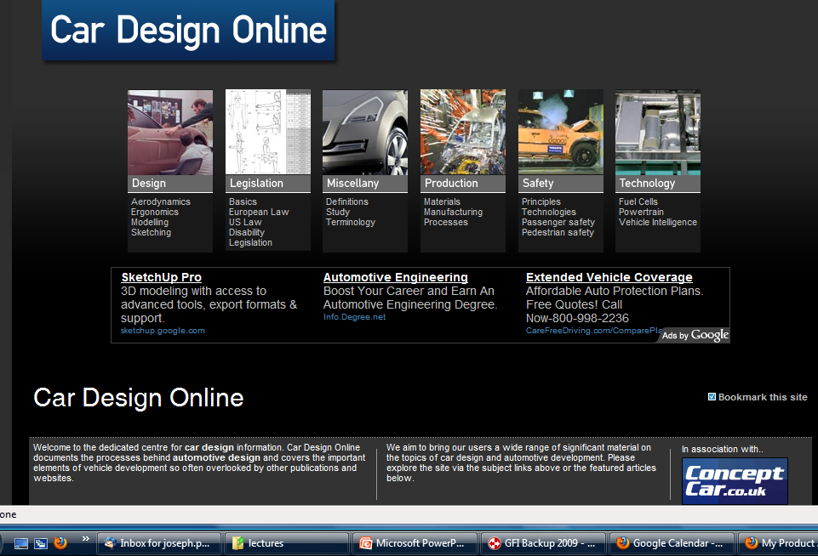
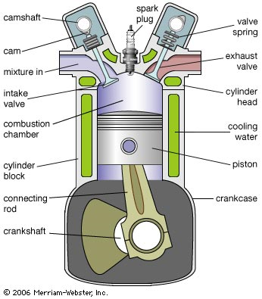
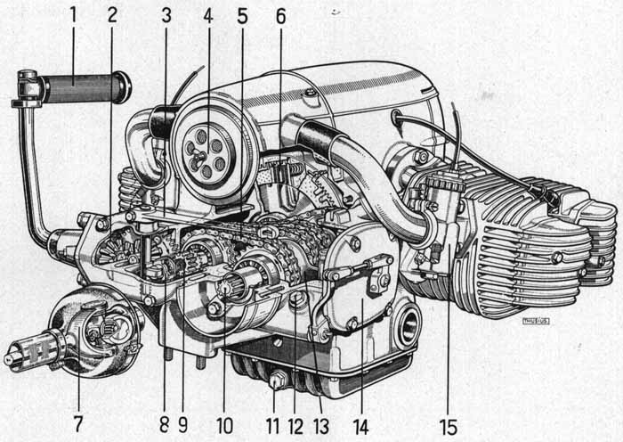
Example: How does an engineer design a car?
helenloe@temple.edu

Slide 11
Summary
You MUST have a senior design project approved by the course instructor BEFORE you enter Senior Design I.
You MUST have a faculty member in the College of Engineering agree to serve as your primary project advisor.
Good senior design projects focus more on the design aspects of the problem rather than innovation or invention.
Projects must address real-world concerns such as size, power, weight, and environmental impact.
Teams should ideally consist of 4 members spanning each department.
Finally…
Enjoy Engineering Seminar – everything you are seeing was put there for a reason ;)

