Slide 1

Lecture 41: Introduction to Neural Networks and Machine Learning
Textbook: Notes
Key Concepts:
A neural network is simply a functional mapping
of inputs (features) to outputs (labels).
Neural networks can learn nonlinear mappings.
Backpropagation is used to train a network.
Matrix vector operations play a key role.
Relevant Web Pages:
Neural Networks: A Beginner's Guide
Linear Algebra and Deep Learning
Next Steps:
How do I survive the final exam?

Slide 2
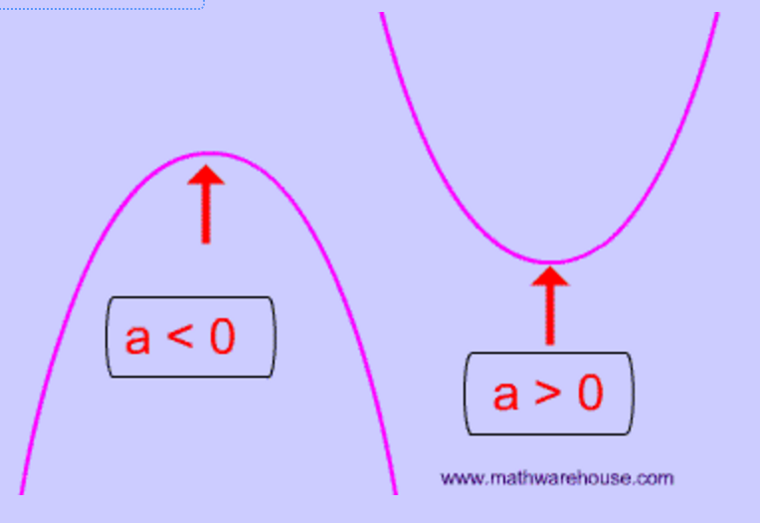
What Is A Function?
Equation of a line: y = mx + b
Equation of a parabola: y = ax² + bx + c
How do we estimate the equation of a line from two points?
  m = slope = (y₂-y₁) / (x₂-x₁)
  b = y intercept:
  y₁ = m(x₁) + b
  b = y₁ – m(x₁)
  check:
  b = y₂ – m(x₂)
How do we estimate the equation of a line from three points or more (hint: mean square error or regression?

Slide 3
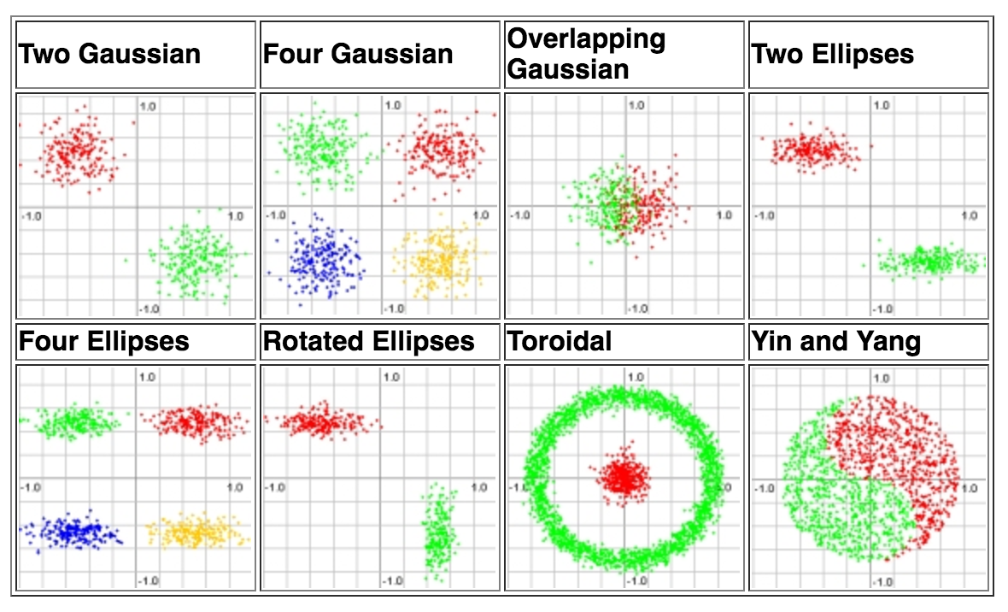
What Is A Functional Mapping?
Emulating human performance can be a complicated process involving highly nonlinear functions.
Example: Equal Loudness Curves
Your perception of loudness varies with frequency.
Perceived loudness also changes depending on the intensity.
Classifying data can be easy:
But generalization can be difficult:

Slide 4
How Do We Minimize An Objective Function?
Most modern learning algorithms use a variant of gradient descent in which we iteratively search for a maximum (or minimum) in a function:
The algorithmic details vary from implementation to implementation, but most approaches are based on derivatives (slopes).

Slide 5
Ideal Search Spaces Are Convex
If the search space for a solution is convex, gradient descent or hill-climbing will find an optimal solution.
This is one reason solutions that minimize the mean square error are popular.
However, real world problems involve optimization in very high dimensional spaces that are extremely complex.
To simplify things, we often try to “regularize” the problem:

Slide 6
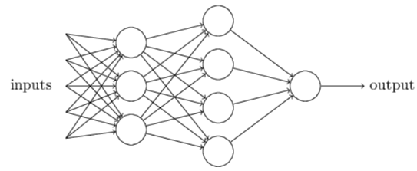
Neural Networks
Artificial neural networks (ANNs) are algorithms modeled after how the human brain operates.
ANNs today perform a number of functions including feature extraction, signal modeling and language or domain modeling.
Neural networks are comprised of nodes, which combine the inputs from the data with a set of coefficients or weights and determine whether the signal will progress further through the network.

Slide 7
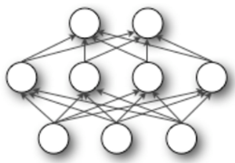
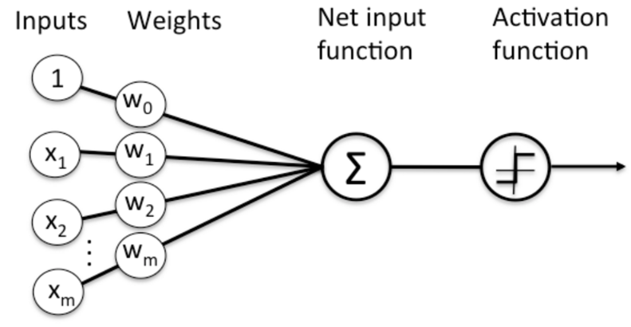
Nodes in Neural Networks
The products between the inputs $x_{n}$ and the weight $ω_{n}$ are summed in the node and the result is passed to the node’s activation function, which determines whether the node will fire.
Perceptrons are the most fundamental and simplest models of neurons.
Node Diagram

Slide 8
Perceptrons
Perceptrons are very simple. They take several binary inputs and generate a single binary output.
Given a set of inputs $x_{1}, x_{2}, x_{3}$, and a set of corresponding weights $ω_{1},ω_{2}$, $ω_{3},$the neuron’s output is given by:
$$output=\left\{\begin{aligned}0 if \sum_{j}{ω_{j}x_{j}≤threshold} \\ 1 if \sum_{j}{ω_{j}x_{j}>threshold}\end{aligned}\right.$$
To simplify, $x$ and $ω$ can be seen as vectors and the threshold is presented as a bias b, where $bias≡−threshold$
$$x_{1}$$
$$ω_{1}$$
$$output=\left\{\begin{aligned}0 if ω∙x+b ≤0 \\ 1 if ω∙x+b >0\end{aligned}\right.$$
$$ω_{2}$$
$$x_{2}$$
$$output$$
$$ω_{3}$$
$$x_{3}$$

Slide 9
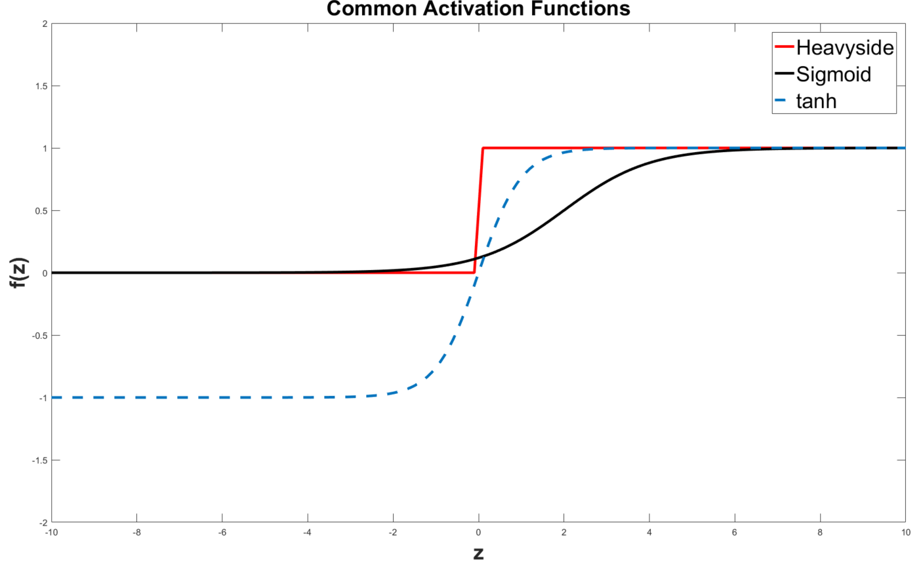
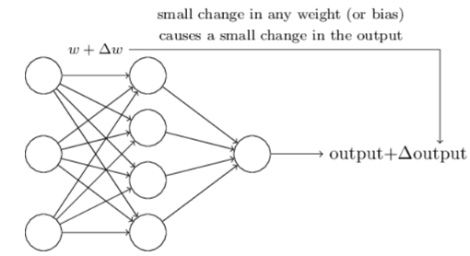
Sigmoid Neurons
Learning algorithms involve the adjustment of the weights and bias
If the neuron model used is the perceptron, a small change in a weight or bias can cause output to completely flip (being a binary model), and the flip can cause a change in the behavior of the entire network
A new type of artificial neuron, a sigmoid neuron, is commonly used to overcome this issue
In this case, the output is given by $σ\left(z\right)≡ \frac{1}{1+e^{z}}$, where $z=ω∙x+b$
This means, the activation function is a logistic function. Other common activation function is the tanh function, given by $tanh\left(z\right)=\frac{{e^{z}−e}^{−z}}{e^{z}+e^{−z}}$

Slide 10
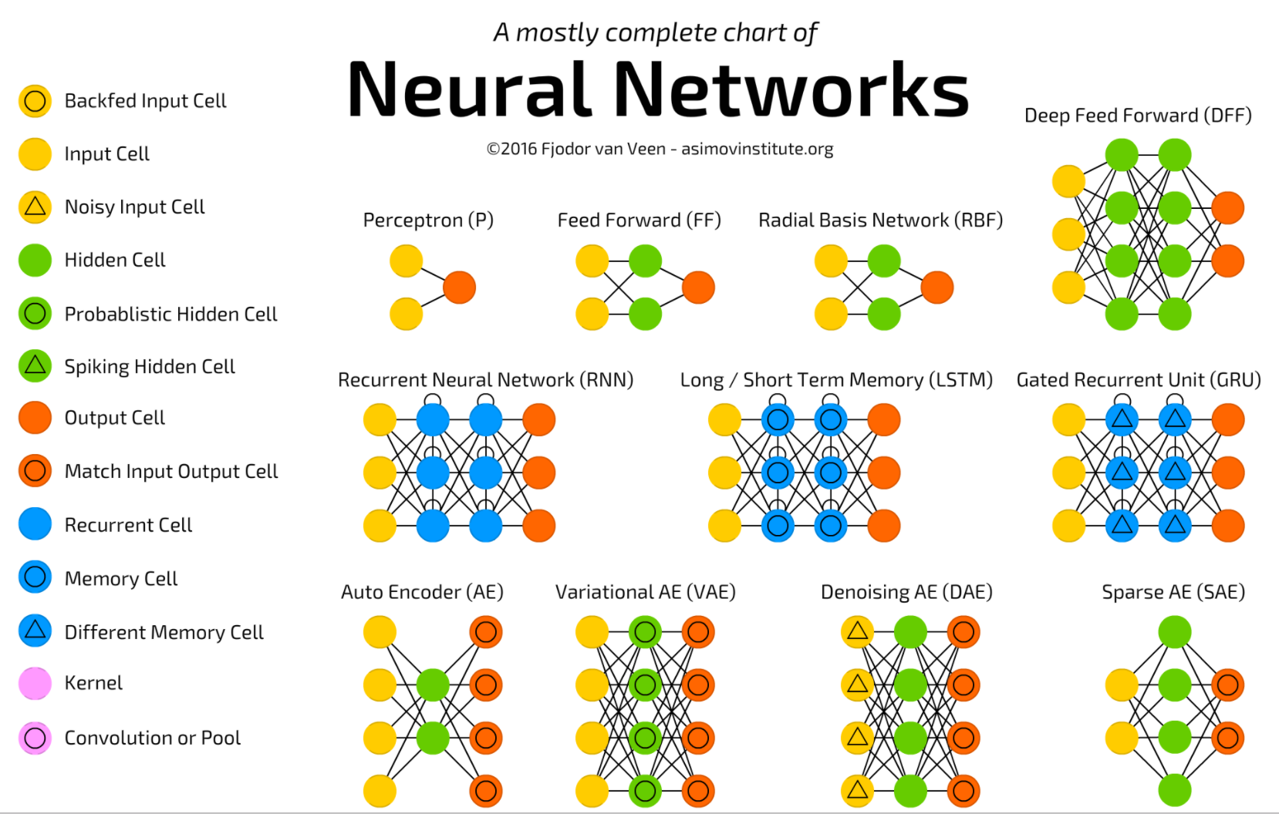
There Are Many Types Of Neural Networks

Slide 11
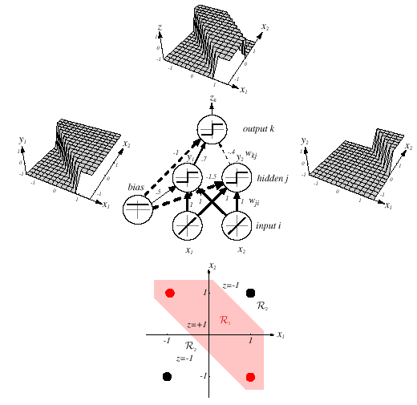
Feedforward Networks
A three-layer neural network consists of an input layer, a hidden layer and an output layer interconnected by modifiable weights represented by links between layers.
A bias term that is connected to all units.
This simple network can solve the exclusive-OR problem.
The hidden and output units from the linear weighted sum of their inputs and perform a simple thresholding (+1 if the inputs are greater than zero, -1 otherwise).

Slide 12
Definitions
A single “bias unit” is connected to each unit other than the input units.
Net activation:
where the subscript i indexes units in the input layer, j in the hidden; w_{ji} denotes the input-to-hidden layer weights at the hidden unit j.
Each hidden unit emits an output that is a nonlinear function of
its activation: y_{j} = f(net_{j})
Even though the individual computational units are simple (e.g., a simple threshold), a collection of large numbers of simple nonlinear units can result in a powerful learning machine (similar to the human brain).
Each output unit similarly computes its net activation based on the hidden unit signals as:
where the subscript k indexes units in the output layer and n_{H} denotes the number of hidden units.
z_{k} will represent the output for systems with more than one output node. An output unit computes z_{k} = f(net_{k}).

Slide 13
Computations
  The hidden unit y₁ computes the boundary:
    ≥ 0 ➔ y₁ = +1
    x₁ + x₂ + 0.5 = 0
    < 0 ➔ y₁ = -1
  The hidden unit y₂ computes the boundary:
    ≥ 0 ➔ y₂ = +1
    x₁ + x₂ -1.5 = 0
    < 0 ➔ y₂ = -1
  The final output unit emits z₁ = +1 iff y₁ = +1 and y₂ = +1
  z_{k} = y₁ and not y₂
  = (x₁ or x₂) and not (x₁ and x₂)
  = x₁ XOR x₂

Slide 14
General Feedforward Operation
For c output units:
Hidden units enable us to express more complicated nonlinear functions and thus extend the classification.
The activation function does not have to be a sign function, it is often required to be continuous and differentiable.
We can allow the activation in the output layer to be different from the activation function in the hidden layer or have different activation for each individual unit.
We assume for now that all activation functions to be identical.
Can every decision be implemented by a three-layer network?
Yes (due to A. Kolmogorov): “Any continuous function from input to output can be implemented in a three-layer net, given sufficient number of hidden units n_{H}, proper nonlinearities, and weights.”
for properly chosen functions δ_{j} and β_{ij}
Notes:
XOR: x_1, x_2, and we want to transform to x_1^2, x_2^2, x_1 x_2
It can also be viewed as feature extraction from the feature vector x, but now we extract more feature than the number of features in x.

Slide 15
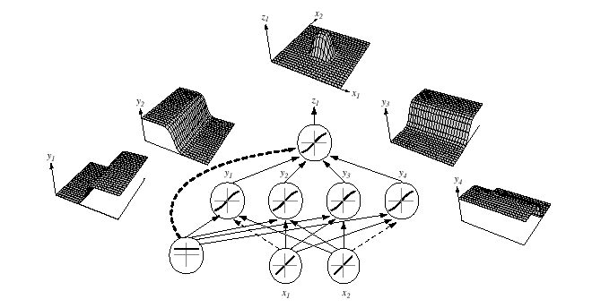
General Feedforward Operation (Cont.)
Each of the 2n+1 hidden units δ_{j} takes as input a sum of d nonlinear functions, one for each input feature x_{i} .
Each hidden unit emits a nonlinear function δ_{j} of its total input.
The output unit emits the sum of the contributions of the hidden units.
Unfortunately: Kolmogorov’s theorem tells us very little about how to find the nonlinear functions based on data; this is the central problem in network-based pattern recognition.
Notes:
XOR: x_1, x_2, and we want to transform to x_1^2, x_2^2, x_1 x_2
It can also be viewed as feature extraction from the feature vector x, but now we extract more feature than the number of features in x.

Slide 16
Backpropagation
Any function from input to output can be implemented as a three-layer neural network.
These results are of greater theoretical interest than practical, since the construction of such a network requires the nonlinear functions and the weight values which are unknown!
Our goal now is to set the interconnection weights based on the training patterns and the desired outputs.
In a three-layer network, it is a straightforward matter to understand how the output, and thus the error, depend on the hidden-to-output layer weights.
The power of backpropagation is that it enables us to compute an effective error for each hidden unit, and thus derive a learning rule for the input-to-hidden weights, this is known as “the credit assignment problem.”
Networks have two modes of operation:
Feedforward: consists of presenting a pattern to the input units and passing (or feeding) the signals through the network in order to get outputs units.
Learning: Supervised learning consists of presenting an input pattern and modifying the network parameters (weights) to reduce distances between the computed output and the desired output.
Notes:
XOR: x_1, x_2, and we want to transform to x_1^2, x_2^2, x_1 x_2
It can also be viewed as feature extraction from the feature vector x, but now we extract more feature than the number of features in x.

Slide 17
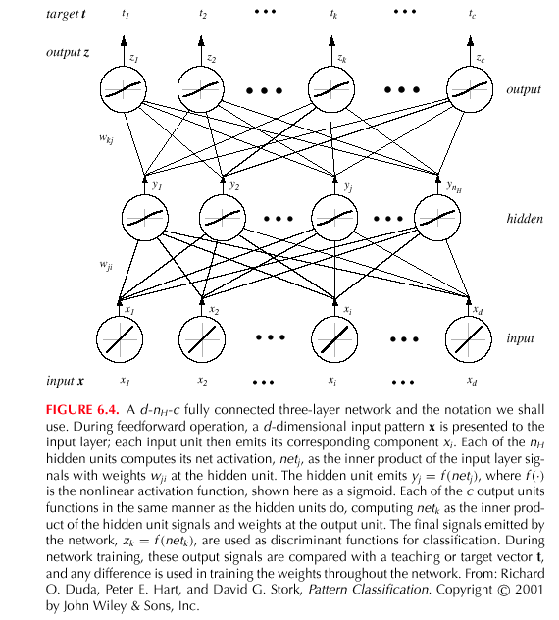
Backpropagation (Cont.)
Notes:
XOR: x_1, x_2, and we want to transform to x_1^2, x_2^2, x_1 x_2
It can also be viewed as feature extraction from the feature vector x, but now we extract more feature than the number of features in x.

Slide 18
Network Learning
  Let t_{k} be the k-th target (or desired) output and z_{k} be the k-th computed output with k = 1, …, c and w represents all the weights of the network.
  Training error:
  The backpropagation learning rule is based on gradient descent:
  The weights are initialized with pseudo-random values and are changed in a direction that will reduce the error:
  where η is the learning rate which indicates the relative size of the change in weights.
  The weight are updated using: w(m +1) = w (m) + Δw (m).
  Error on the hidden–to-output weights:
  where the sensitivity of unit k is defined as:
  and describes how the overall error
  changes with the activation
  of the unit’s net:

Slide 19
Network Learning (Cont.)
  Since net_{k} = w_{k}^{t}.y:
  Therefore, the weight update (or learning rule) for the hidden-to-output weights is: Δw_{kj} = ηδ_{k}y_{j} = η(t_{k} – z_{k}) f’ (net_{k})y_{j}
  The error on the input-to-hidden units is:
  The first term is given by:
  We define the sensitivity for a hidden unit:
  which demonstrates that “the sensitivity at a hidden unit is simply the sum of the individual sensitivities at the output units weighted by the hidden-to-output weights w_{kj}; all multipled by f’(net_{j}).”
  The learning rule for the
  input-to-hidden weights is:

Slide 20
Stochastic Back Propagation
  Starting with a pseudo-random weight configuration, the stochastic backpropagation algorithm can be written as:
  Begin
  initialize n_{H}; w, criterion θ, η, m ⬅ 0
  do m ⬅ m + 1
  x^{m} ⬅ randomly chosen pattern
  w_{ji} ⬅ w_{ji} + ηδ_{j}x_{i}; w_{kj} ⬅ w_{kj} + ηδ_{k}y_{j}
  until ||∇J(w)|| < θ
  return w
  End

Slide 21
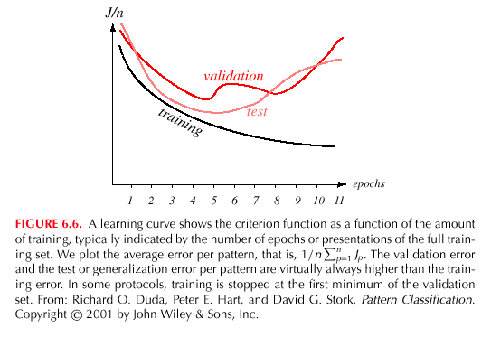
Learning Curves
  Before training starts, the error on the training set is high; through the learning process, the error becomes smaller.
  The error per pattern depends on the amount of training data and the expressive power (such as the number of weights) in the network.
  The average error on an independent test set is always higher than on the training set, and it can decrease as well as increase.
  A validation set is used in order to decide
  when to stop training; we do not want to
  overfit the network and decrease the
  power of the classifier generalization.

Slide 22
Summary
The ability to learn complex mappings from data can be a powerful way to predict and classify data, and can lead to a better understanding of underlying dependencies.
This type of learning, however, requires iterative algorithms that are computationally expensive.
Gradient descent is a popular way to find good solutions.
A neural network attempts to emulate properties observed in the human brain: a simple computational element is used that emulates the basic properties of a neuron. By combining large numbers of these nodes in various topologies, we can solve complex engineering and scientific problems.
There are many types of neural networks in use today.

