Slide 1
Lecture 36: State Variables and the State Equations
Textbook: Notes
Key Concepts:
State variables are used to describe physical quantities in linear systems.
A N^{th} order differential equation can be converted to N first-order differential equations.
The state equations can be used to describe any linear system.
These can be solved using eigenvalue/eigenvector analysis.
This topic is covered more extensively in a control systems course.
Relevant Videos, Web Pages and Python Code:
The Upside Down Pendulum, Control Systems in Python
Complex Introduction to State Space Equations
State Variables
Next Steps:
How can we discover underlying structure in data?

Slide 2
Motivation
Thus far we have dealt primarily with the input/output characteristics of linear systems. State variable, or state space, representations describe the internal state of the system.
State variables represent a way to describe ALL linear systems in terms of a common set of equations involving matrix algebra.
Many familiar properties, such as stability, can be derived from this common representation. It forms the basis for the theoretical analysis of linear systems.
State variables are used extensively in a wide range of engineering problems, particularly mechanical engineering, and are the foundation of control theory.
The state variables often represent internal elements of the system such as voltages across capacitors and currents across inductors.
They account for observable elements of the circuit, such as voltages, and also account for the initial conditions of the circuit, such as energy stored in capacitors. This is critical to computing the overall response of the system.
Matrix transformations can be used to convert from one state variable representation to the other, so the initial choice of variables is not critical.
Software tools such as Python can be used to perform the matrix manipulations required.
Notes:
]i=k,

Slide 3
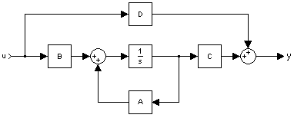
State Equations
Let us define the state of the system by an N-element column vector, x(t):
Note that in this development, v(t) will be the input, y(t) will be the output, and x(t) is used for the state variables.
Any linear system can be modeled by the following state equations:
This system model can handle single input/single output systems, or multiple inputs and outputs.
The equations above can be implemented using the signal flow graph shown to the right.
Works for ALL linear systems!
Notes:
]i=k,

Slide 4
Differential Equations
Consider the CT differential equations:
A second-order differential equation requires two state variables:
We can reformulate the differential equation as a set of three equations:
We can write these in matrix form as:
This can be extended to an N^{th}-order differential equation of this type:
The state variables are defined as:
Notes:
]i=k,

Slide 5
Differential Equations (Cont.)
The resulting state equations are:
Next, consider a differential equation with a more complex forcing function:
The state model is:
We can verify this by expanding the matrix equation:
Notes:
]i=k,

Slide 6
Differential Equations (Cont.)
To construct the original equation, differentiate the last equation:
Differentiate the last equation again and substitute:
Hence, given a general LTI system:
Notes:
]i=k,

Slide 7
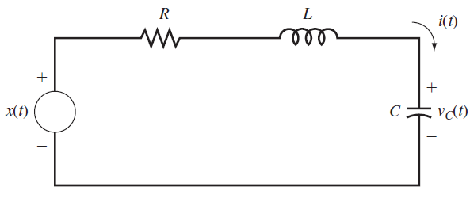
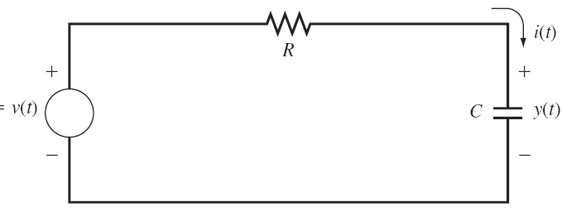
Application to Circuits (Using Slide #3)
Notes:
]i=k,

Slide 8
Preliminaries
Recall our state equations:
To solve these equations, we will need a few mathematical tools. First:
where I is an NxN identity matrix. A^{k} is simply AxAx…A.
For any real numbers t and λ:
Further, setting λ = -t:
Next:
We can use these results to show that the solution to is:
Notes:
]i=k,

Slide 9
Solutions to the Forced Equation
If:
is referred to as the state-transition matrix.
We can apply these results to the state equations:
Note that:
Integrating both sides:
Generalization of our convolution integral
Notes:
]i=k,

Slide 10
Solution to the Output Equation
Recall:
Using the definition of the unit impulse:
Recall our convolution integral for a single-input single-output system:
Equating terms:
The impulse response can be computed directly from the coefficient matrices.
Notes:
]i=k,

Slide 11
Solution via the Laplace Transform
Recall our state equations:
Using the Laplace transform on the first equation:
Comparing this to:
reveals that:
Continuing with the output equation:
For zero initial conditions:
The transfer function can be computed directly from the system parameters.
Notes:
]i=k,

Slide 12
Discrete-Time Systems
The discrete-time equivalents of the state equations are:
The process is completely analogous to CT systems, with one exception: these equations are easy to implement and solve using difference equations ☺
For example, note that if v[n] = 0 for n ≥ 0,
and A^{n} is the state-transition matrix for the discrete-time case.
The output equation can be derived following the procedure for the CT case:
The impulse response is given by:
Notes:
]i=k,

Slide 13
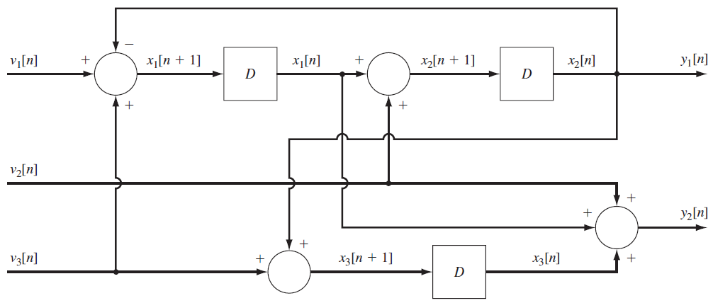
Solutions Using the z-Transform
Just as we solved the CT equations with the Laplace transform, we can solve the DT case with the z-transform:
Note that historically the CT state equations were solved numerically using a discrete-time approximation for the derivatives, and this provided a bridge between the CT and DT solutions.
Example:
Notes:
]i=k,

Slide 14
Summary
Introduced the concept of a state variable.
Described a linear system in terms of the general state equation.
Demonstrated a process for deriving the state equations from a differential equation with a simple forcing function.
Generalized this to an N^{th}-order differential equation with a more complex forcing function.
Demonstrated these techniques on a 1st-order (RC) and 2nd-order (RLC) circuit.
Observation: We have now encapsulated all passive circuit analysis (RLCs) into a single matrix equation. In fact, we now have a unified representation for all linear time-invariant systems.
Demonstrated a solution to the forced equation.
Discussed how this is a generalization of the single-input single-output analysis approach previously studied (e.g., convolution).
Applied the Laplace transform to solve the state equations using algebra. Derived an expression for the transfer function.
Extended the state equations to the discrete-time case.

