Slide 1
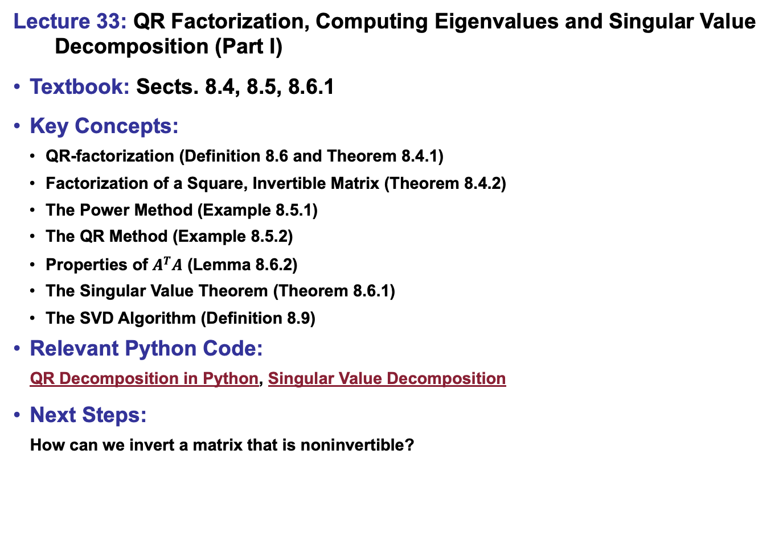
Lecture 33: QR Factorization, Computing Eigenvalues and Singular Value
Decomposition (Part I)
Textbook: Sects. 8.4, 8.5, 8.6.1
Key Concepts:
QR-factorization (Definition 8.6 and Theorem 8.4.1)
Factorization of a Square, Invertible Matrix (Theorem 8.4.2)
The Power Method (Example 8.5.1)
The QR Method (Example 8.5.2)
Properties of $A^{T}A$ (Lemma 8.6.2)
The Singular Value Theorem (Theorem 8.6.1)
The SVD Algorithm (Definition 8.9)
Relevant Python Code:
QR Decomposition in Python, Singular Value Decomposition
Next Steps:
How can we invert a matrix that is noninvertible?

