Slide 1
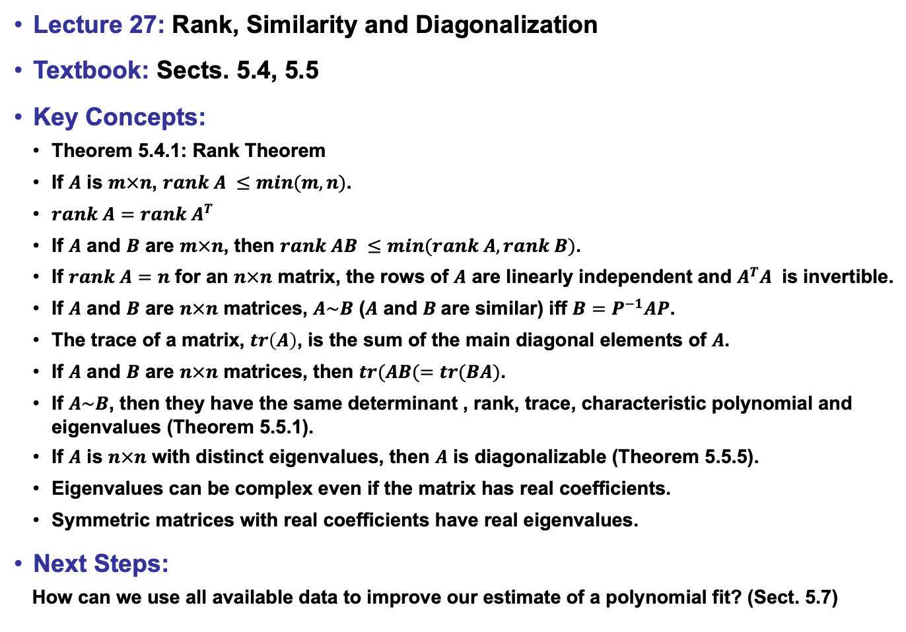
Lecture 27: Rank, Similarity and Diagonalization
Textbook: Sects. 5.4, 5.5
Key Concepts:
Theorem 5.4.1: Rank Theorem
If $A$ is $m×n$, $rank A ≤min(m,n)$.
$rank A=rank{ A}^{T}$
If $A$ and $B$ are $m×n$, then $rank AB ≤min(rank A, rank B)$.
If $rank A=n$ for an $n×n$ matrix, the rows of $A$ are linearly independent and $A^{T}A$ is invertible.
If $A$ and $B$ are $n×n$ matrices, $A\sim B$ ($A$ and $B$are similar) iff $B=P^{−1}AP$.
The trace of a matrix, $tr\left(A\right)$, is the sum of the main diagonal elements of $A$.
If $A$ and $B$ are $n×n$ matrices, then $tr(AB(=tr(BA)$.
If $A\sim B$, then they have the same determinant , rank, trace, characteristic polynomial and eigenvalues (Theorem 5.5.1).
If $A$ is $n×n$ with distinct eigenvalues, then $A$ is diagonalizable (Theorem 5.5.5).
Eigenvalues can be complex even if the matrix has real coefficients.
Symmetric matrices with real coefficients have real eigenvalues.
Next Steps:
How can we use all available data to improve our estimate of a polynomial fit? (Sect. 5.7)

