Slide 1
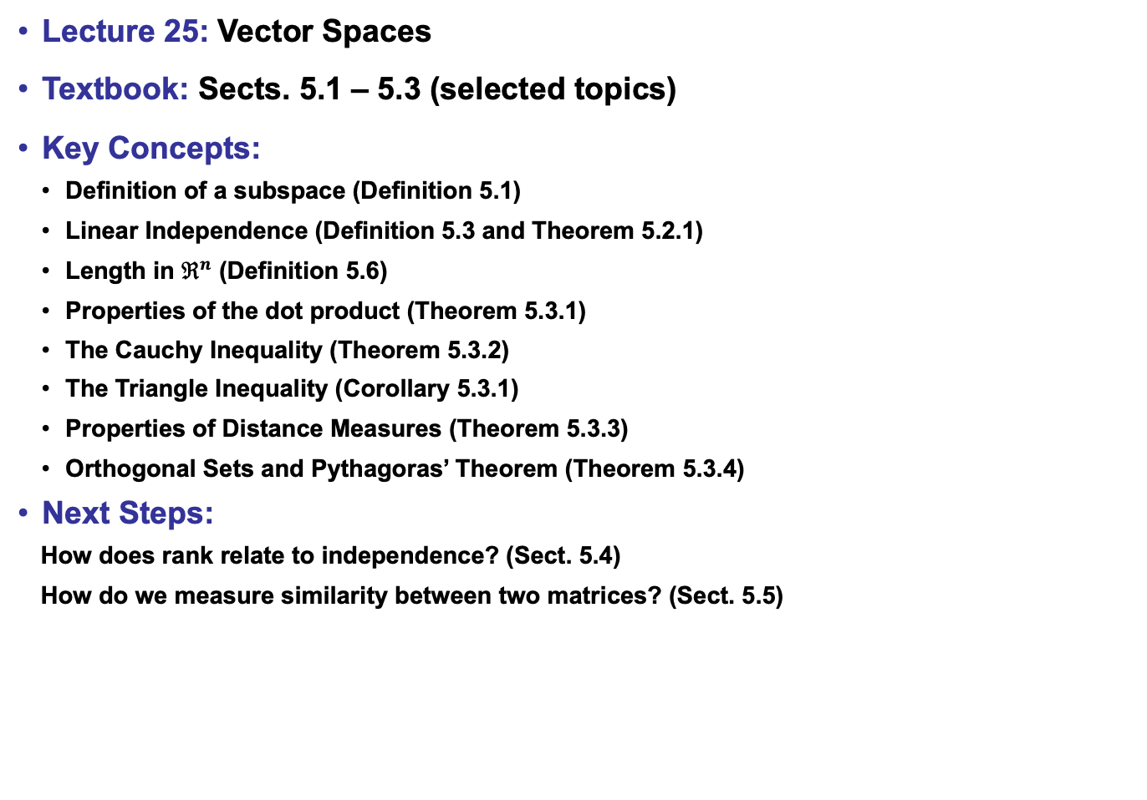
Lecture 25: Vector Spaces
Textbook: Sects. 5.1 – 5.3 (selected topics)
Key Concepts:
Definition of a subspace (Definition 5.1)
Linear Independence (Definition 5.3 and Theorem 5.2.1)
Length in $ℜ^{n}$ (Definition 5.6)
Properties of the dot product (Theorem 5.3.1)
The Cauchy Inequality (Theorem 5.3.2)
The Triangle Inequality (Corollary 5.3.1)
Properties of Distance Measures (Theorem 5.3.3)
Orthogonal Sets and Pythagoras’ Theorem (Theorem 5.3.4)
Next Steps:
How does rank relate to independence? (Sect. 5.4)
How do we measure similarity between two matrices? (Sect. 5.5)

