Slide 1
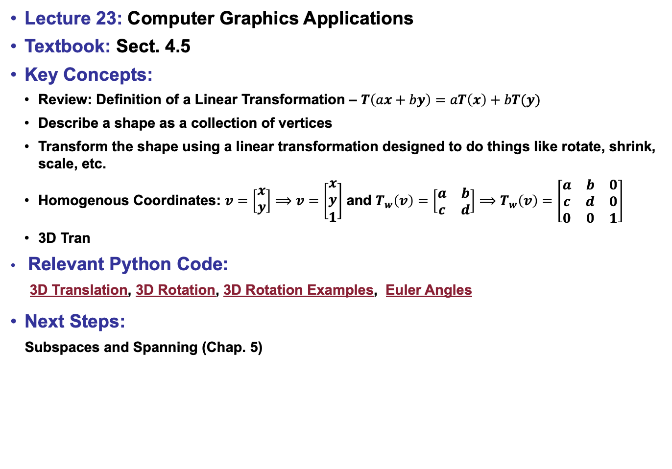
Lecture 23: Computer Graphics Applications
Textbook: Sect. 4.5
Key Concepts:
Review: Definition of a Linear Transformation – $T\left(ax+by\right)=aT\left(x\right)+bT(y)$
Describe a shape as a collection of vertices
Transform the shape using a linear transformation designed to do things like rotate, shrink, scale, etc.
Homogenous Coordinates: $v=\left[\begin{matrix}x \\ y\end{matrix}\right]⟹$ $v=\left[\begin{matrix}x \\ y \\ 1\end{matrix}\right]$ and $T_{w}\left(v\right)=\left[\begin{matrix}a & b \\ c & d\end{matrix}\right]⟹$ $T_{w}\left(v\right)=\left[\begin{matrix}a & b & 0 \\ c & d & 0 \\ 0 & 0 & 1\end{matrix}\right]$
3D Tran
Relevant Python Code:
3D Translation, 3D Rotation, 3D Rotation Examples, Euler Angles
Next Steps:
Subspaces and Spanning (Chap. 5)

