Slide 1
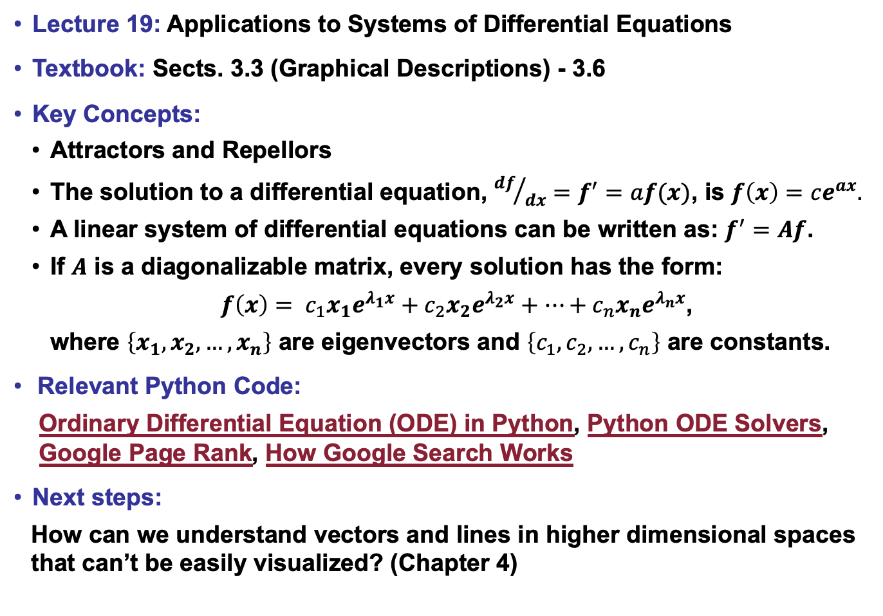
Lecture 19: Applications to Systems of Differential Equations
Textbook: Sects. 3.3 (Graphical Descriptions) - 3.6
Key Concepts:
Attractors and Repellors
The solution to a differential equation, ${df}/{dx}=f^{′}=af(x)$, is $f\left(x\right)=ce^{ax}.$
A linear system of differential equations can be written as: $f^{′}=Af$.
If $A$ is a diagonalizable matrix, every solution has the form:
$f\left(x\right)= c_{1}x_{1}e^{λ_{1}x}+c_{2}x_{2}e^{λ_{2}x}+…+c_{n}x_{n}e^{λ_{n}x}$,
where $\left\{x_{1},x_{2},…,x_{n}\right\}$ are eigenvectors and $\left\{c_{1},c_{2},…,c_{n}\right\}$ are constants.
Relevant Python Code:
Ordinary Differential Equation (ODE) in Python, Python ODE Solvers,
Google Page Rank, How Google Search Works
Next steps:
How can we understand vectors and lines in higher dimensional spaces that can’t be easily visualized? (Chapter 4)

