Slide 1
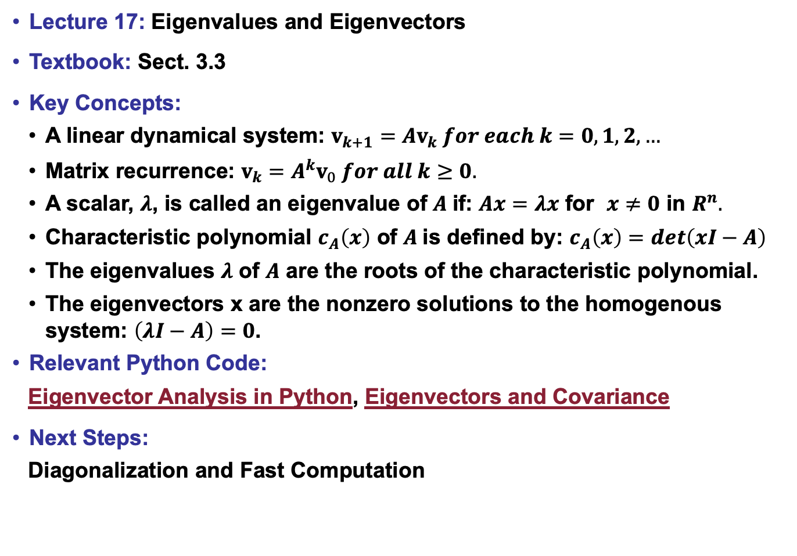
Lecture 17: Eigenvalues and Eigenvectors
Textbook: Sect. 3.3
Key Concepts:
A linear dynamical system: $v_{k+1}=Av_{k} for each k=0,1,2,…$
Matrix recurrence: $v_{k}=A^{k}v_{0} for all k≥0.$
A scalar, $λ$, is called an eigenvalue of $A$if: $Ax=λx$ for $x≠0$ in $R^{n}.$
Characteristic polynomial $c_{A}\left(x\right)$ of $A$is defined by: $c_{A}\left(x\right)=det\left(xI−A\right)$
The eigenvalues $λ$ of $A$ are the roots of the characteristic polynomial.
The eigenvectors x are the nonzero solutions to the homogenous system: $\left(λI−A\right)=0$.
Relevant Python Code:
Eigenvector Analysis in Python, Eigenvectors and Covariance
Next Steps:
Diagonalization and Fast Computation

