Slide 1
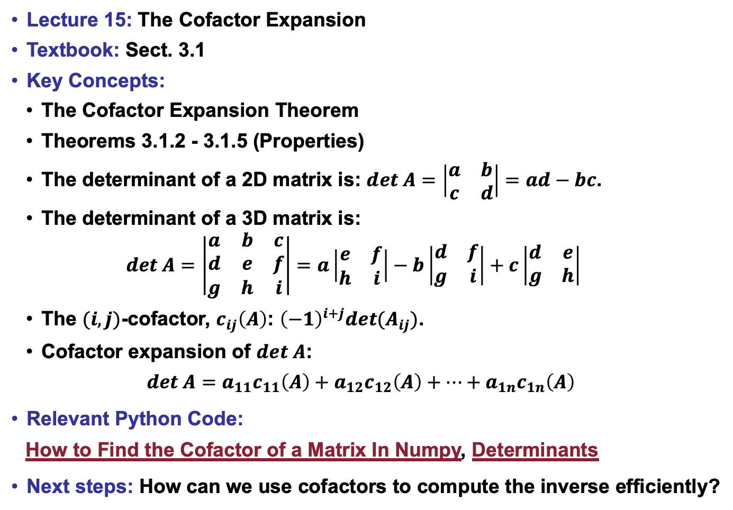
Lecture 15: The Cofactor Expansion
Textbook: Sect. 3.1
Key Concepts:
The Cofactor Expansion Theorem
Theorems 3.1.2 - 3.1.5 (Properties)
The determinant of a 2D matrix is: $det A=\left|\begin{matrix}a & b \\ c & d\end{matrix}\right|=ad−bc$.
The determinant of a 3D matrix is: $det A=\left|\begin{matrix}a & b & c \\ d & e & f \\ g & h & i\end{matrix}\right|=a\left|\begin{matrix}e & f \\ h & i\end{matrix}\right|−b\left|\begin{matrix}d & f \\ g & i\end{matrix}\right|+c\left|\begin{matrix}d & e \\ g & h\end{matrix}\right|$
The $(i,j)$-cofactor, $c_{ij}\left(A\right)$: ${\left(−1\right)}^{i+j}det(A_{ij})$.
Cofactor expansion of $det A$:
$$det A=a_{11}c_{11}\left(A\right)+a_{12}c_{12}\left(A\right)+…+a_{1n}c_{1n}\left(A\right)$$
Relevant Python Code:
How to Find the Cofactor of a Matrix In Numpy, Determinants
Next steps: How can we use cofactors to compute the inverse efficiently?

