Slide 1
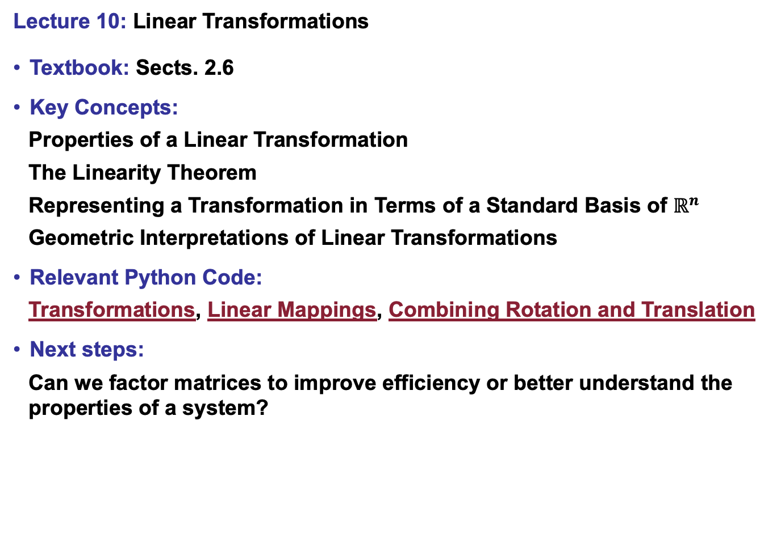
Lecture 10: Linear Transformations
Textbook: Sects. 2.6
Key Concepts:
Properties of a Linear Transformation
The Linearity Theorem
Representing a Transformation in Terms of a Standard Basis of $ℝ^{n}$
Geometric Interpretations of Linear Transformations
Relevant Python Code:
Transformations, Linear Mappings, Combining Rotation and Translation
Next steps:
Can we factor matrices to improve efficiency or better understand the properties of a system?

