Slide 1
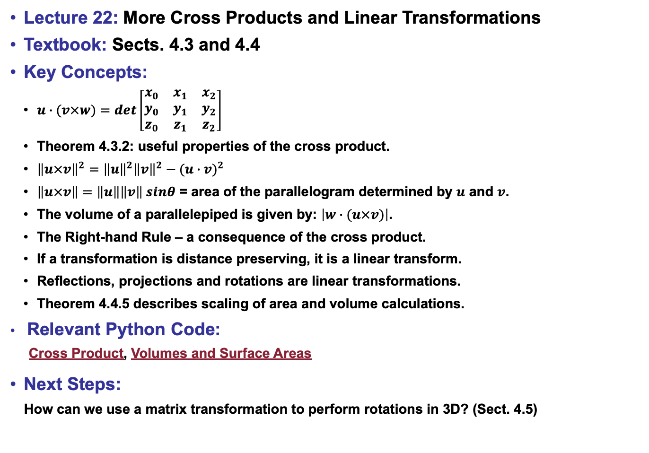
Lecture 22: More Cross Products and Linear Transformations
Textbook: Sects. 4.3 and 4.4
Key Concepts:
$u∙(v×w)=det\left[\begin{matrix}x_{0} & x_{1} & x_{2} \\ y_{0} & y_{1} & y_{2} \\ z_{0} & z_{1} & z_{2}\end{matrix}\right]$
Theorem 4.3.2: useful properties of the cross product.
${\left\|u×v\right\|}^{2}={\left\|u\right\|}^{2}{\left\|v\right\|}^{2}−{(u∙v)}^{2}$
$\left\|u×v\right\|=\left\|u\right\|\left\|v\right\| sinθ$ = area of the parallelogram determined by $u$ and $v$.
The volume of a parallelepiped is given by: $\left|w∙(u×v)\right|$.
The Right-hand Rule – a consequence of the cross product.
If a transformation is distance preserving, it is a linear transform.
Reflections, projections and rotations are linear transformations.
Theorem 4.4.5 describes scaling of area and volume calculations.
Relevant Python Code:
Cross Product, Volumes and Surface Areas
Next Steps:
How can we use a matrix transformation to perform rotations in 3D? (Sect. 4.5)

