Slide 1
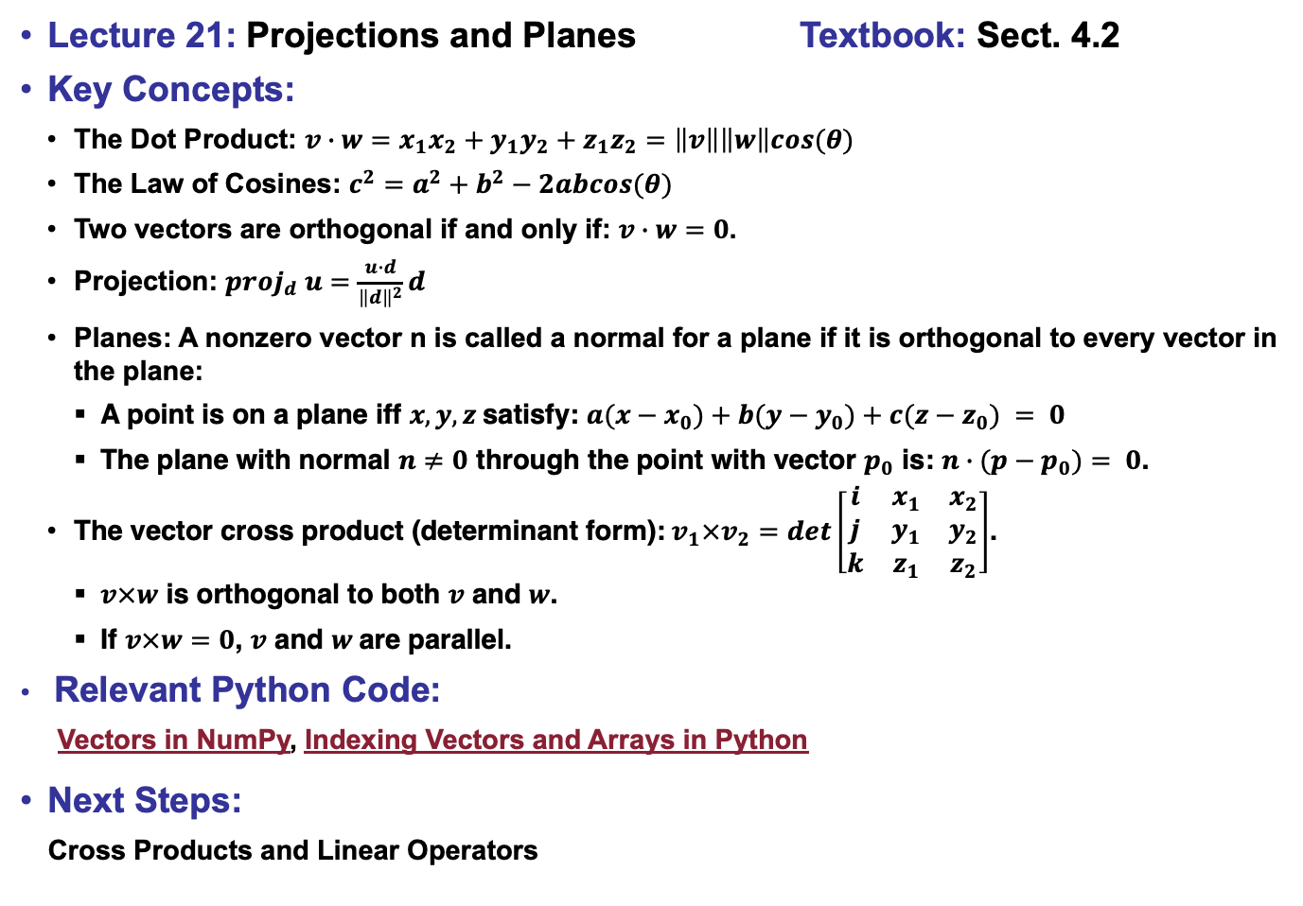
Lecture 21: Projections and Planes Textbook: Sect. 4.2
Key Concepts:
The Dot Product: $v∙w=x_{1}x_{2}+y_{1}y_{2}+z_{1}z_{2}=\left\|v\right\|\left\|w\right\|cos(θ)$
The Law of Cosines: $c^{2}=a^{2}+b^{2}−2abcos(θ)$
Two vectors are orthogonal if and only if: $v∙w=0$.
Projection: ${proj}_{d} u=\frac{u∙d}{{\left\|d\right\|}^{2}}d$
Planes: A nonzero vector n is called a normal for a plane if it is orthogonal to every vector in the plane:
  A point is on a plane iff $x, y, z$satisfy: $a(x−x_{0})+b(y−y_{0})+c(z−z_{0}) = 0$
  The plane with normal $n≠0$ through the point with vector $p_{0}$ is: $n∙(p−p_{0})= 0$.
The vector cross product (determinant form):$v_{1}×v_{2}=det\left[\begin{matrix}i & x_{1} & x_{2} \\ j & y_{1} & y_{2} \\ k & z_{1} & z_{2}\end{matrix}\right]$.
  $v×w$ is orthogonal to both $v$ and $w$.
  If $v×w=0$, $v$ and $w$are parallel.
Relevant Python Code:
Vectors in NumPy, Indexing Vectors and Arrays in Python
Next Steps:
Cross Products and Linear Operators

