Slide 1
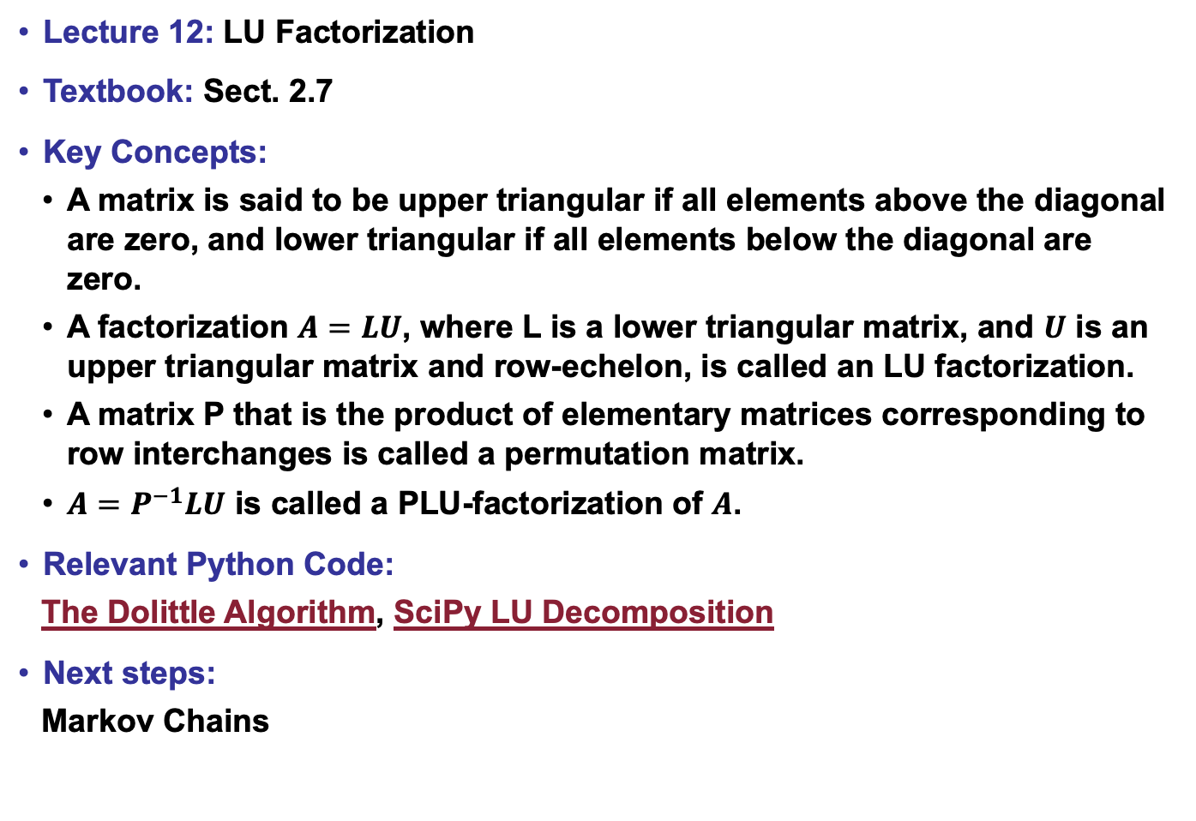
Lecture 12: LU Factorization
Textbook: Sect. 2.7
Key Concepts:
A matrix is said to be upper triangular if all elements above the diagonal are zero, and lower triangular if all elements below the diagonal are zero.
A factorization $A=LU$, where L is a lower triangular matrix, and $U$ is an upper triangular matrix and row-echelon, is called an LU factorization.
A matrix P that is the product of elementary matrices corresponding to row interchanges is called a permutation matrix.
$A=P^{−1}LU$ is called a PLU-factorization of $A$.
Relevant Python Code:
The Dolittle Algorithm, SciPy LU Decomposition
Next steps:
Markov Chains

