Slide 1
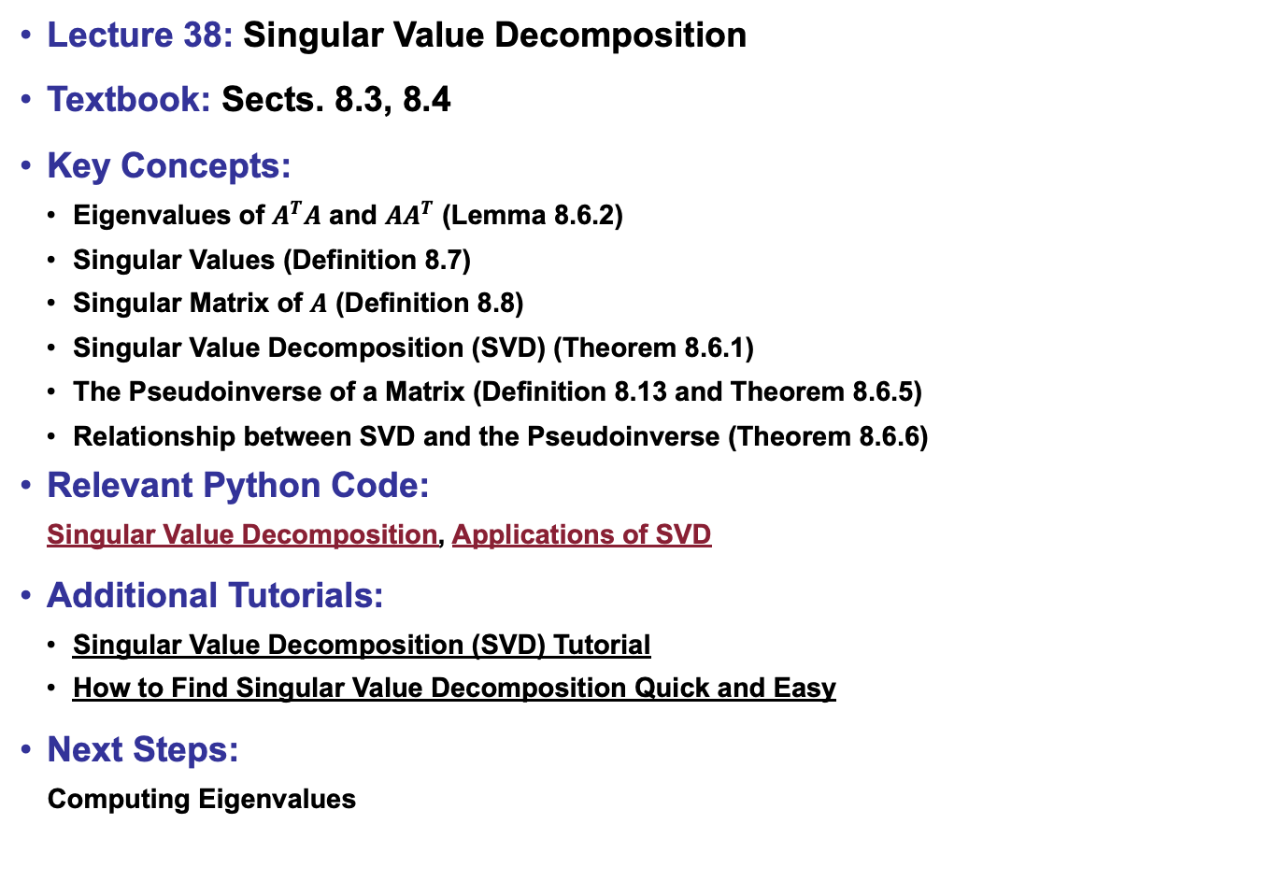
Lecture 38: Singular Value Decomposition
Textbook: Sects. 8.3, 8.4
Key Concepts:
Eigenvalues of $A^{T}A$ and ${AA}^{T}$ (Lemma 8.6.2)
Singular Values (Definition 8.7)
Singular Matrix of $A$ (Definition 8.8)
Singular Value Decomposition (SVD) (Theorem 8.6.1)
The Pseudoinverse of a Matrix (Definition 8.13 and Theorem 8.6.5)
Relationship between SVD and the Pseudoinverse (Theorem 8.6.6)
Relevant Python Code:
Singular Value Decomposition, Applications of SVD
Additional Tutorials:
Singular Value Decomposition (SVD) Tutorial
How to Find Singular Value Decomposition Quick and Easy
Next Steps:
Computing Eigenvalues

