Slide 1
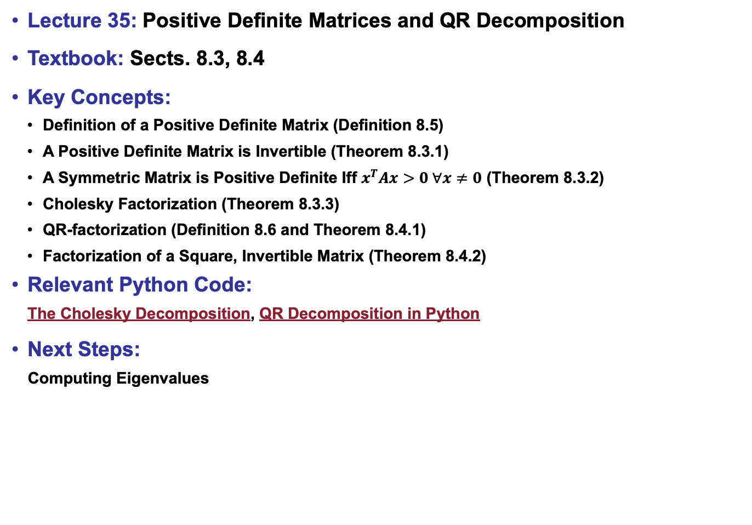
Lecture 35: Positive Definite Matrices and QR Decomposition
Textbook: Sects. 8.3, 8.4
Key Concepts:
Definition of a Positive Definite Matrix (Definition 8.5)
A Positive Definite Matrix is Invertible (Theorem 8.3.1)
A Symmetric Matrix is Positive Definite Iff $x^{T}Ax>0 ∀x≠0$ (Theorem 8.3.2)
Cholesky Factorization (Theorem 8.3.3)
QR-factorization (Definition 8.6 and Theorem 8.4.1)
Factorization of a Square, Invertible Matrix (Theorem 8.4.2)
Relevant Python Code:
The Cholesky Decomposition, QR Decomposition in Python
Next Steps:
Computing Eigenvalues

