Slide 1
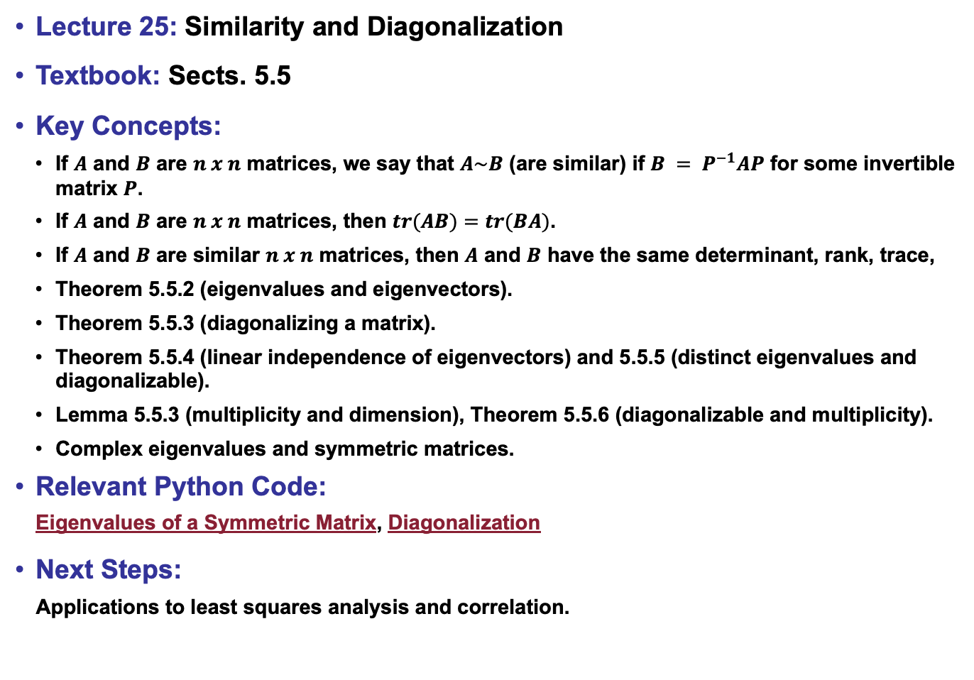
Lecture 25: Similarity and Diagonalization
Textbook: Sects. 5.5
Key Concepts:
If $A$ and $B$ are $n x n$ matrices, we say that $A\sim B$ (are similar) if $B = P^{−1}AP$ for some invertible matrix $P$.
If $A$ and $B$ are $n x n$ matrices, then $tr(AB)=tr(BA)$.
If $A$ and $B$ are similar $n x n$ matrices, then $A$ and $B$ have the same determinant, rank, trace,
Theorem 5.5.2 (eigenvalues and eigenvectors).
Theorem 5.5.3 (diagonalizing a matrix).
Theorem 5.5.4 (linear independence of eigenvectors) and 5.5.5 (distinct eigenvalues and diagonalizable).
Lemma 5.5.3 (multiplicity and dimension), Theorem 5.5.6 (diagonalizable and multiplicity).
Complex eigenvalues and symmetric matrices.
Relevant Python Code:
Eigenvalues of a Symmetric Matrix, Diagonalization
Next Steps:
Applications to least squares analysis and correlation.

