Slide 1
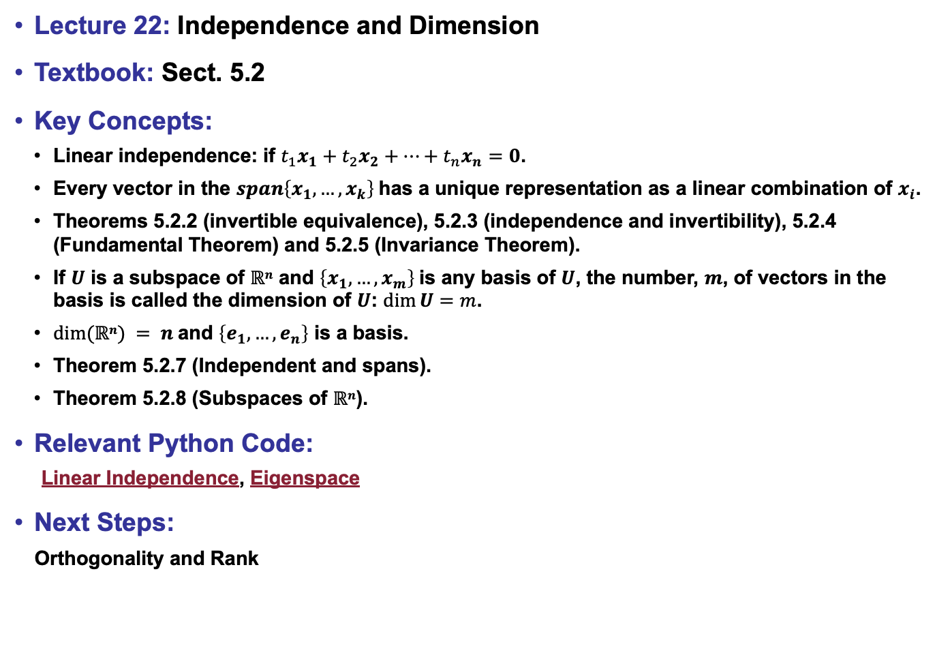
Lecture 22: Independence and Dimension
Textbook: Sect. 5.2
Key Concepts:
Linear independence: if $t_{1}x_{1}+t_{2}x_{2}+…+t_{n}x_{n}=0$.
Every vector in the $span\left\{x_{1},…,x_{k}\right\}$has a unique representation as a linear combination of $x_{i}$.
Theorems 5.2.2 (invertible equivalence), 5.2.3 (independence and invertibility), 5.2.4 (Fundamental Theorem) and 5.2.5 (Invariance Theorem).
If $U$ is a subspace of $ℝn$ and $\left\{x_{1},…,x_{m}\right\}$is any basis of $U$, the number, $m$, of vectors in the basis is called the dimension of $U$: $dim⁡U=m$.
$dim⁡(ℝn) = n$and $\left\{e_{1},…,e_{n}\right\}$ is a basis.
Theorem 5.2.7 (Independent and spans).
Theorem 5.2.8 (Subspaces of $ℝn$).
Relevant Python Code:
Linear Independence, Eigenspace
Next Steps:
Orthogonality and Rank

