Slide 1
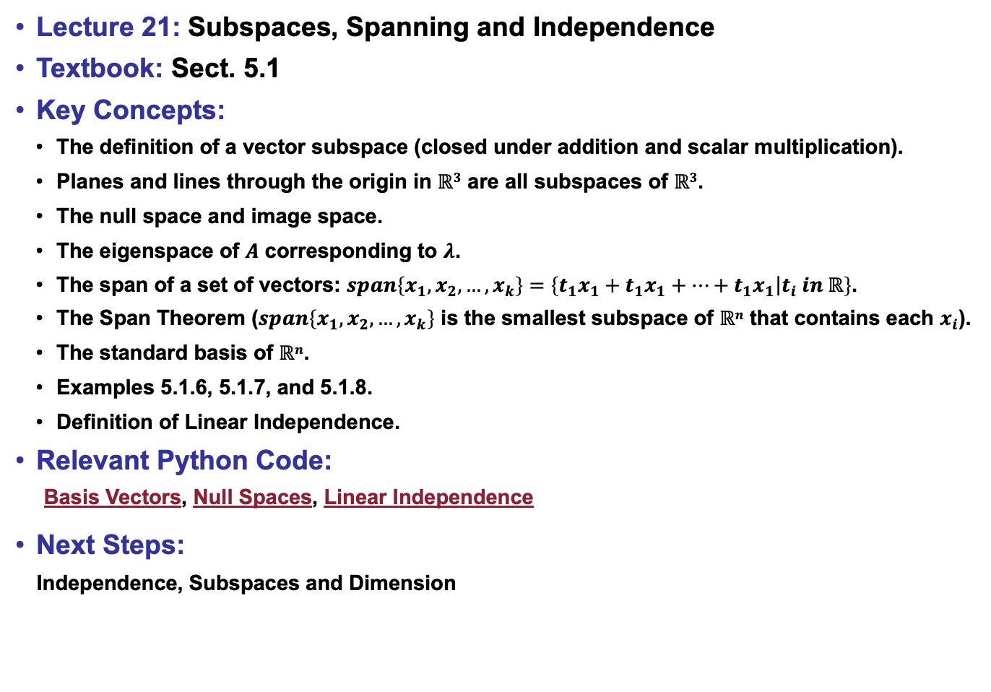
Lecture 21: Subspaces, Spanning and Independence
Textbook: Sect. 5.1
Key Concepts:
The definition of a vector subspace (closed under addition and scalar multiplication).
Planes and lines through the origin in $ℝ3$ are all subspaces of $ℝ3$.
The null space and image space.
The eigenspace of $A$ corresponding to $λ$.
The span of a set of vectors: $span\left\{x_{1},x_{2},…,x_{k}\right\}=\left\{\left.t_{1}x_{1}+t_{1}x_{1}+…+t_{1}x_{1}\right|t_{i} in ℝ\right\}$.
The Span Theorem ($span\left\{x_{1},x_{2},…,x_{k}\right\}$ is the smallest subspace of $ℝn$ that contains each $x_{i}$).
The standard basis of $ℝn$.
Examples 5.1.6, 5.1.7, and 5.1.8.
Definition of Linear Independence.
Relevant Python Code:
Basis Vectors, Null Spaces, Linear Independence
Next Steps:
Independence, Subspaces and Dimension

