Slide 1
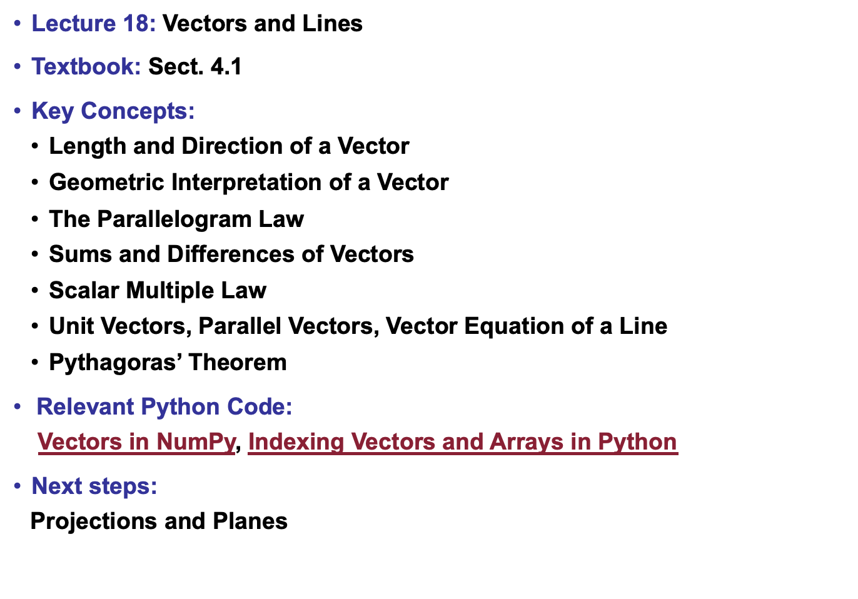
Lecture 18: Vectors and Lines
Textbook: Sect. 4.1
Key Concepts:
Length and Direction of a Vector
Geometric Interpretation of a Vector
The Parallelogram Law
Sums and Differences of Vectors
Scalar Multiple Law
Unit Vectors, Parallel Vectors, Vector Equation of a Line
Pythagoras’ Theorem
Relevant Python Code:
Vectors in NumPy, Indexing Vectors and Arrays in Python
Next steps:
Projections and Planes

