Slide 1
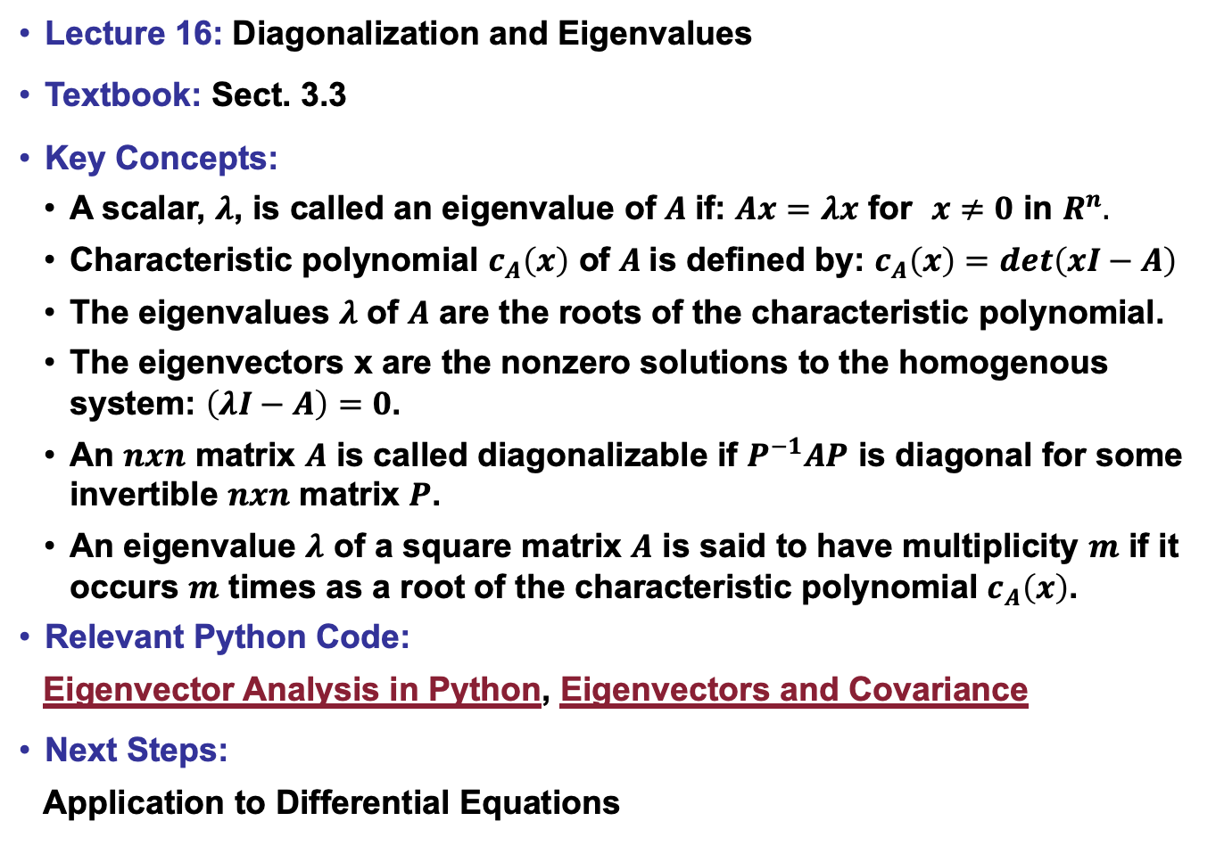
Lecture 16: Diagonalization and Eigenvalues
Textbook: Sect. 3.3
Key Concepts:
A scalar, $λ$, is called an eigenvalue of $A$if: $Ax=λx$ for $x≠0$ in $R^{n}.$
Characteristic polynomial $c_{A}\left(x\right)$ of $A$is defined by: $c_{A}\left(x\right)=det\left(xI−A\right)$
The eigenvalues $λ$ of $A$ are the roots of the characteristic polynomial.
The eigenvectors x are the nonzero solutions to the homogenous system: $\left(λI−A\right)=0$.
An $nxn$ matrix $A$ is called diagonalizable if $P^{−1}AP$ is diagonal for some invertible $nxn$ matrix $P$.
An eigenvalue $λ$ of a square matrix $A$ is said to have multiplicity $m$ if it occurs $m$ times as a root of the characteristic polynomial $c_{A}\left(x\right)$.
Relevant Python Code:
Eigenvector Analysis in Python, Eigenvectors and Covariance
Next Steps:
Application to Differential Equations

