Slide 1
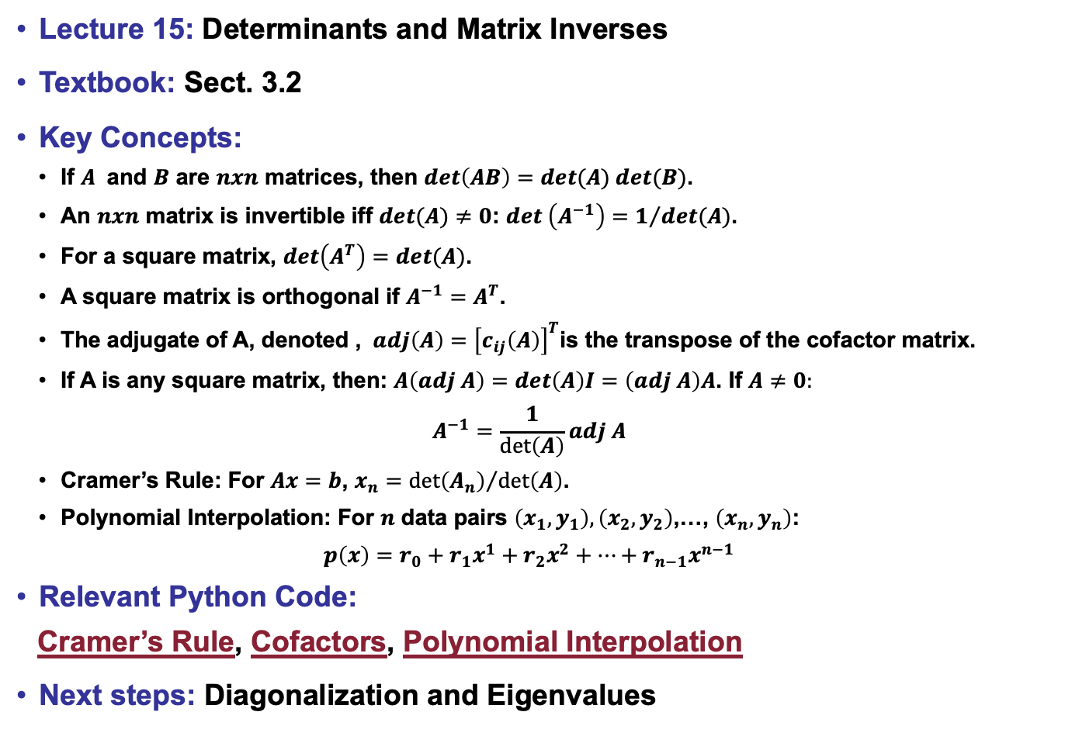
Lecture 15: Determinants and Matrix Inverses
Textbook: Sect. 3.2
Key Concepts:
If $A$ and $B$ are $nxn$ matrices, then $det\left(AB\right)=det(A) det(B)$.
An $nxn$ matrix is invertible iff $det(A)≠0$: $det \left(A^{−1}\right)=1/{det(A)}$.
For a square matrix, $det\left(A^{T}\right)=det(A)$.
A square matrix is orthogonal if $A^{−1}=A^{T}$.
The adjugate of A, denoted , $adj\left(A\right)={\left[c_{ij}\left(A\right)\right]}^{T}$is the transpose of the cofactor matrix.
If A is any square matrix, then: $A\left(adj A\right)=det\left(A\right)I=\left(adj A\right)A$. If $A≠0:$
$$A^{−1}=\frac{1}{\det\left(A\right)}adj A$$
Cramer’s Rule: For $Ax=b$, $x_{n}={\det\left(A_{n}\right)}/{\det\left(A\right)}$.
Polynomial Interpolation: For $n$ data pairs $\left(x_{1},y_{1}\right),\left(x_{2},y_{2}\right)$,…, $\left(x_{n},y_{n}\right)$:
$$p\left(x\right)=r_{0}+r_{1}x^{1}+r_{2}x^{2}+…+r_{n−1}x^{n−1}$$
Relevant Python Code:
Cramer’s Rule, Cofactors, Polynomial Interpolation
Next steps: Diagonalization and Eigenvalues

