Slide 1
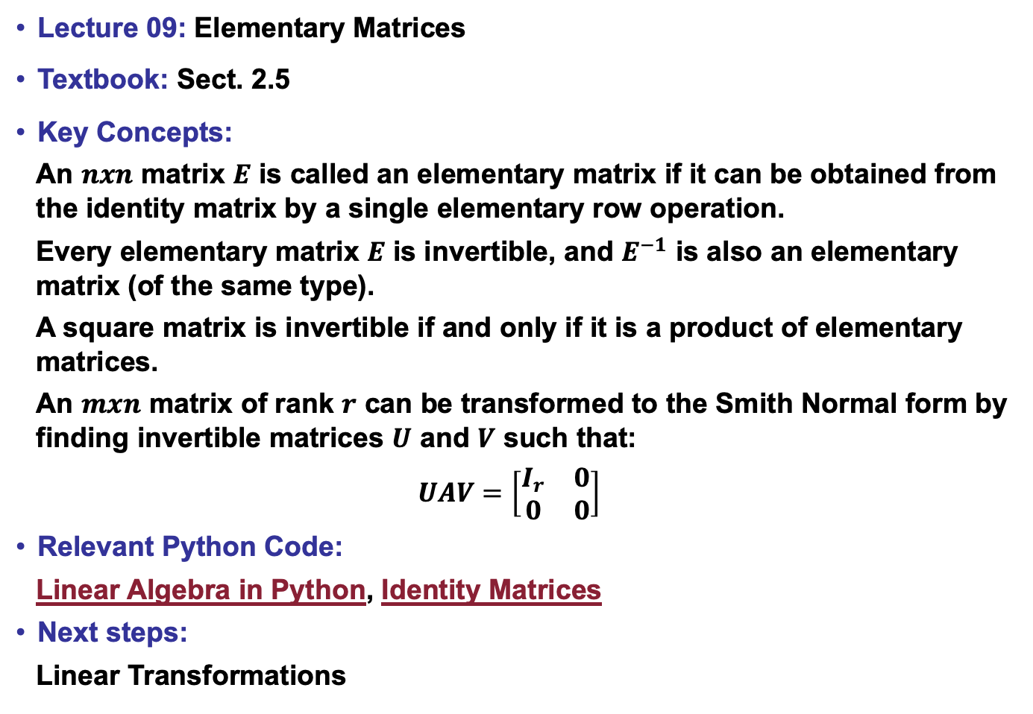
Lecture 09: Elementary Matrices
Textbook: Sect. 2.5
Key Concepts:
An $nxn$ matrix $E$ is called an elementary matrix if it can be obtained from the identity matrix by a single elementary row operation.
Every elementary matrix $E$ is invertible, and $E^{−1}$ is also an elementary matrix (of the same type).
A square matrix is invertible if and only if it is a product of elementary matrices.
An $mxn$ matrix of rank $r$ can be transformed to the Smith Normal form by finding invertible matrices $U$ and $V$ such that:
$$UAV=\left[\begin{matrix}I_{r} & 0 \\ 0 & 0\end{matrix}\right]$$
Relevant Python Code:
Linear Algebra in Python, Identity Matrices
Next steps:
Linear Transformations

