Slide 1
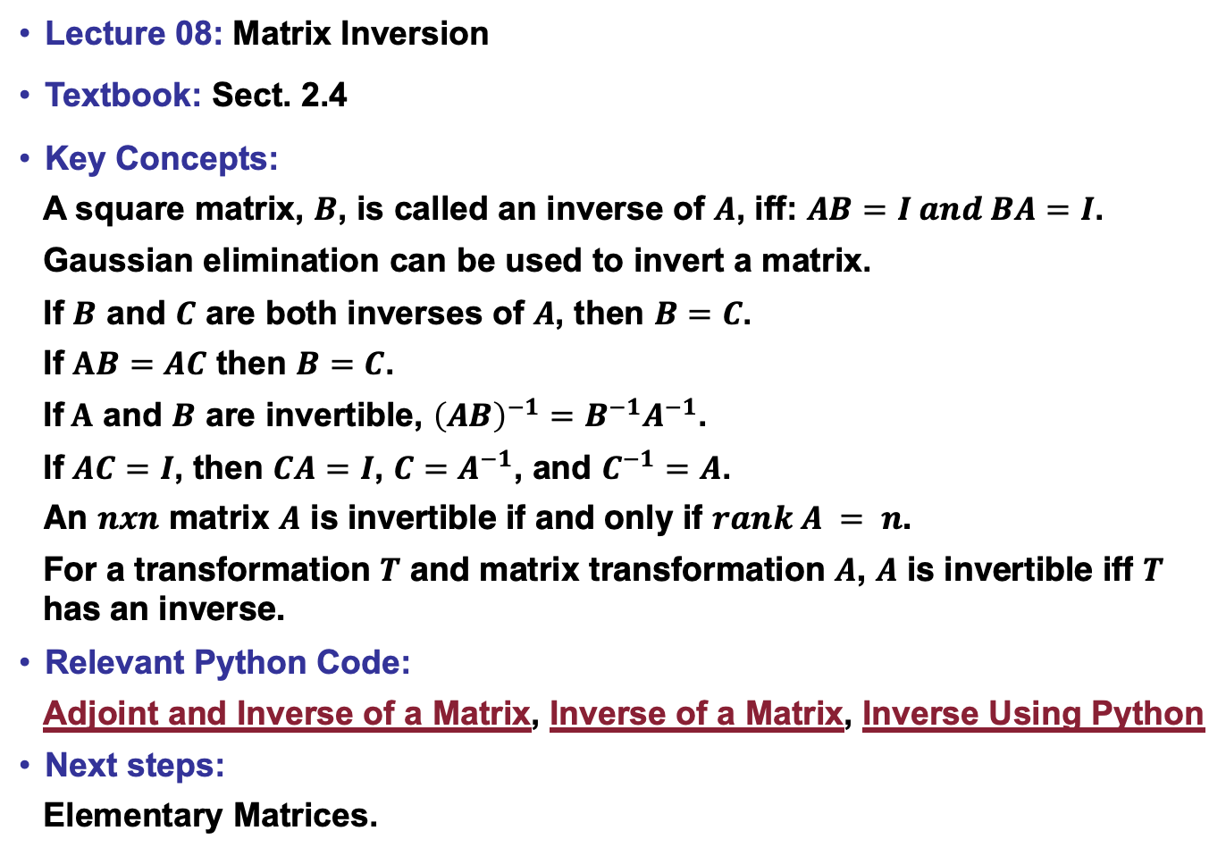
Lecture 08: Matrix Inversion
Textbook: Sect. 2.4
Key Concepts:
A square matrix, $B$, is called an inverse of $A$, iff: $AB=I and BA=I$.
Gaussian elimination can be used to invert a matrix.
If $B$ and $C$ are both inverses of $A$, then $B=C$.
If $AB=AC$ then $B=C$.
If$A$ and $B$ are invertible, ${\left(AB\right)}^{−1}=B^{−1}A^{−1}$.
If $AC=I$, then $CA=I$, ${C=A}^{−1}$, and $C^{−1}=A$.
An $nxn$ matrix $A$ is invertible if and only if $rank A = n$.
For a transformation $T$ and matrix transformation $A$, $A$ is invertible iff $T$ has an inverse.
Relevant Python Code:
Adjoint and Inverse of a Matrix, Inverse of a Matrix, Inverse Using Python
Next steps:
Elementary Matrices.

