Slide 1
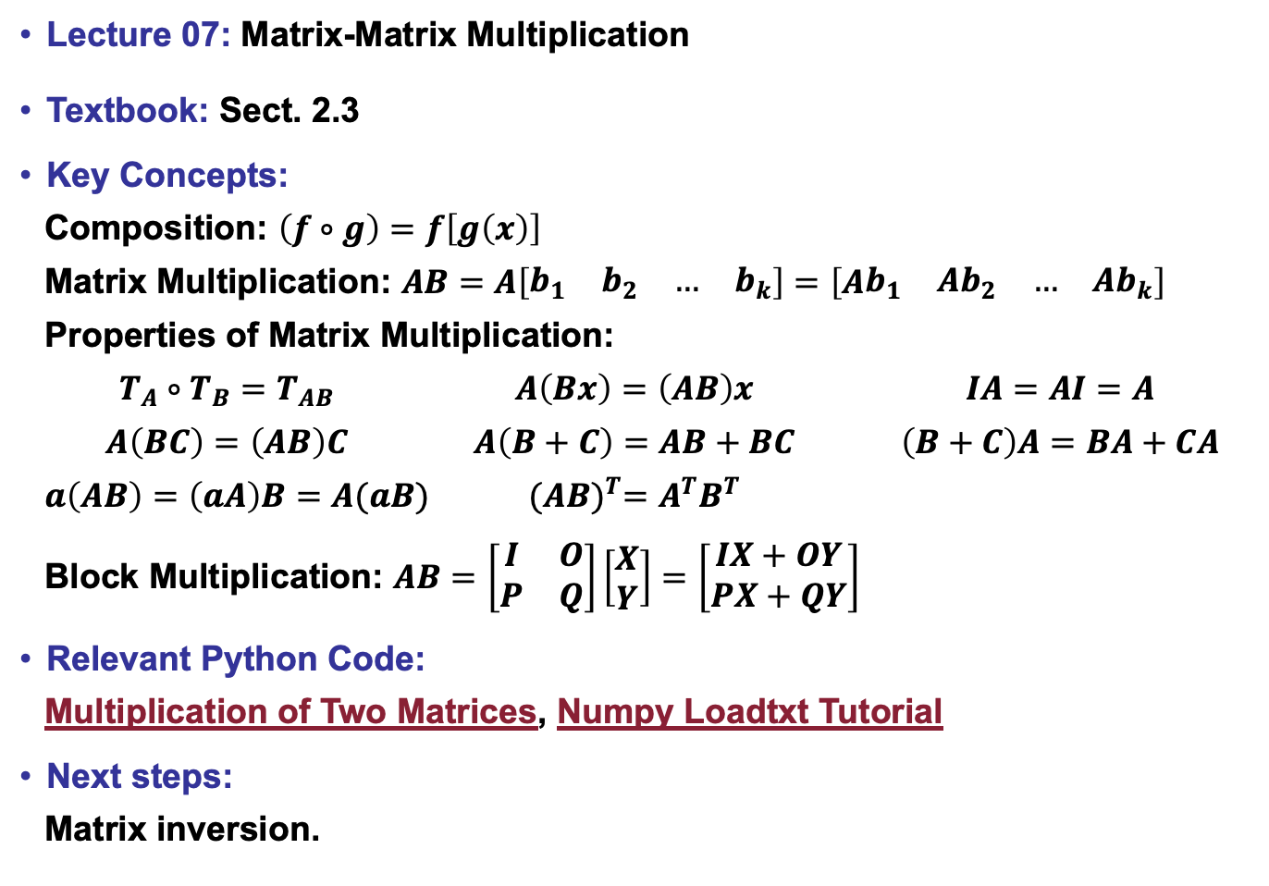
Lecture 07: Matrix-Matrix Multiplication
Textbook: Sect. 2.3
Key Concepts:
Composition: $\left(f∘g\right)=f\left[g\left(x\right)\right]$
Matrix Multiplication: $AB=A\left[\begin{matrix}b_{1} & b_{2} & … & b_{k}\end{matrix}\right]=\left[A\begin{matrix}b_{1} & Ab_{2} & … & Ab_{k}\end{matrix}\right]$
Properties of Matrix Multiplication:
$T_{A}∘T_{B}=T_{AB}$ $A\left(Bx\right)=\left(AB\right)x$ $IA=AI=A$
$A\left(BC\right)=\left(AB\right)C$ $A\left(B+C\right)=AB+BC$ $\left(B+C\right)A=BA+CA$
$a\left(AB\right)=\left(aA\right)B=A(aB)$ ${(AB)}^{T}=A^{T}B^{T}$
Block Multiplication: $AB=\left[\begin{matrix}I & O \\ P & Q\end{matrix}\right]\left[\begin{matrix}X \\ Y\end{matrix}\right]=\left[\begin{matrix}IX+OY \\ PX+QY\end{matrix}\right]$
Relevant Python Code:
Multiplication of Two Matrices, Numpy Loadtxt Tutorial
Next steps:
Matrix inversion.

