Slide 1
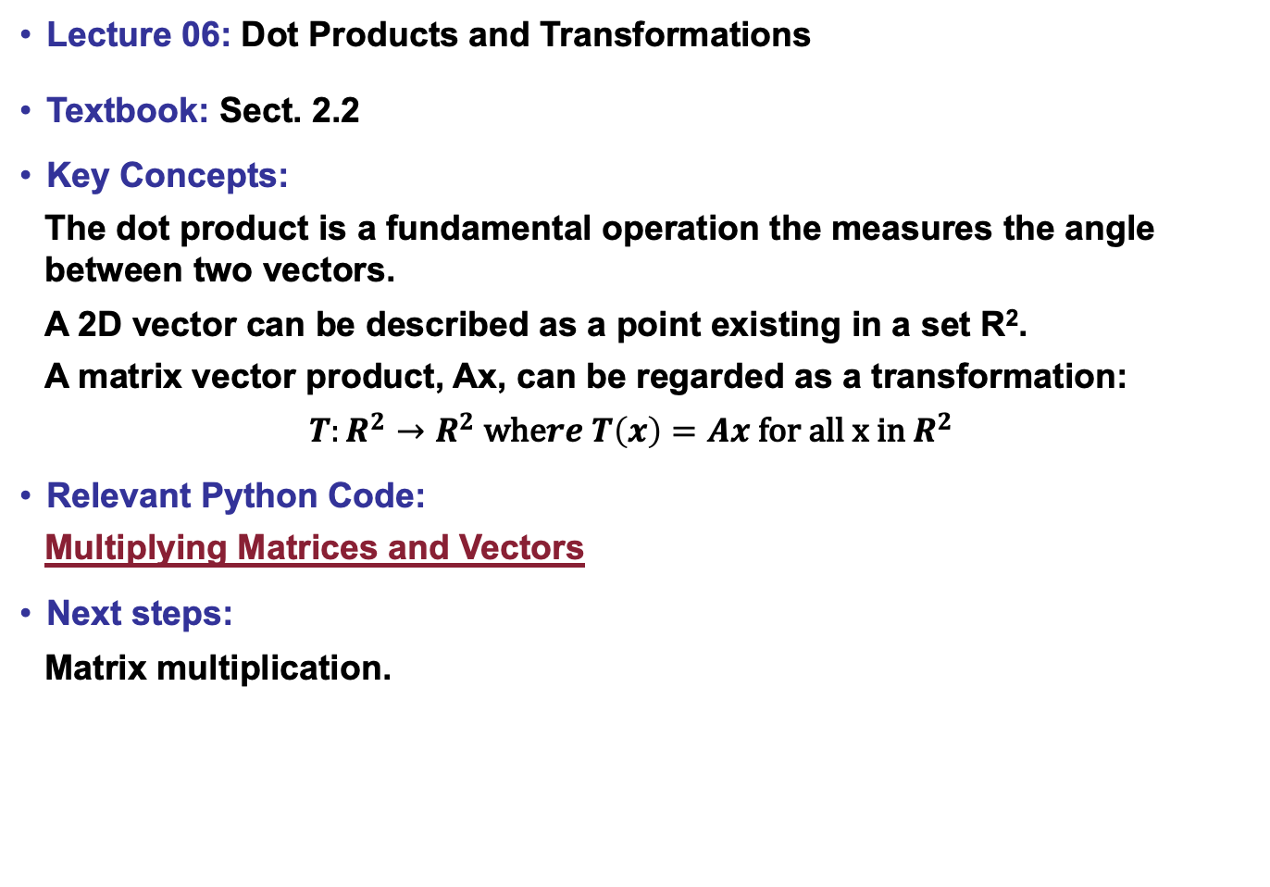
Lecture 06: Dot Products and Transformations
Textbook: Sect. 2.2
Key Concepts:
The dot product is a fundamental operation the measures the angle between two vectors.
A 2D vector can be described as a point existing in a set R².
A matrix vector product, Ax, can be regarded as a transformation:
$$T:R^{2}→R^{2} \text{whe}re T\left(x\right)=Ax \text{for} \text{all} \text{x} \text{in} R^{2}$$
Relevant Python Code:
Multiplying Matrices and Vectors
Next steps:
Matrix multiplication.

