Slide 1
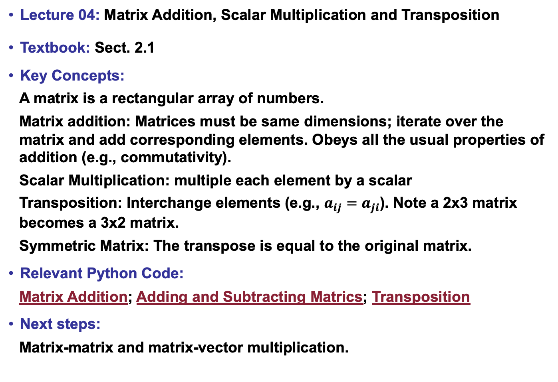
Lecture 04: Matrix Addition, Scalar Multiplication and Transposition
Textbook: Sect. 2.1
Key Concepts:
A matrix is a rectangular array of numbers.
Matrix addition: Matrices must be same dimensions; iterate over the matrix and add corresponding elements. Obeys all the usual properties of addition (e.g., commutativity).
Scalar Multiplication: multiple each element by a scalar
Transposition: Interchange elements (e.g., $a_{ij}=a_{ji}$). Note a 2x3 matrix becomes a 3x2 matrix.
Symmetric Matrix: The transpose is equal to the original matrix.
Relevant Python Code:
Matrix Addition; Adding and Subtracting Matrics; Transposition
Next steps:
Matrix-matrix and matrix-vector multiplication.

