Slide 1
Transformer
Transformer overview
Encoder
Decoder

Slide 2
Transformer architecture

Slide 3
How does the transformer work?
EE
I am a student
decoder
encoder
من یک دانش آموز هستم

Slide 4
Decoder
Encoder
I am a Student.
من یک دانش آموز هستم
Decoder
Encoder
Decoder
Encoder

Slide 5
Encoder
Encoder
Feed Forward
Multi-Head Attention

Slide 6
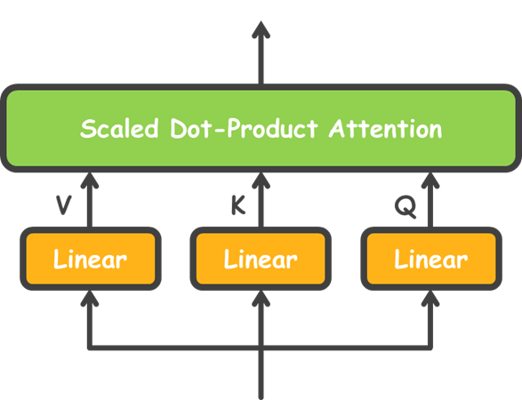
Multi-head attention
Z₁
Z₂
Z_{h}
...
X

Slide 7
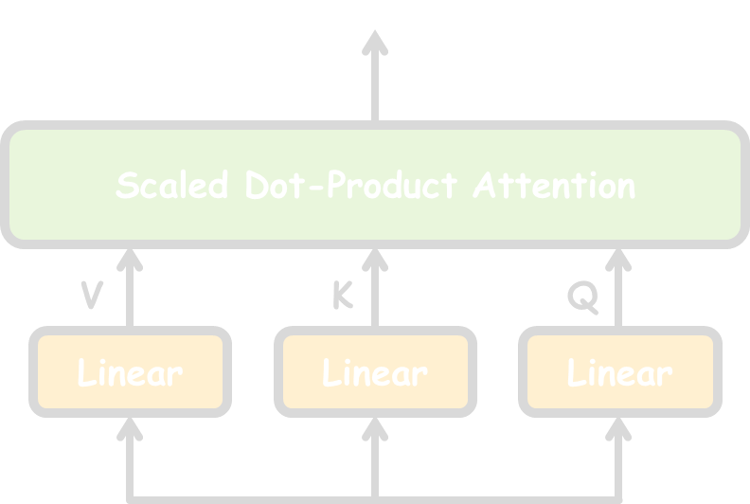
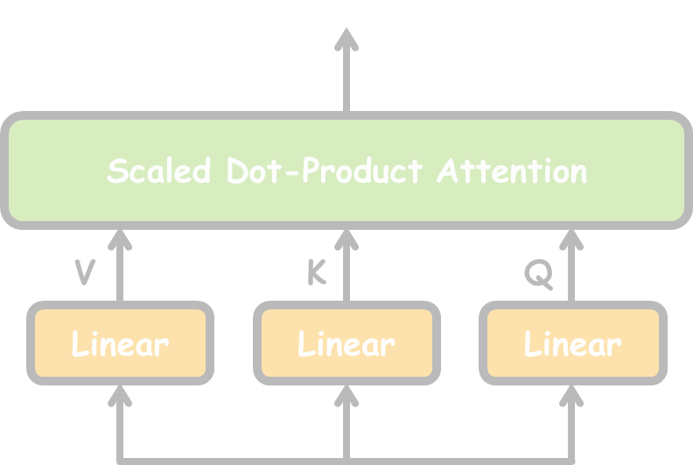
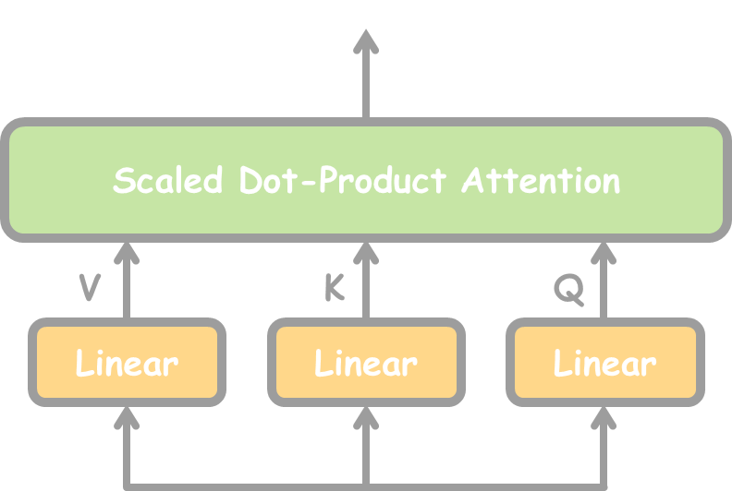
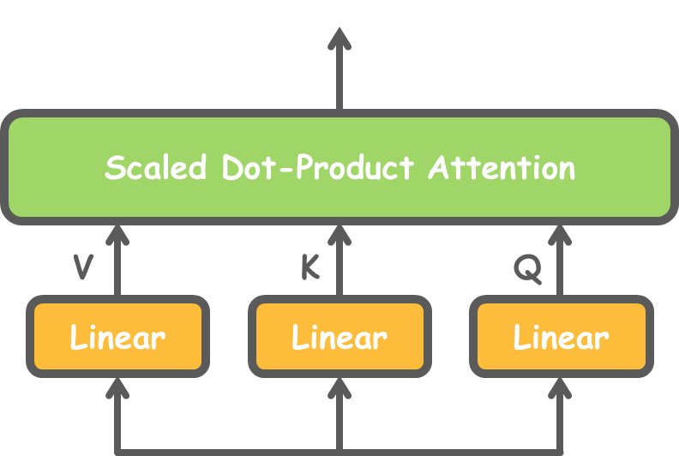
Multi-head attention
Z
X

Slide 8
Scaled Dot-Product Attention
Z
MatMul
Z
SoftMax
Scaled Dot-Product Attention
Scale
K
Linear
Q
Linear
V
Linear
MatMul
Q
K
V
X

Slide 9
Example
X₁: | 1 | 0 | 1 | 0 |  | 1 | 0 | 1 | 0
X₂: | 0 | 2 | 0 | 2 | → X = | 0 | 2 | 0 | 2 | W_{K} | =
0 0 1
1 1 0
0 1 0
1 1 0
1 0 1
1 0 0
0 0 1
0 1 1
0 2 0
0 3 0
1 0 3
1 1 0
W_{Q} =
W_{V} =
X :
1 1
1 1
1 1 1 1
3
0 0 1
1 1 0
0 1 0
1 1 0
0 1 1
4 4 0
2 3 1
Z
1 |  |  | 0 | 1 | 0
K = XW_{K} | = | 0 | 2 | 0 | 2 | ×
 |  | 1 | 1 | 1 | 1
=
1 0 1
1 0 0
0 0 1
0 1 1
Scaled Dot-Product Attention
1 0 1 0
0 2 0 2
1 1 1 1
1 0 2
2 2 2
2 1 3
Q = XW_{Q} =
×
=
V
Linear
K
Linear
Q
Linear
1 0 1 0
0 2 0 2
1 1 1 1
0 2 0
0 3 0
1 0 3
1 1 0
1 2 3
2 8 0
2 6 3
V = XW_{V} =
×
=
X

Slide 10
Scaling and SoftMax
Z
1 0 2
2 2 2
2 1 3
0 4 2 2 4 4
1 4 3 = 4 16 12
1 0 1 4 12 10
MatMul
QK^{𝑇} =
×
SoftMax
QK^{𝑇}
2 4 4
4 16 12 /
4 12 10
1.15 2.30 2.30
2.30 9.23 6.92
2.30 6.92 5.77
=
3 =
𝑑_{𝑄}
Scale
QK^{𝑇}
 | 0.14 | 0.43 | 0.43
= | 0.01 | 0.90 | 0.09
 | 0.01 | 0.75 | 0.24
softmax
MatMul
𝑑_{𝑄}
QK^{𝑇}
𝑑_{𝑄}
1.86 6.32 1.71
2.00 7.81 0.27
1.99 7.48 0.74
Q
K
V
Z = softmax
V =

Slide 11
Multi-head Attention
Linear
concat
h

Slide 12
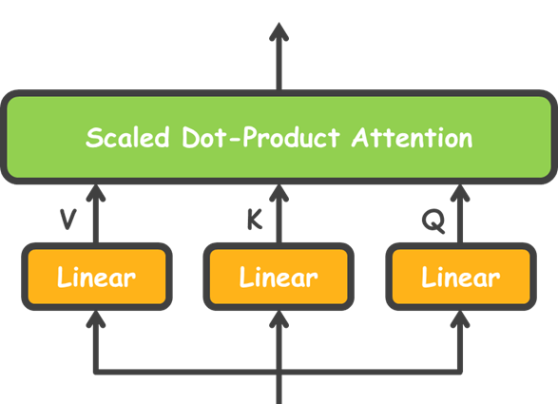
h = 3
مج
م ن
یا
بلاط
م زا
یرا
دربی
پک و
رش

Slide 13
Encoder
Feed Forward
Multi-Head Attention

Slide 14
Feed Forward
Linear
4XLinear

Slide 15
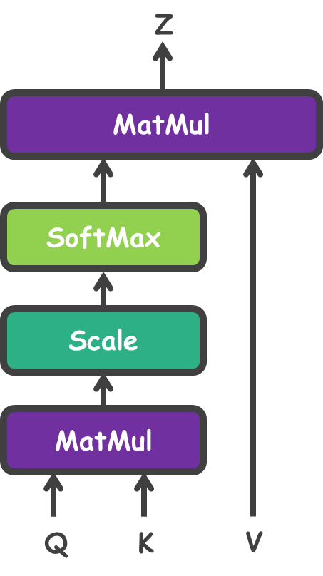
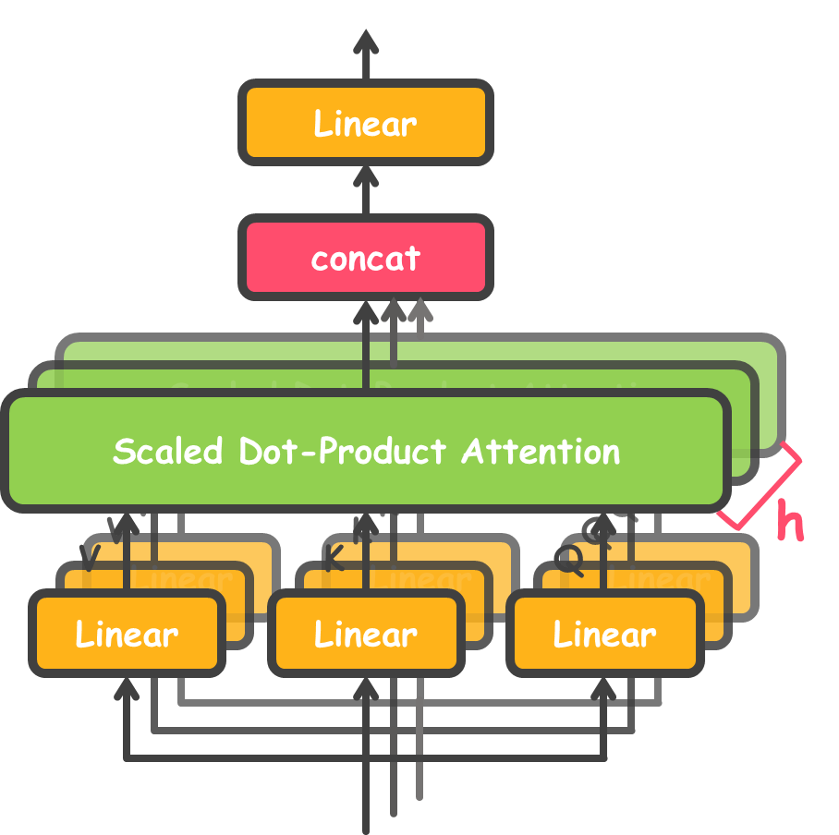
Encoder architecture
Encoder
Linear
Feed Forward
4XLinear
Multi-Head Attention
یعوـنـصمشوـه یـمداـکآ
howsam.org | مــسوــه

Slide 16
Norm & Residual connections
Encoder
Norm
Feed Forward
Norm
( )
+
Multi-Head Attention
رادر
بی
پک و
رش

Slide 17
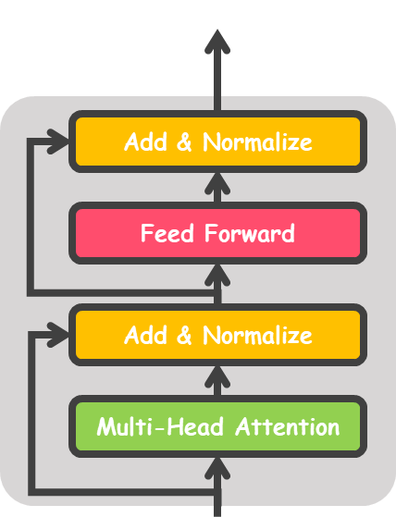
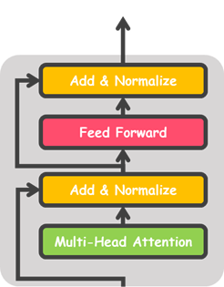
Several layers of Encoders
Encoder
...
N
Encoder
Encoder

Slide 18
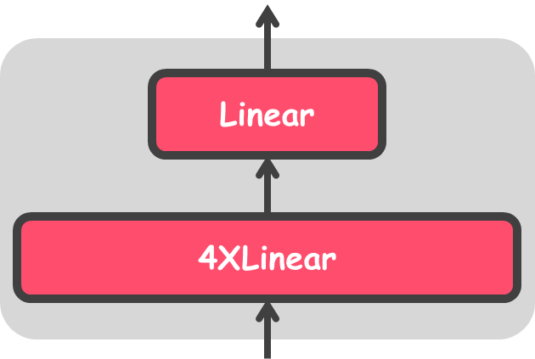
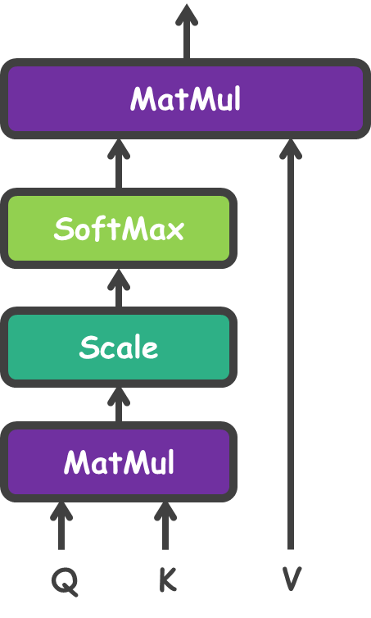
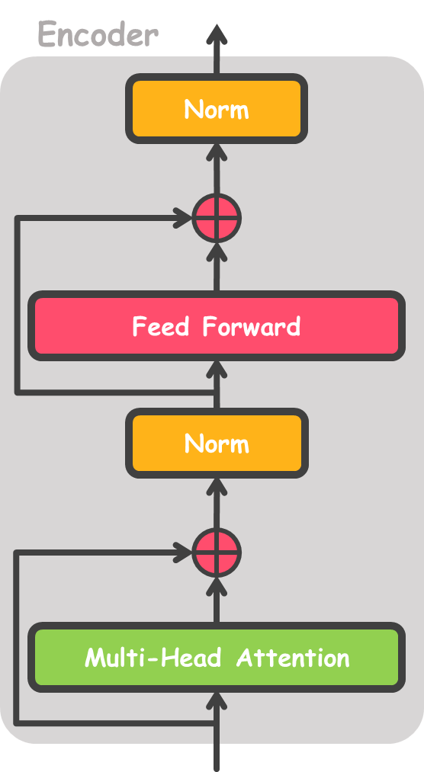
Whole in one image
Encoder
...
N
Encoder
Encoder

Slide 19
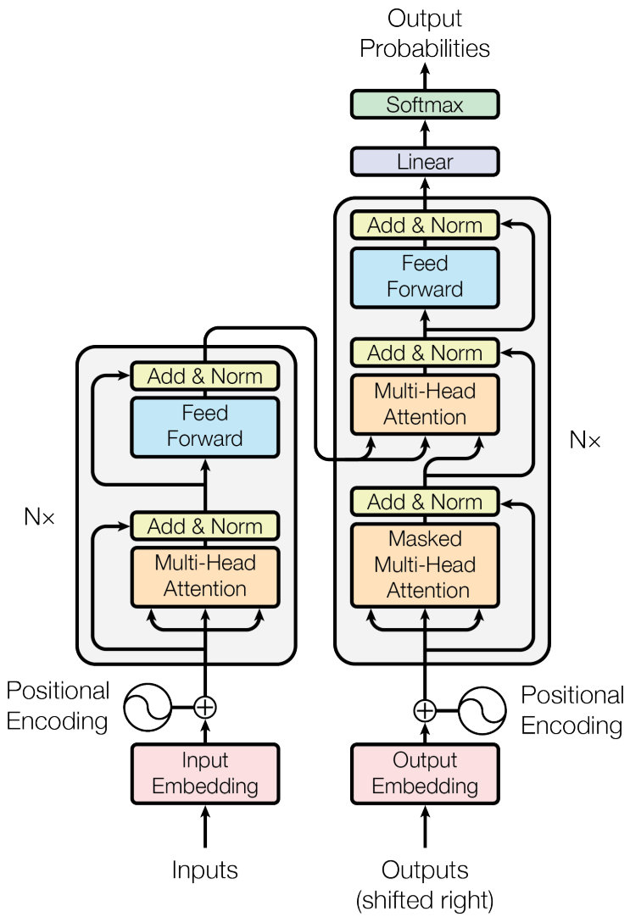
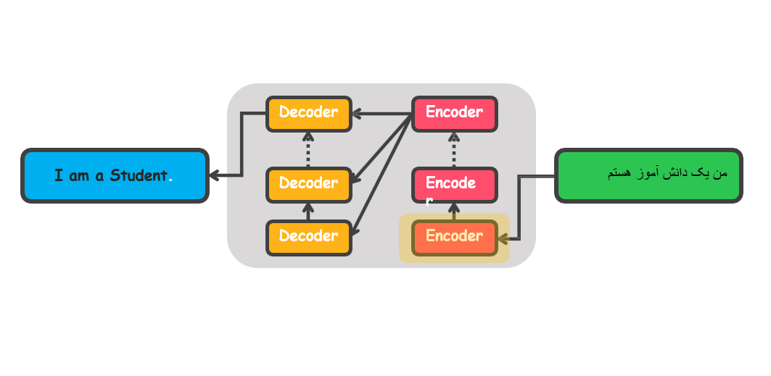

Slide 20
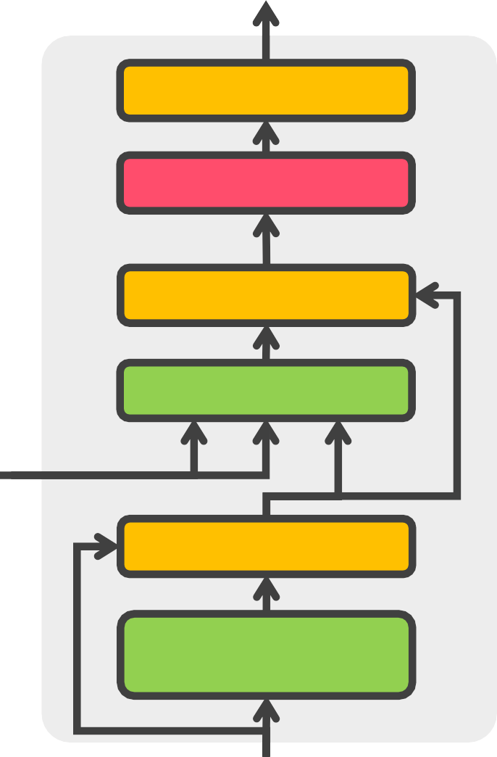
Decoder
Decoder
Add & Normalize
Feed Forward
Add & Normalize
Multi-Head Attention
K,V
Q
Add & Normalize
Masked
Multi-Head Attention

Slide 21
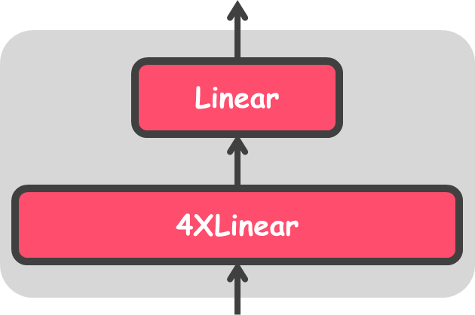
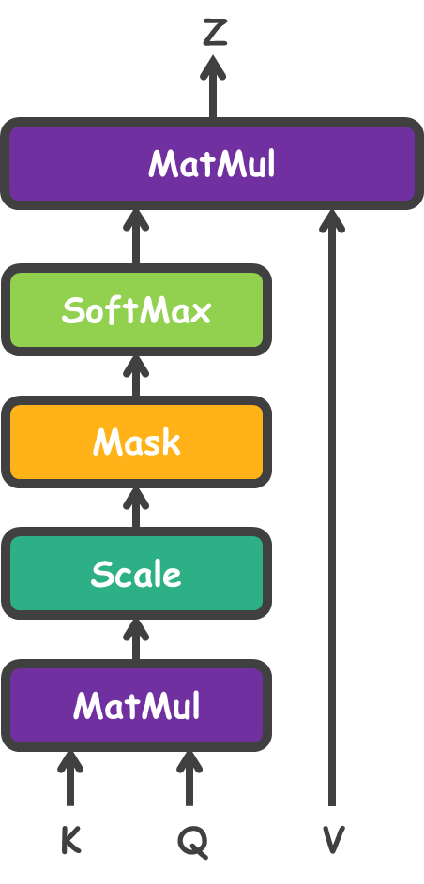
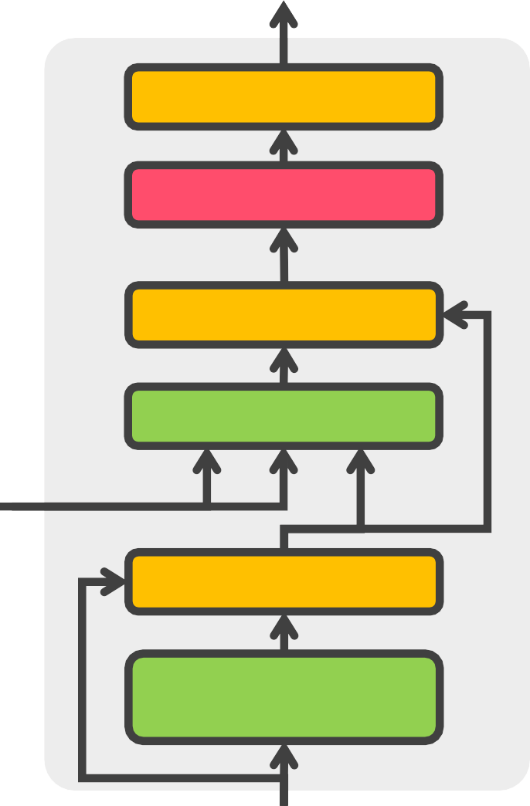
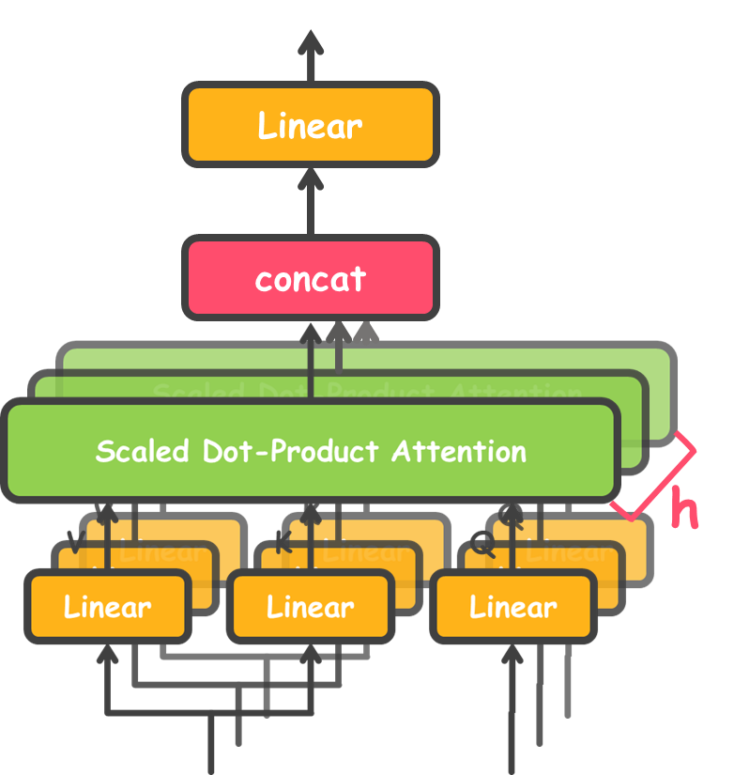
Decoder
Add & Normalize
Feed Forward
Add & Normalize
Multi-Head Attention
K,V
Q
Add & Normalize
Masked
Multi-Head Attention

Slide 22
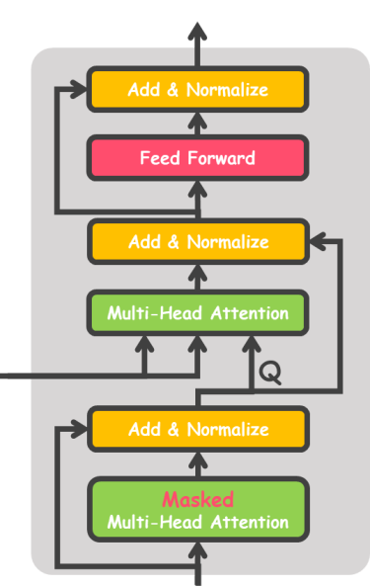
Decoder #N
N
...
Decoder #1

Slide 24
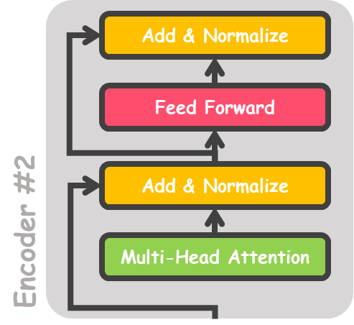
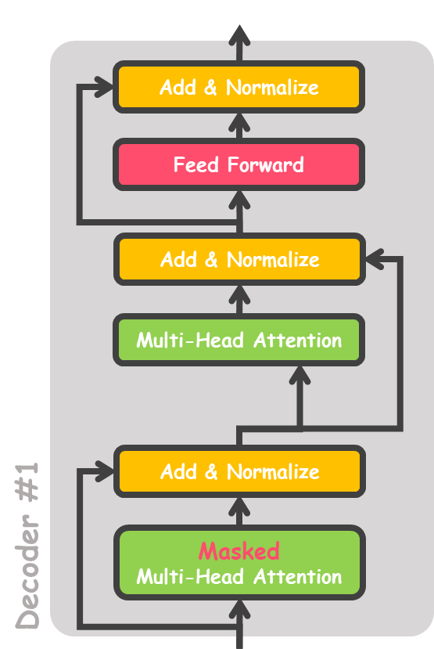
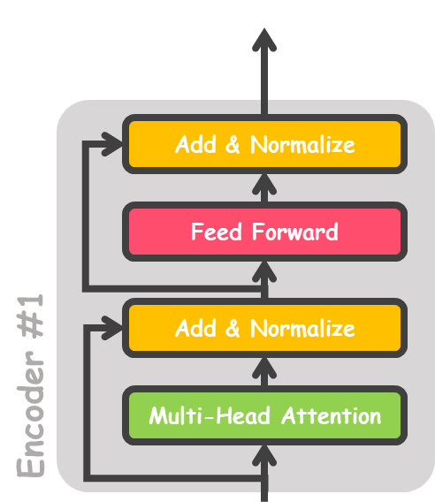

Slide 25
Hello
My
Friend
𝐲_{𝟏}
𝐲_{𝟐}
𝐲_{𝟑}
𝐡_{𝟑}
𝐡_{𝟎}
𝐡_{𝟑}
𝐱_{𝟏}
𝐱_{𝟐}
𝐱_{𝟑}
𝐲_{𝟏}
𝐲_{𝟐}
سلام
دوست
من
<sos>
Hello
My
Hello my friend
سلام دوست من
یعوـنـصمشوـه یـمداـکآ
howsam.org | مــسوــه

Slide 26
Hello
my
friend
Linear
Encoder
Decoder
سلام
دوست
من
<sos>
Hello
my

Slide 27
friend
my
hello
_{K}𝑇
Q
hello
my
friend
Decoder
+
=
QK^{𝑇} + Mask
𝑑_{𝑄}
Z = softmax
V
0 −∞ −∞
Mask = 0 0 −∞
0 0 0

Slide 28
−∞
zero

Slide 29
X₁: | 1 | 0 | 1 | 0 |  | 1 | 0 | 1 | 0
X₂: | 0 | 2 | 0 | 2 | → X = | 0 | 2 | 0 | 2 | W_{K} | =
0 0 1
1 1 0
0 1 0
1 1 0
1 0 1
1 0 0
0 0 1
0 1 1
0 2 0
0 3 0
1 0 3
1 1 0
W_{Q} =
W_{V} =
X :
1 1
1 1
1 1 1 1
3
0 0 1
1 1 0
0 1 0
1 1 0
0 1 1
4 4 0
2 3 1
Z
1 |  |  | 0 | 1 | 0
K = XW_{K} | = | 0 | 2 | 0 | 2 | ×
 |  | 1 | 1 | 1 | 1
=
1 0 1
1 0 0
0 0 1
0 1 1
Scaled Dot-Product Attention
1 0 1 0
0 2 0 2
1 1 1 1
1 0 2
2 2 2
2 1 3
Q = XW_{Q} =
×
=
V
Linear
K
Linear
Q
Linear
1 0 1 0
0 2 0 2
1 1 1 1
0 2 0
0 3 0
1 0 3
1 1 0
1 2 3
2 8 0
2 6 3
V = XW_{V} =
×
=
X

Slide 30
Z
1 0 2
2 2 2
2 1 3
0 4 2 2 4 4
1 4 3 = 4 16 12
1 0 1 4 12 10
MatMul
QK^{𝑇} =
×
SoftMax
QK^{𝑇}
2 4 4 1.15 2.30 2.30
= 4 16 12 / 3 = 2.30 9.23 6.92
4 12 10 2.30 6.92 5.77
𝑑_{𝑄}
Mask
QK^{𝑇}
1.15 2.30 2.30
2.30 9.23 6.92
2.30 6.92 5.77
0 −∞ −∞
0 0 −∞
0 0 0
1.15 −∞ −∞ 2.30 9.23 −∞ 2.30 6.92 5.77
+ Mask =
+
=
Scale
𝑑_{𝑄}
QK^{𝑇}
1.00 0.00 0.00
0.00 0.99 0.00
0.00 0.75 0.24
MatMul
softmax
=
𝑑_{𝑄}
K
Q
V
QK^{𝑇}
1.00 2.00 3.00
Z = softmax
V =
2 7.9 0
𝑄
1.99 7.48 0.74

Slide 31
Hello
My
Friend
𝐲_{𝟏}
𝐲_{𝟐}
𝐲_{𝟑}
𝐡_{𝟑}
𝐡_{𝟎}
𝐡_{𝟑}
𝐱_{𝟏}
𝐱_{𝟐}
𝐱_{𝟑}
𝐲_{𝟏}
𝐲_{𝟐}
سلام
دوست
من
<sos>
Hello
My
Hello my friend
سلام دوست من
یعوـنـصمشوـه یـمداـکآ
howsam.org | مــسوــه

Slide 33
Hello
my
friend
Linear
Encoder
Decoder
سلام
دوست
من
<sos>
Hello
my

Slide 34
Positional Encoding
Hello
my
friend
Linear
Encoder
Decoder
+
+
+
+
+
+
سلام
دوست
من
<sos>
Hello
my

Slide 35
Positional Encoding
سلام
+
دوست
من

Slide 36
1
₌ sin 𝜔_{𝑘}𝑡
𝑖 = 2𝑘
𝑖 = 2𝑘 + 1
{
𝜔_{𝑘} =
𝑃
2𝑘
10000 𝑑
𝑡,i
cos 𝜔_{𝑘}𝑡
i
t

Slide 37
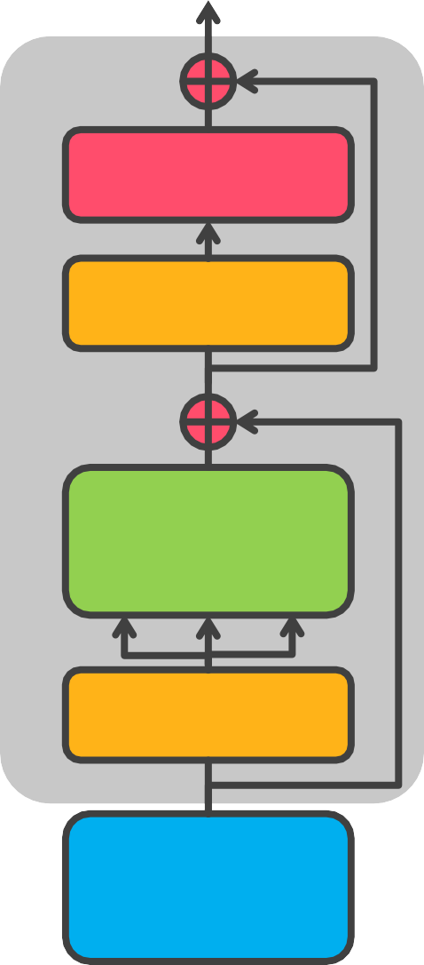
ViT
Class
Mlp Head
× 𝐿
MLP
Transformer Encoder
Norm
Patch + Position Embedding
0 * 1 2 3 4 5 6 7 8 9
Multi-Head
Attention
Linear Projection of Flatten Patches
Norm
Embedded Patches

