Slide 1
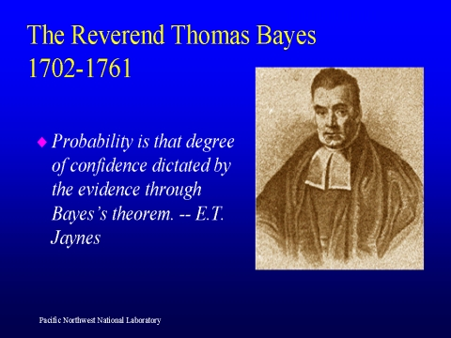
Lecture 06: Applications of Bayesian Decision Theory
Objectives:
Likelihood Functions
Minimum Error Rate
Likelihood Ratios
Decision Surfaces
Gaussian Classifiers
Threshold Decoding
Resources:
Textbook (Sections 9.3 – 9.6)
DHS: Chapter 2

Slide 2
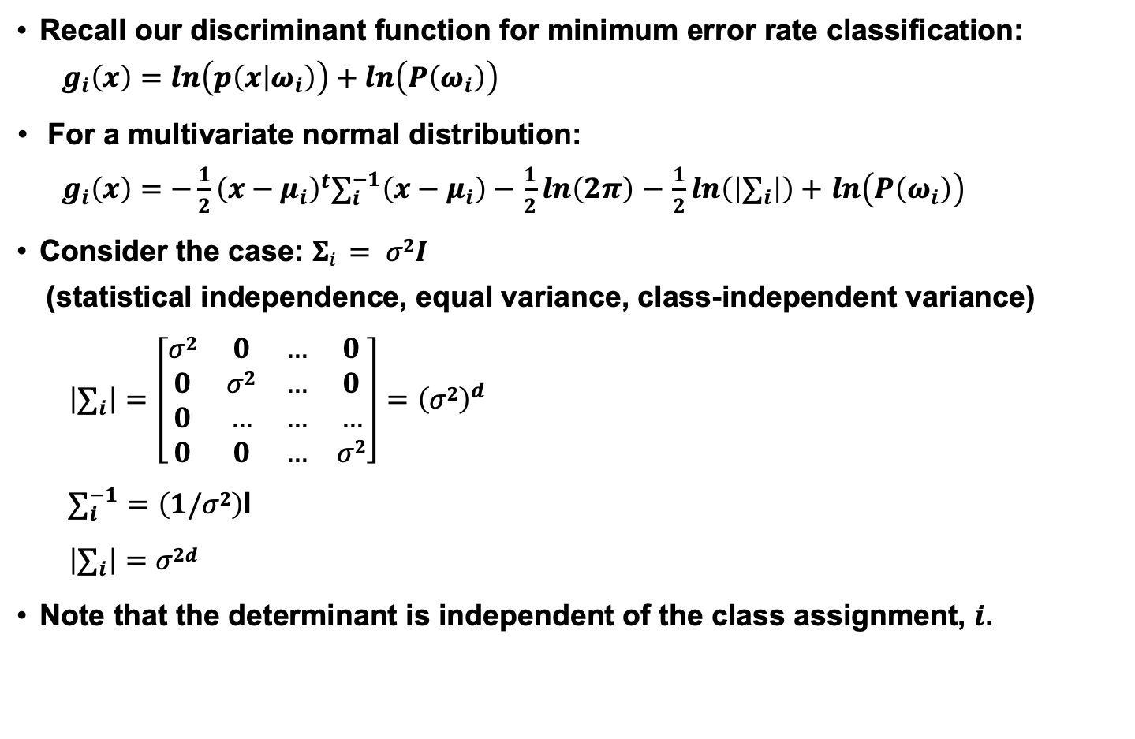
Discriminant Functions
Recall our discriminant function for minimum error rate classification:
$$g_{i}\left(x\right)=ln\left(p\left(x | ω_{i}\right)\right)+ln\left(P\left(ω_{i}\right)\right)$$
For a multivariate normal distribution:
$g_{i}\left(x\right)=−\frac{1}{2}{\left(x−μ_{i}\right)}^{t}∑_{i}^{−1}\left(x−μ_{i}\right)−$ $\frac{1}{2}ln\left(2π\right)$ $−$ $\frac{1}{2}ln\left(\left|∑_{i}\right|\right)+$ $ln\left(P\left(ω_{i}\right)\right)$
Consider the case: $Σi = σ2I$
(statistical independence, equal variance, class-independent variance)
$$\left|∑_{i}\right|=\left[\begin{matrix}σ2 & 0 & … & 0 \\ 0 & σ2 & … & 0 \\ 0 & … & … & … \\ 0 & 0 & … & σ2\end{matrix}\right]={\left(σ2\right)}^{d}$$
$∑_{i}^{−1}=\left(1/σ2\right)$I
$$\left|∑_{i}\right|=σ2d$$
Note that the determinant is independent of the class assignment, $i$.

Slide 3
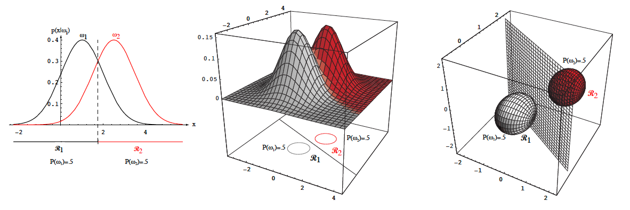
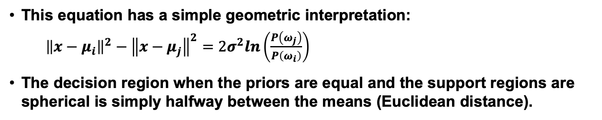
Threshold Decoding
This equation has a simple geometric interpretation:
${\left\|x−μ_{i}\right\|}^{2}−{\left\|x−μ_{j}\right\|}^{2}=2σ^{2}ln\left(\frac{P\left(ω_{j}\right)}{P\left(ω_{i}\right)}\right)$
The decision region when the priors are equal and the support regions are spherical is simply halfway between the means (Euclidean distance).

Slide 4
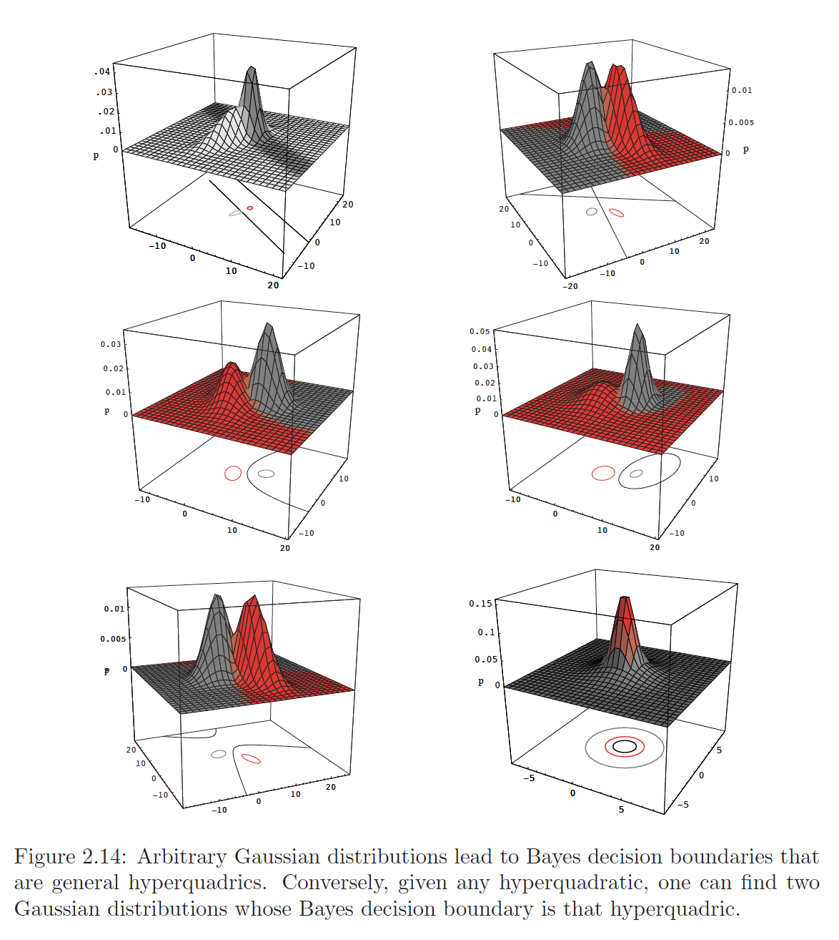
Two-Class 2D Decision Surfaces
From the Duda & Hart Pattern Recognition book linked in the syllabus.
Note the relationship between the decision surface and the support region.

Slide 5
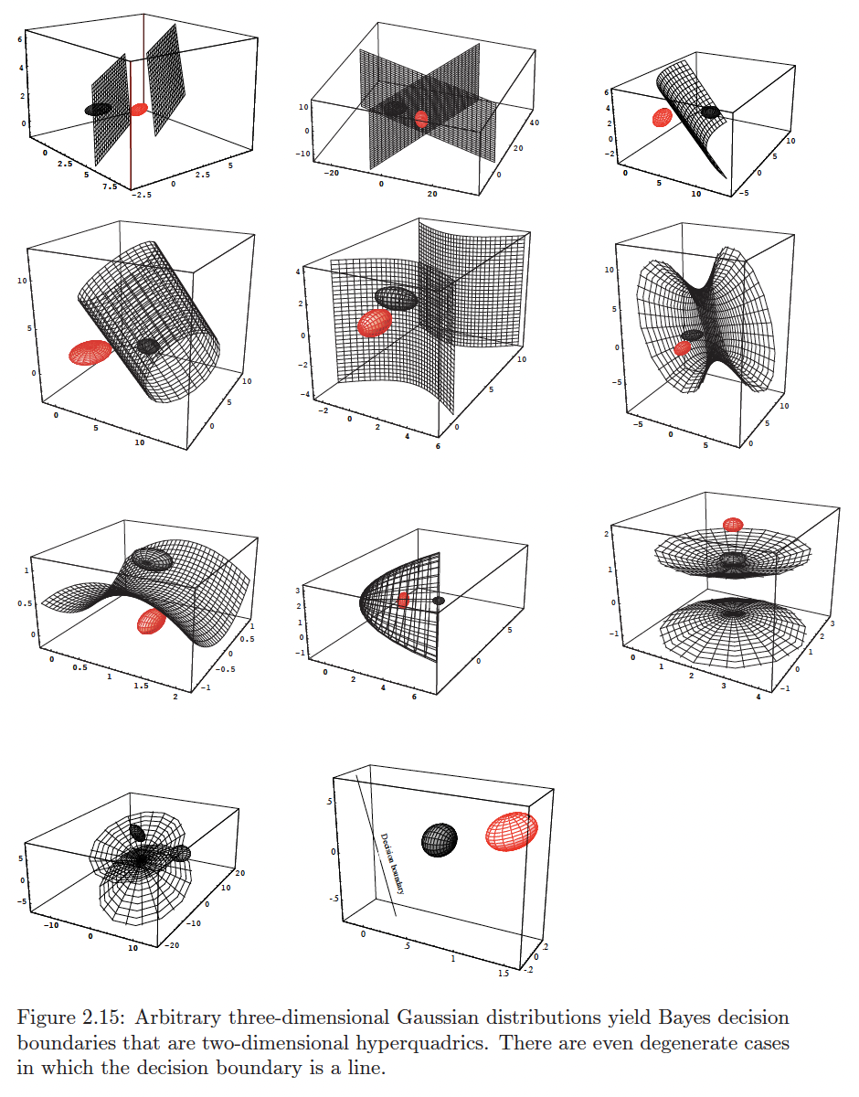
Two-Class 3D Decision Surfaces
From the Duda & Hart Pattern Recognition book linked in the syllabus.
Note the inputs are 3D vectors. We cannot visualize the distributions in 4D space.
But we can use the support regions to understand the decision surfaces.

Slide 6
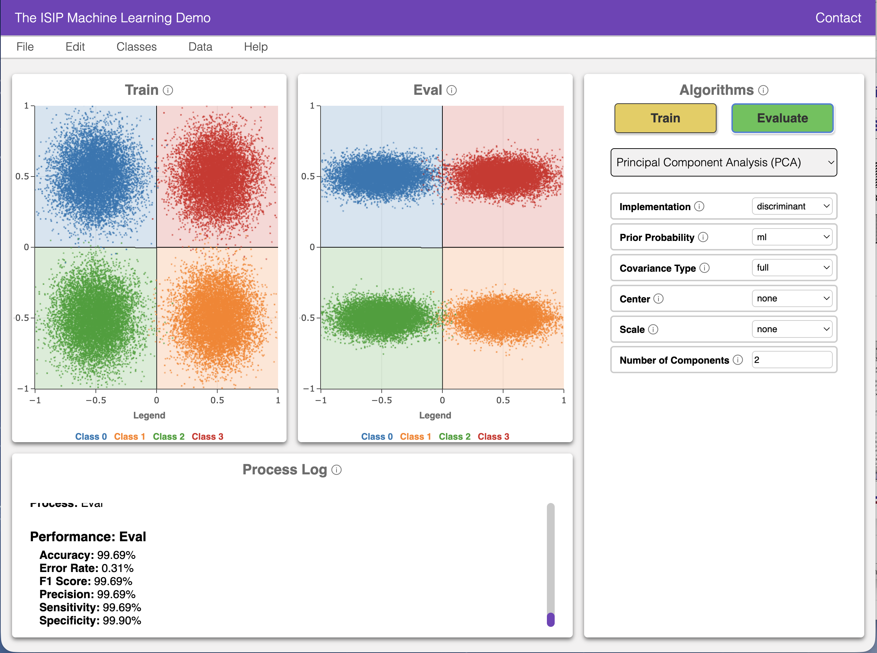
ISIP Machine Learning Demo (IMLD)
There are many excellent resources on the Internet that demonstrate pattern recognition concepts.
There are many Python, MATLAB and C++ toolboxes that implement state of the art algorithms.
One such resource is the ISIP Machine Learning Demo (IMLD) that lets you quickly explore how a variety of algorithms process the same data.
Users can create data sets with the application, save them to disk, or upload new data sets.
Users can select from a variety of machine learning algorithms.
Users can test generalization by creating training and open-set evaluation sets.
….
The application is written in Python using PyQT5, PyQtGraph and the Python machine learning package SciKit-Learn.
New: Client/server web–based app.
New: Includes quantum machine learning algorithms.

Slide 7
Summary
Discriminant Functions: the discriminant functions for Gaussian distributions have a simple geometric interpretation.
PCA vs. QDA: Traditional PCA uses a common, or pooled covariance matrix, for all classes. QDA is closer to the true Bayesian model and uses a class dependent covariance matrix.
Parameter Estimation (Things to Come): How do we estimate means, covariances and other model parameters? Hint: We also use machine learning/statistics.

