Slide 1
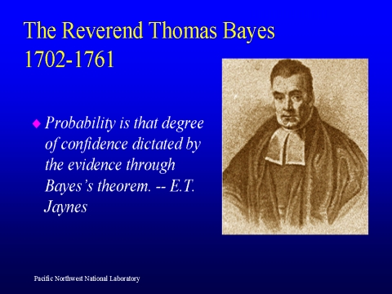
Lecture 05: Two Category Classification
Objectives:
Likelihood Functions
Minimum Error Rate
Likelihood Ratios
Decision Surfaces
Gaussian Classifiers
Threshold Decoding
Resources:
Textbook (Sections 9.1 – 9.2)
DHS: Chapter 2

Slide 2
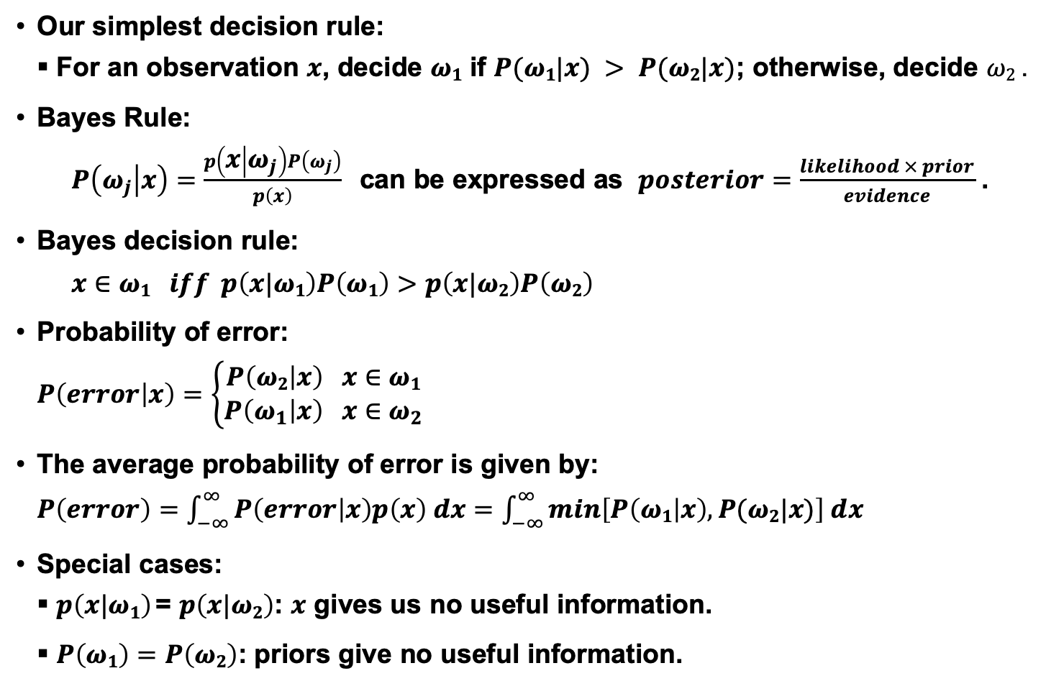
Posterior Probabilities
Our simplest decision rule:
For an observation $x$, decide $ω1$ if $P(ω1|x) > P(ω2|x)$; otherwise, decide $ω2$ .
Bayes Rule:
$P\left(ω_{j} | x\right)=\frac{p\left(x | ω_{j}\right)P\left(ω_{j}\right)}{p\left(x\right)}$ can be expressed as $posterior=\frac{likelihood × prior}{evidence}$ .
Bayes decision rule:
$$x∈ω1 iff p\left(x|ω1\right)P\left(ω1\right)>p\left(x|ω2\right)P\left(ω2\right)$$
Probability of error:
$$P\left(error | x\right)=\left\{\begin{matrix}P\left(ω2 | x\right) x∈ω1 \\ P\left(ω_{1} | x\right) x∈ω_{2}\end{matrix}\right.$$
The average probability of error is given by:
$P\left(error\right)=\int_{−∞}^{∞}{P\left(error | x\right)p\left(x\right) dx=}$ $\int_{−∞}^{∞}{min\left[P\left(ω1 | x\right),P(ω2|x)\right] dx}$
Special cases:
$p\left(x|ω1\right)$= $p\left(x|ω2\right)$: $x$ gives us no useful information.
$P\left(ω1\right)=P\left(ω2\right)$: priors give no useful information.

Slide 3
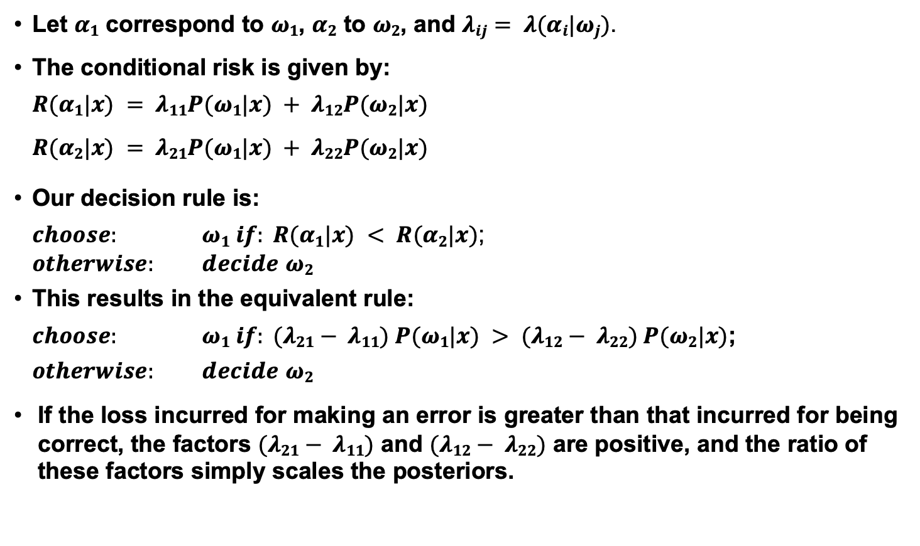
Two-Category Classification
Let $α1$ correspond to $ω1$, $α2$ to $ω2$, and $λij= λ(αi|ωj)$.
The conditional risk is given by:
$$R(α1|x) = λ11P(ω1|x) + λ12P(ω2|x)$$
$$R(α2|x) = λ21P(ω1|x) + λ22P(ω2|x)$$
Our decision rule is:
$choose:$ $ω1 if: R(α1|x) < R(α2|x)$; $otherwise:$ $decide$ $ω2$
This results in the equivalent rule:
$choose:$ $ω1 if: (λ21− λ11) P(ω1|x) > (λ12− λ22) P(ω2|x)$;
$otherwise:$ $decide$ $ω2$
If the loss incurred for making an error is greater than that incurred for being correct, the factors $(λ21− λ11)$ and $(λ12− λ22)$ are positive, and the ratio of these factors simply scales the posteriors.

Slide 4
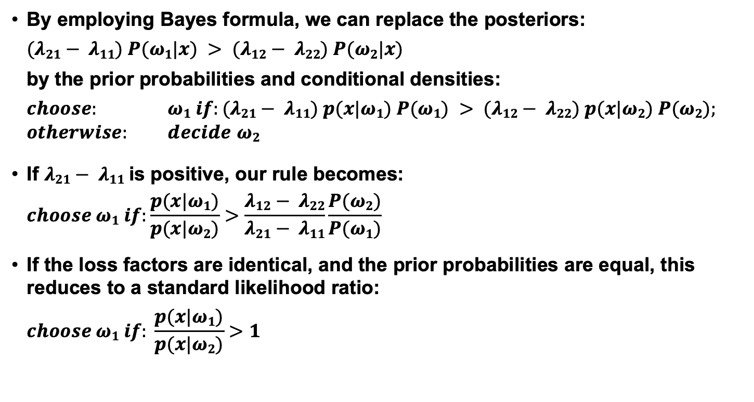
Likelihood
By employing Bayes formula, we can replace the posteriors:
$$(λ21− λ11) P(ω1|x) > (λ12− λ22) P(ω2|x)$$
by the prior probabilities and conditional densities:
$choose:$ $ω1 if:(λ21− λ11) p(x|ω1) P(ω1) > (λ12− λ22) p(x|ω2) P(ω2);$ $otherwise:$ $decide$ $ω2$
If $λ21− λ11$is positive, our rule becomes:
$$choose ω1 if:\frac{p(x|ω1)}{p(x|ω2)}>\frac{λ12− λ22}{λ21− λ11}\frac{P(ω2)}{P(ω1)}$$
If the loss factors are identical, and the prior probabilities are equal, this reduces to a standard likelihood ratio:
$$choose ω1 if: \frac{p(x|ω1)}{p(x|ω2)}>1$$

Slide 5
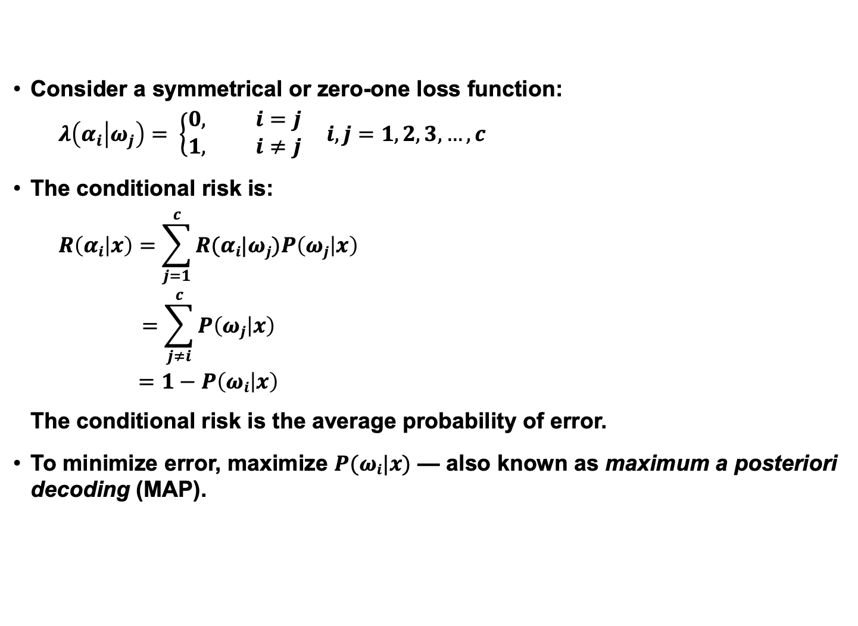
Minimum Error Rate
Consider a symmetrical or zero-one loss function:
$$λ\left(α_{i} | ω_{j}\right)= \left\{\begin{matrix}0, i=j \\ 1, i≠j\end{matrix} i,j=1, 2, 3, …, c\right.$$
The conditional risk is:
$$\begin{matrix}R\left(αi | x\right)=\sum_{j=1}^{c}{R(αi|ωj)P\left(ωj | x\right)} \\ =\sum_{j≠i}^{c}{P\left(ωj | x\right)} \\ =1−P\left(ωi | x\right)\end{matrix}$$
The conditional risk is the average probability of error.
To minimize error, maximize $P(ωi|x)$ — also known as maximum a posteriori decoding (MAP).

Slide 6
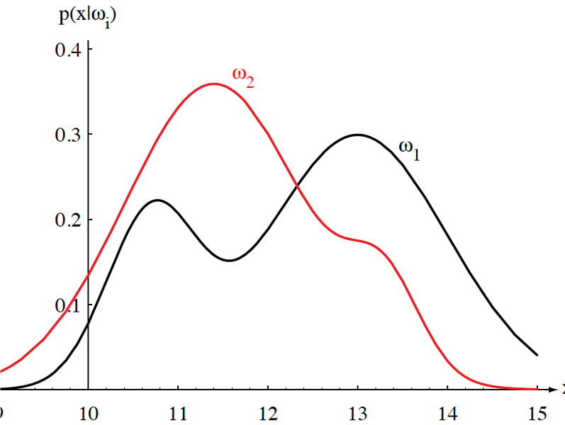
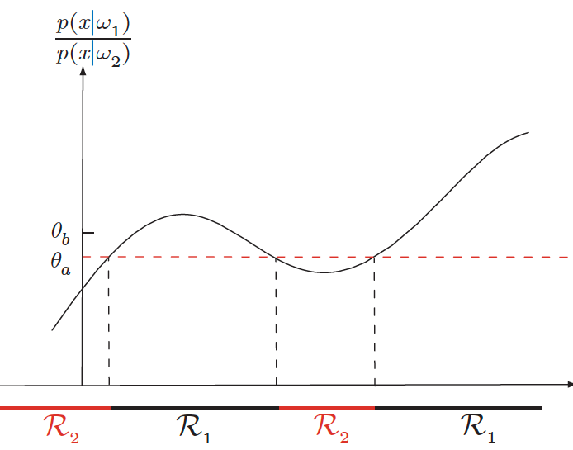
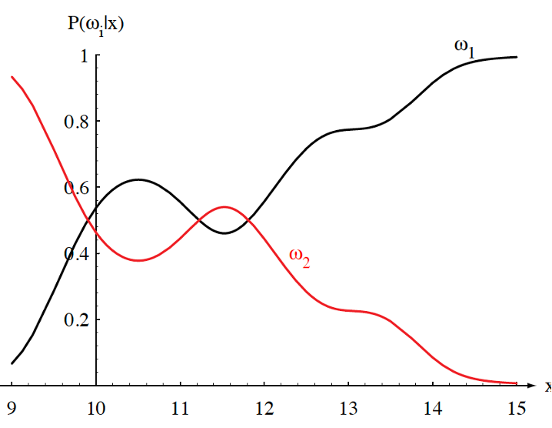

Likelihood Ratio
Minimum error rate classification:
$$choose ωi if: P(ωi| x) > P(ωj| x) for all j≠i$$

Slide 7
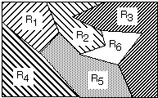
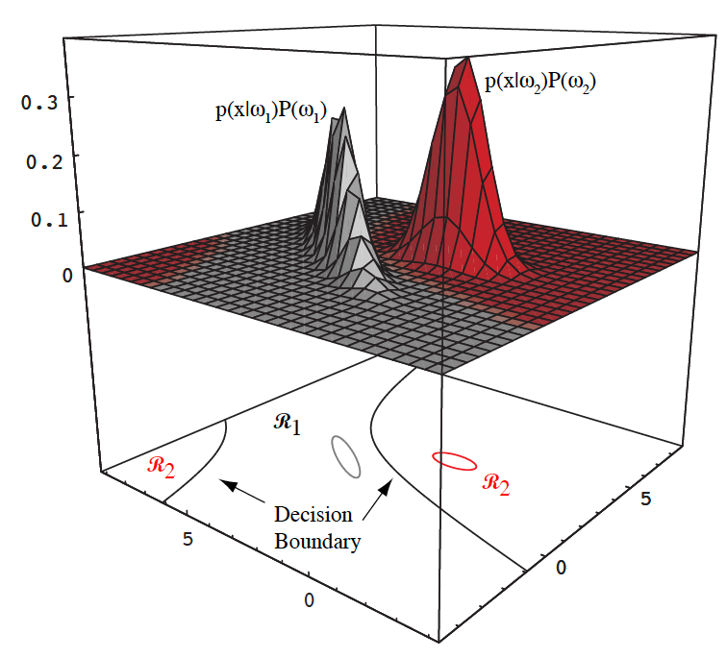

Decision Surfaces
We can visualize our decision rule several ways:

Slide 8
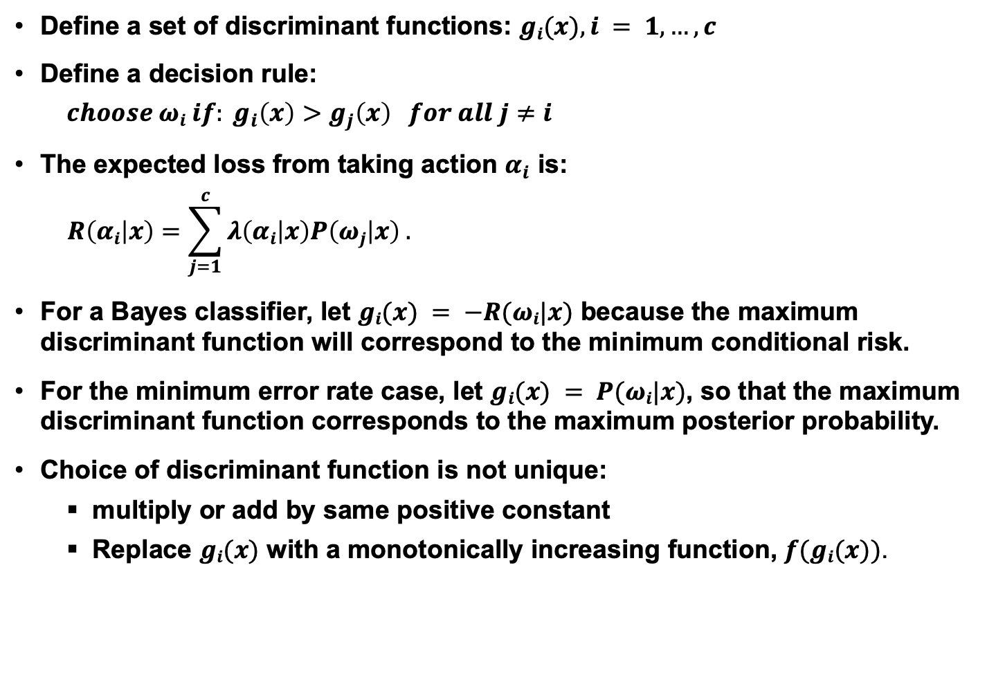
Multicategory Decision Surfaces
Define a set of discriminant functions: $gi(x), i = 1,…, c$
Define a decision rule:
$$choose ωi if: g_{i}\left(x\right)>g_{j}\left(x\right) for all j≠i$$
The expected loss from taking action $α_{i}$ is:
$$R\left(αi | x\right)=\sum_{j=1}^{c}{λ\left(αi | x\right)P\left(ωj | x\right) .}$$
For a Bayes classifier, let $gi(x) = −R(ωi|x)$ because the maximum discriminant function will correspond to the minimum conditional risk.
For the minimum error rate case, let $gi(x) = P(ωi|x)$, so that the maximum discriminant function corresponds to the maximum posterior probability.
Choice of discriminant function is not unique:
multiply or add by same positive constant
Replace $gi(x)$ with a monotonically increasing function, $f(gi(x))$.

Slide 9

Log Probabilities
Some monotonically increasing functions can simplify calculations considerably:
$g_{i}\left(x\right)=P\left(ω_{i} | x\right)=\frac{p\left(x | ω_{i}\right)P\left(ω_{i}\right)}{\sum_{j=1}^{c}{p\left(x | ω_{j}\right)P\left(ω_{j}\right)}}$ (1)
$g_{i}\left(x\right)=$ $p\left(x | ω_{i}\right)P\left(ω_{i}\right)$ (2)
$f\left(g_{i}\left(x\right)\right)=ln\left(g_{i}\left(x\right)\right)=ln\left(p\left(x | ω_{i}\right)\right)+ln\left(P\left(ω_{i}\right)\right)$ (3)
What are some of the reasons (3) is particularly useful?
Computational complexity (e.g., Gaussian)
Numerical accuracy (e.g., probabilities tend to zero)
Decomposition (e.g., likelihood and prior are separated and can be weighted differently)
Normalization (e.g., likelihoods are channel dependent).

Slide 10
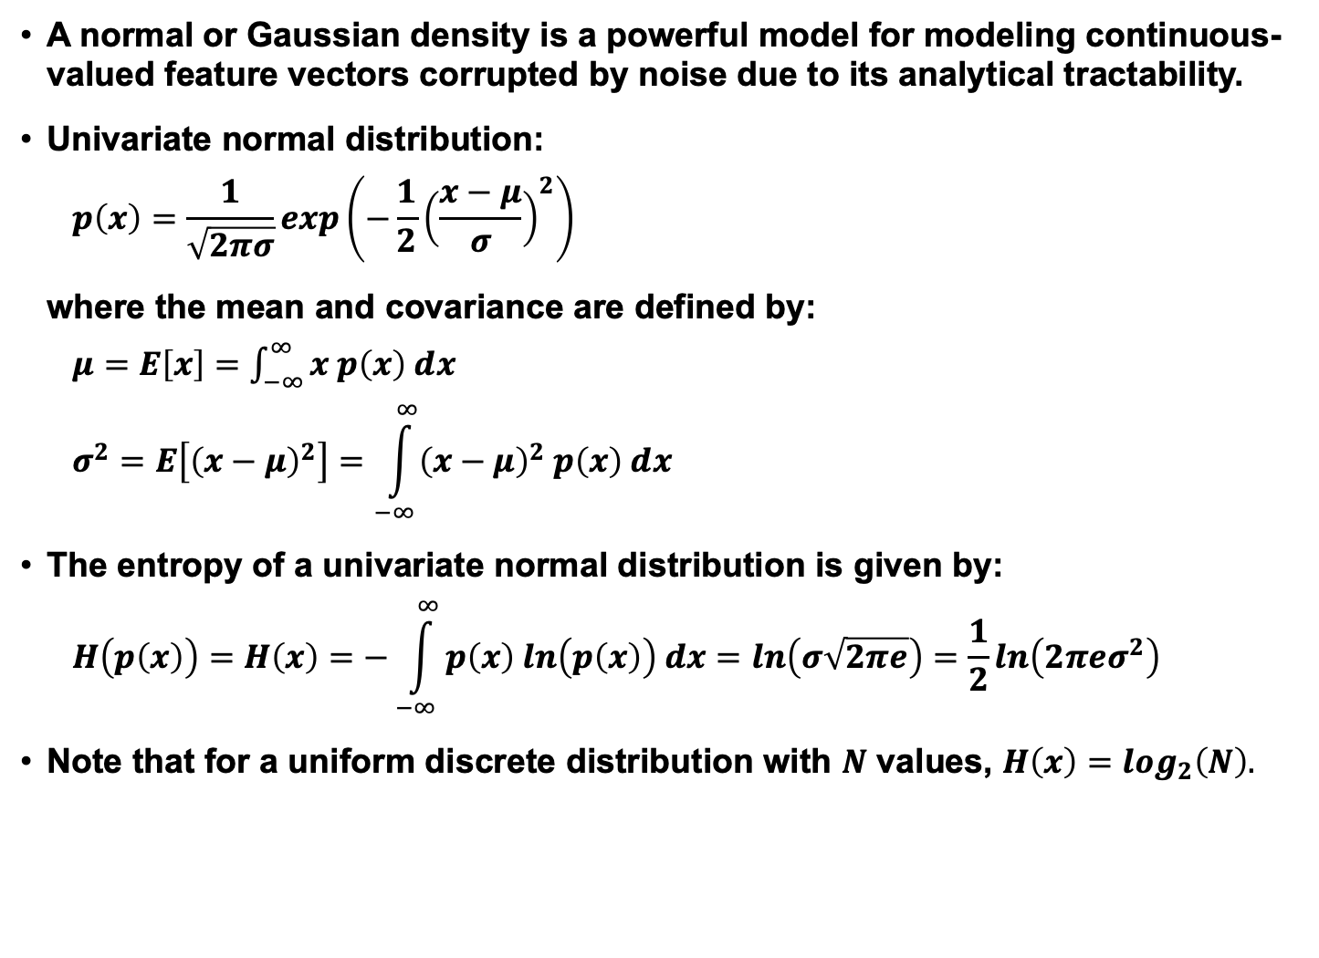
Univariate Normal Distribution
A normal or Gaussian density is a powerful model for modeling continuous-valued feature vectors corrupted by noise due to its analytical tractability.
Univariate normal distribution:
$$p\left(x\right)=\frac{1}{\sqrt{2πσ}}exp\left(−\frac{1}{2}{\left(\frac{x−μ}{σ}\right)}^{2}\right)$$
where the mean and covariance are defined by:
$μ=E\left[x\right]=$ $\int_{−∞}^{∞}{x p\left(x\right) dx}$
$$σ^{2}=E\left[{\left(x−μ\right)}^{2}\right]=\int_{−∞}^{∞}{{\left(x−μ\right)}^{2} p\left(x\right) dx}$$
The entropy of a univariate normal distribution is given by:
$$H\left(p\left(x\right)\right)=H\left(x\right)=−\int_{−∞}^{∞}{p\left(x\right) ln\left(p\left(x\right)\right) dx=ln\left(σ\sqrt{2πe}\right)=\frac{1}{2}ln\left(2πeσ^{2}\right)}$$
Note that for a uniform discrete distribution with $N$ values, $H\left(x\right)=\log_{2}\left(N\right).$

Slide 11

Multivariate Gaussian (Normal) Distributions
Recall the definition of a normal distribution (Gaussian):
$$p\left(x\right)=\frac{1}{\left({2π}^{d/2}\right){\left|Σ\right|}^{1/2}}exp\left(−\frac{1}{2}{\left(x−μ\right)}^{t}Σ^{−1}\left(x−μ\right)\right)$$
Why is this distribution so important in engineering?
Mean: $μ=E\left[x\right]$ $=\int_{−∞}^{∞}{x p\left(x\right) dx}$
Covariance: $∑=E\left[{\left(x−μ\right)\left(x−μ\right)}^{t}\right]$
Statistical independence?
Higher-order moments?
Occam’s Razor?
Entropy?
Linear combinations of normal random variables?
Central Limit Theorem?

Slide 12
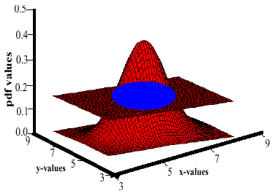
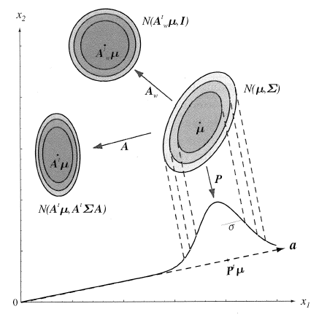
Support Regions
A support region is the obtained by the intersection of a Gaussian distribution with a plane.
For a horizontal plane, this generates an ellipse whose points are of equal probability density.
The shape of the support region is defined by the covariance matrix.

Slide 13
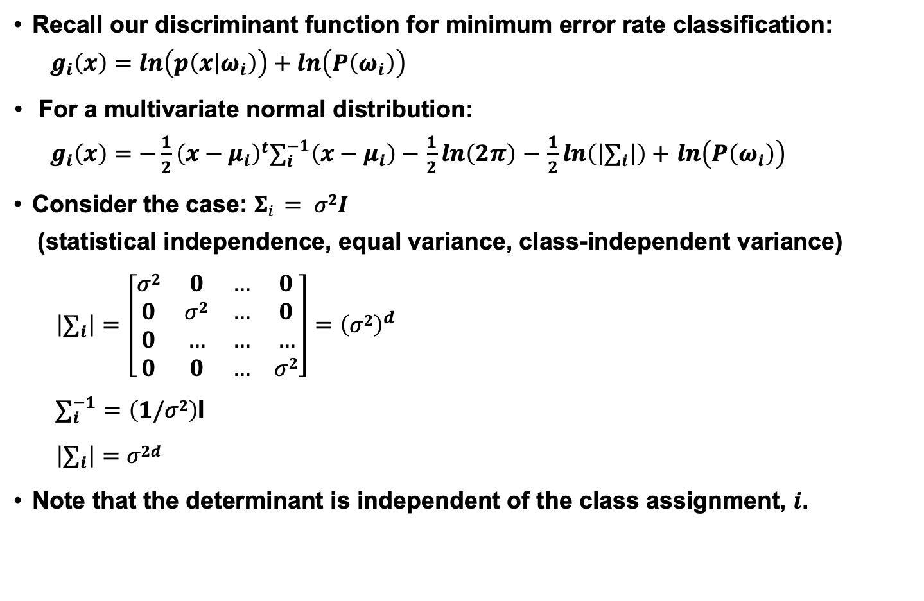
Discriminant Functions
Recall our discriminant function for minimum error rate classification:
$$g_{i}\left(x\right)=ln\left(p\left(x | ω_{i}\right)\right)+ln\left(P\left(ω_{i}\right)\right)$$
For a multivariate normal distribution:
$g_{i}\left(x\right)=−\frac{1}{2}{\left(x−μ_{i}\right)}^{t}∑_{i}^{−1}\left(x−μ_{i}\right)−$ $\frac{1}{2}ln\left(2π\right)$ $−$ $\frac{1}{2}ln\left(\left|∑_{i}\right|\right)+$ $ln\left(P\left(ω_{i}\right)\right)$
Consider the case: $Σi = σ2I$
(statistical independence, equal variance, class-independent variance)
$$\left|∑_{i}\right|=\left[\begin{matrix}σ2 & 0 & … & 0 \\ 0 & σ2 & … & 0 \\ 0 & … & … & … \\ 0 & 0 & … & σ2\end{matrix}\right]={\left(σ2\right)}^{d}$$
$∑_{i}^{−1}=\left(1/σ2\right)$I
$$\left|∑_{i}\right|=σ2d$$
Note that the determinant is independent of the class assignment, $i$.

Slide 14
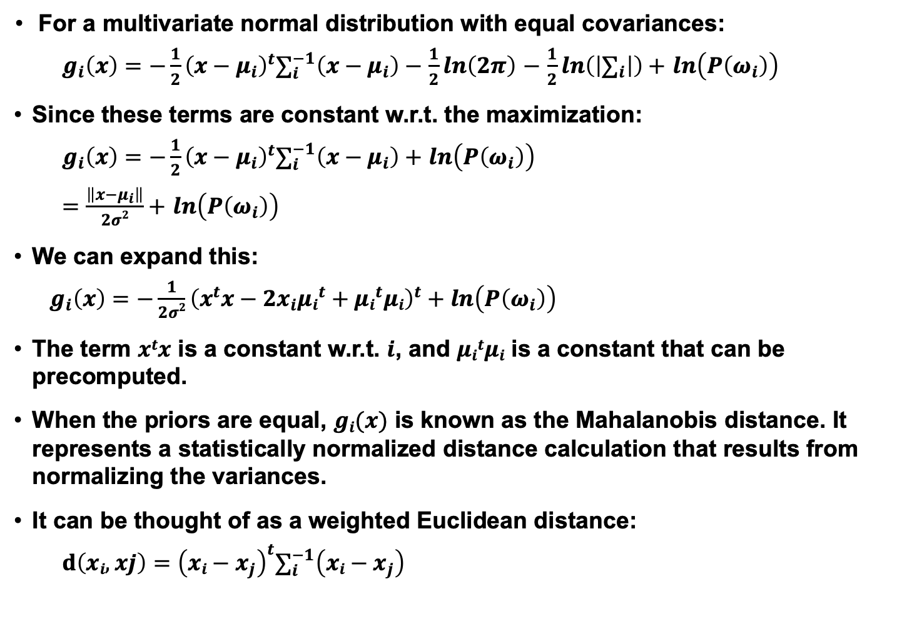
Gaussian Classifiers
For a multivariate normal distribution with equal covariances:
$g_{i}\left(x\right)=−\frac{1}{2}{\left(x−μ_{i}\right)}^{t}∑_{i}^{−1}\left(x−μ_{i}\right)−$ $\frac{1}{2}ln\left(2π\right)$ $−$ $\frac{1}{2}ln\left(\left|∑_{i}\right|\right)+$ $ln\left(P\left(ω_{i}\right)\right)$
Since these terms are constant w.r.t. the maximization:
$g_{i}\left(x\right)=−\frac{1}{2}{\left(x−μ_{i}\right)}^{t}∑_{i}^{−1}\left(x−μ_{i}\right)+$ $ln\left(P\left(ω_{i}\right)\right)$
$=\frac{\left\|x−μ_{i}\right\|}{2σ2}+$ $ln\left(P\left(ω_{i}\right)\right)$
We can expand this:
$g_{i}\left(x\right)=−\frac{1}{2σ2}{\left(x^{t}x−{2x}_{i}{μi}^{t}+{μi}^{t}μi\right)}^{t}+$ $ln\left(P\left(ω_{i}\right)\right)$
The term $xtx$ is a constant w.r.t. $i$, and $μitμi$ is a constant that can be precomputed.
When the priors are equal, $gi(x)$ is known as the Mahalanobis distance. It represents a statistically normalized distance calculation that results from normalizing the variances.
It can be thought of as a weighted Euclidean distance:
$$d\left(xi,xj\right)={\left(xi−x_{j}\right)}^{t}∑_{i}^{−1}\left(xi−x_{j}\right)$$

Slide 15
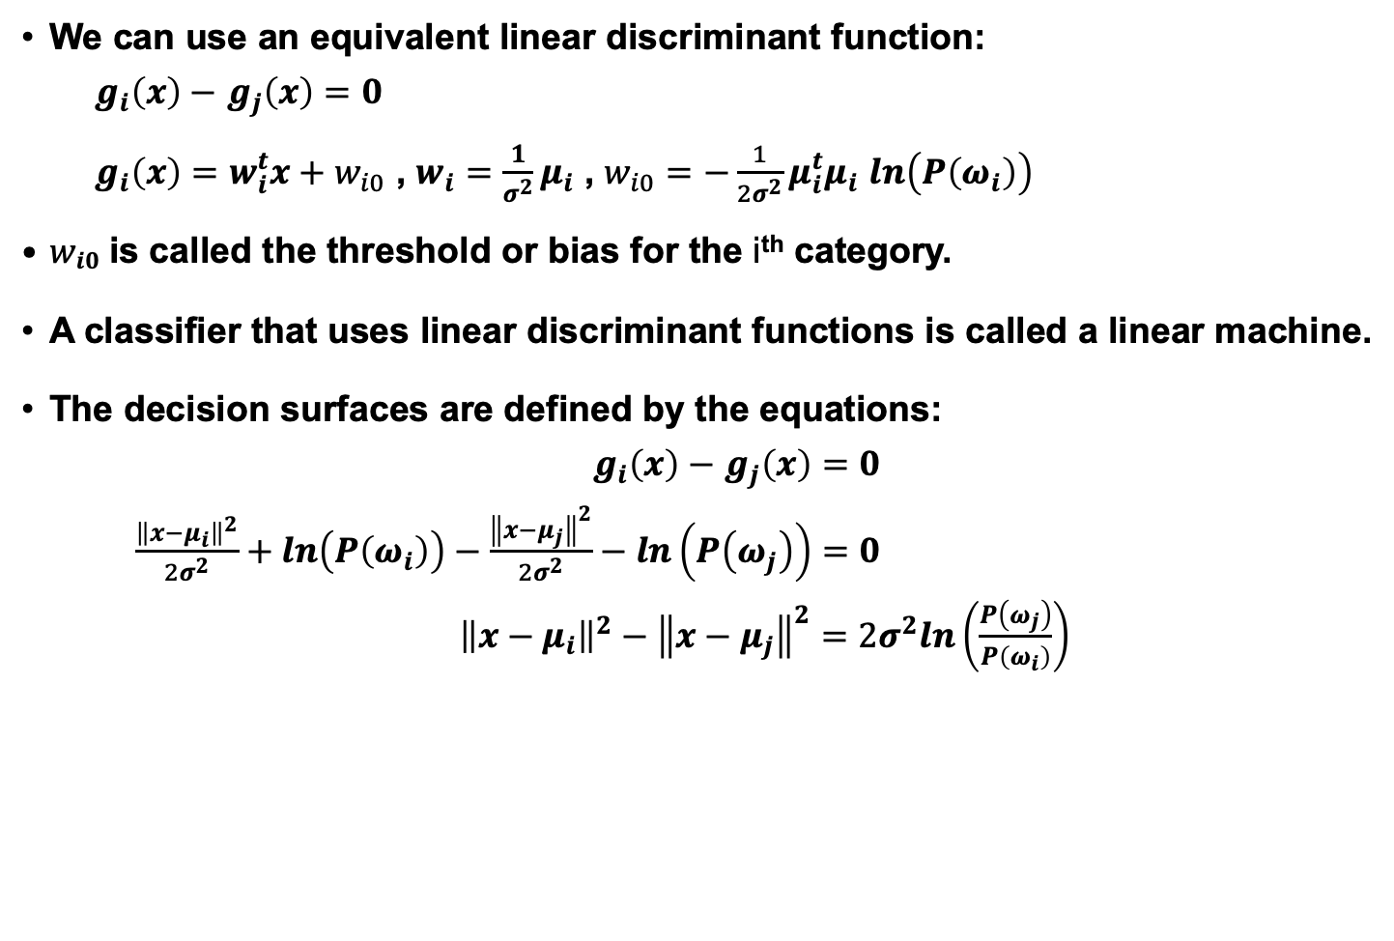
Linear Machines
We can use an equivalent linear discriminant function:
$g_{i}\left(x\right)−$ $g_{j}\left(x\right)=0$
$g_{i}\left(x\right)=w_{i}^{t}x+w_{i0}$ , $w_{i}=\frac{1}{σ^{2}}μ_{i}$ , $w_{i0}=−\frac{1}{2σ^{2}}{μ_{i}^{t}μ}_{i}$ $ln\left(P\left(ω_{i}\right)\right)$
$wi0$ is called the threshold or bias for the i^{th} category.
A classifier that uses linear discriminant functions is called a linear machine.
The decision surfaces are defined by the equations:
$g_{i}\left(x\right)−$ $g_{j}\left(x\right)=0$
$\frac{{\left\|x−μ_{i}\right\|}^{2}}{2σ^{2}}+ln\left(P\left(ω_{i}\right)\right)−\frac{{\left\|x−μ_{j}\right\|}^{2}}{2σ^{2}}−ln\left(P\left(ω_{j}\right)\right)=0$
${\left\|x−μ_{i}\right\|}^{2}−{\left\|x−μ_{j}\right\|}^{2}=2σ^{2}ln\left(\frac{P\left(ω_{j}\right)}{P\left(ω_{i}\right)}\right)$

Slide 16
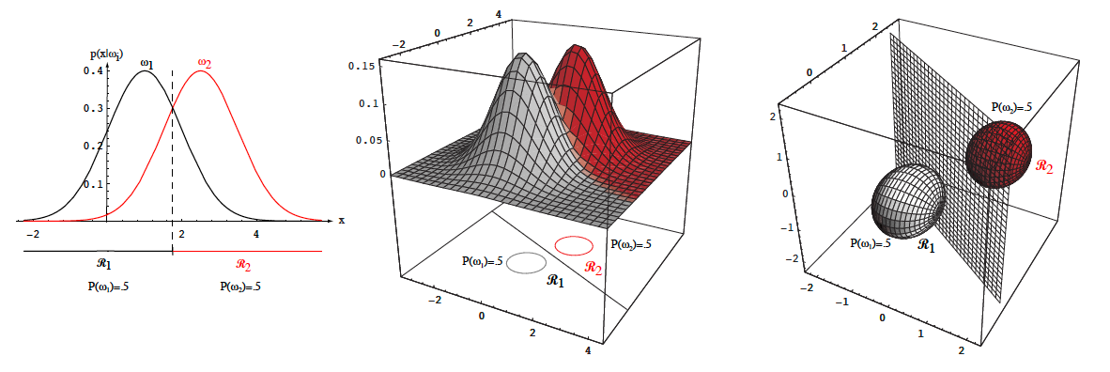
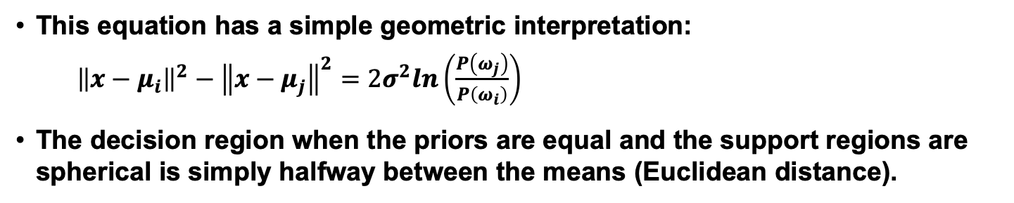
Threshold Decoding
This equation has a simple geometric interpretation:
${\left\|x−μ_{i}\right\|}^{2}−{\left\|x−μ_{j}\right\|}^{2}=2σ^{2}ln\left(\frac{P\left(ω_{j}\right)}{P\left(ω_{i}\right)}\right)$
The decision region when the priors are equal and the support regions are spherical is simply halfway between the means (Euclidean distance).

Slide 17
Summary
Prior Probabilities: reflect our knowledge of the problem, which comes from “subject matter expertise.”
Likelihoods: A model that assesses the probability a specific feature vector could have occurred from a specific class.
Posterior Probabilities: the probability a class occurred given a specific feature vector (converts a measurement to a probability that it came from a specific class).
Likelihood Ratio: a simple decision rule or method for evaluating a classifier over a range of operating conditions. Convenient for two-class problems.
Bayes Rule: factors a posterior into a combination of a likelihood, prior and the evidence. Is this the only appropriate engineering model?
Bayes Decision Rule: choose the class that has the highest posterior.
Decision Criteria: Several viable choices for decision rules. The shape of the decision surface is influenced by the number of categories and the statistics of the data.
Bayes Risk: what is its relation to performance?
Minimum Error Rate: How do we compute it?

Slide 18
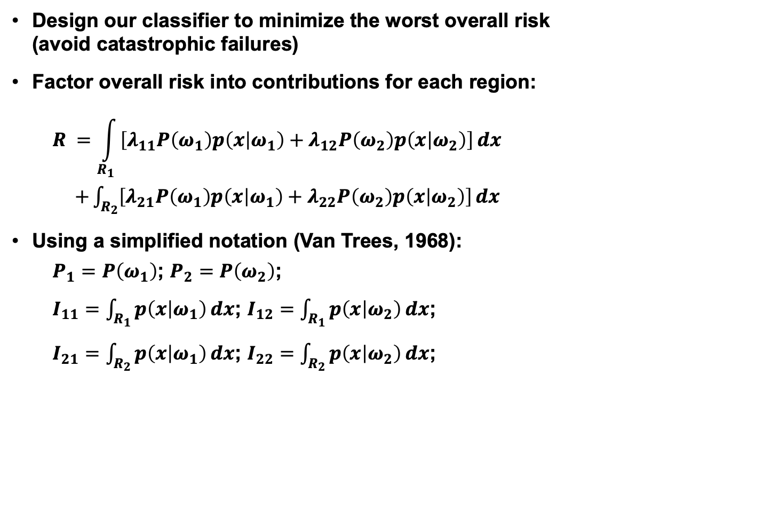
Minimax Criterion
Design our classifier to minimize the worst overall risk (avoid catastrophic failures)
Factor overall risk into contributions for each region:
$$R =\int_{R_{1}}{\left[λ_{11}P\left(ω_{1}\right)p\left(x | ω_{1}\right)+λ_{12}P\left(ω_{2}\right)p\left(x | ω_{2}\right)\right]ⅆx}$$ $+\int_{R_{2}}{\left[λ_{21}P\left(ω_{1}\right)p\left(x | ω_{1}\right)+λ_{22}P\left(ω_{2}\right)p\left(x | ω_{2}\right)\right]ⅆx}$
Using a simplified notation (Van Trees, 1968):
$P_{1}=$ $P\left(ω_{1}\right)$; $P_{2}=$ $P\left(ω_{2}\right)$;
$I_{11}=$ $\int_{R_{1}}{p\left(x | ω_{1}\right)ⅆx}$; $I_{12}=$ $\int_{R_{1}}{p\left(x | ω_{2}\right)ⅆx}$;
$I_{21}=$ $\int_{R_{2}}{p\left(x | ω_{1}\right)ⅆx}$; $I_{22}=$ $\int_{R_{2}}{p\left(x | ω_{2}\right)ⅆx}$;

Slide 19
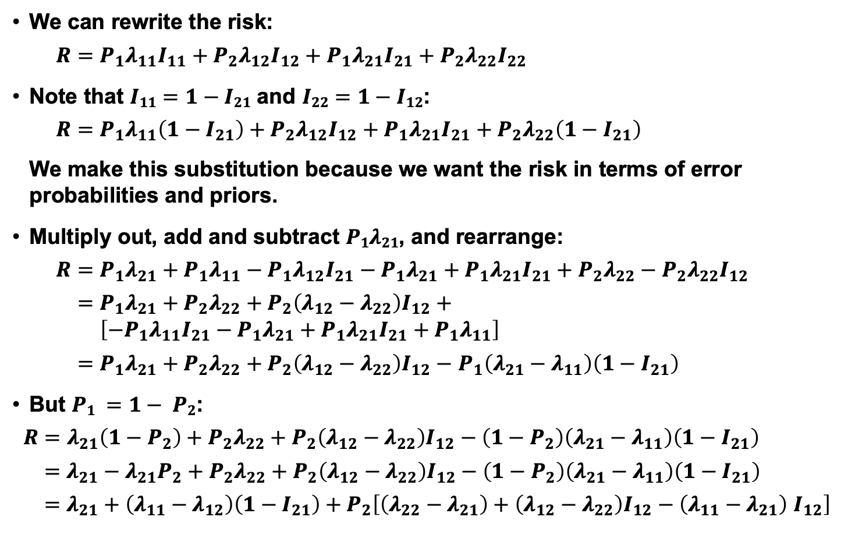
Minimax Criterion
We can rewrite the risk:
$$R=P_{1}λ_{11}I_{11}+P_{2}λ_{12}I_{12}+P_{1}λ_{21}I_{21}+P_{2}λ_{22}I_{22}$$
Note that $I11=1−I21$ and $I22=1−I12$:
$$R=P_{1}λ_{11}\left(1−I_{21}\right)+P_{2}λ_{12}I_{12}+P_{1}λ_{21}I_{21}+P_{2}λ_{22}\left(1−I_{21}\right)$$
We make this substitution because we want the risk in terms of error probabilities and priors.
Multiply out, add and subtract $P1λ21$, and rearrange:
$$R=P_{1}λ_{21}+P_{1}λ_{11}−P_{1}λ_{12}I_{21}−P_{1}λ_{21}+P_{1}λ_{21}I_{21}+P_{2}λ_{22}−P_{2}λ_{22}I_{12}$$
$=P_{1}λ_{21}+P_{2}λ_{22}+P_{2}\left(λ_{12}−λ_{22}\right)I_{12}+$ $\left[{−P}_{1}λ_{11}I_{21}−P_{1}λ_{21}+P_{1}λ_{21}I_{21}+P_{1}λ_{11}\right]$
$=P_{1}λ_{21}+P_{2}λ_{22}+P_{2}\left(λ_{12}−λ_{22}\right)I_{12}−$ $P_{1}\left(λ_{21}−λ_{11}\right)\left(1−I_{21}\right)$
But $P1 =1− P2$:
$R=$ $λ_{21}\left(1−P_{2}\right)+P_{2}λ_{22}+P_{2}\left(λ_{12}−λ_{22}\right)I_{12}−\left(1−P_{2}\right)\left(λ_{21}−λ_{11}\right)\left(1−I_{21}\right)$
$=$ $λ_{21}−λ_{21}P_{2}+P_{2}λ_{22}+P_{2}\left(λ_{12}−λ_{22}\right)I_{12}−\left(1−P_{2}\right)\left(λ_{21}−λ_{11}\right)\left(1−I_{21}\right)$
$=$ $λ_{21}+\left(λ_{11}−λ_{12}\right)\left(1−I_{21}\right)+P_{2}\left[\left(λ_{22}−λ_{21}\right)+{\left(λ_{12}−λ_{22}\right)I}_{12}−\left(λ_{11}−λ_{21}\right) I_{12}\right]$

Slide 20
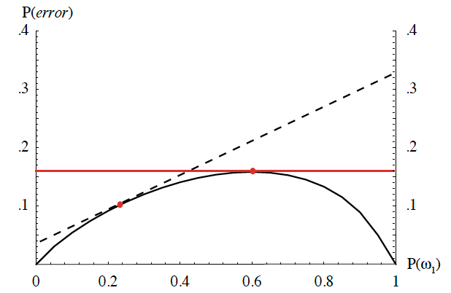
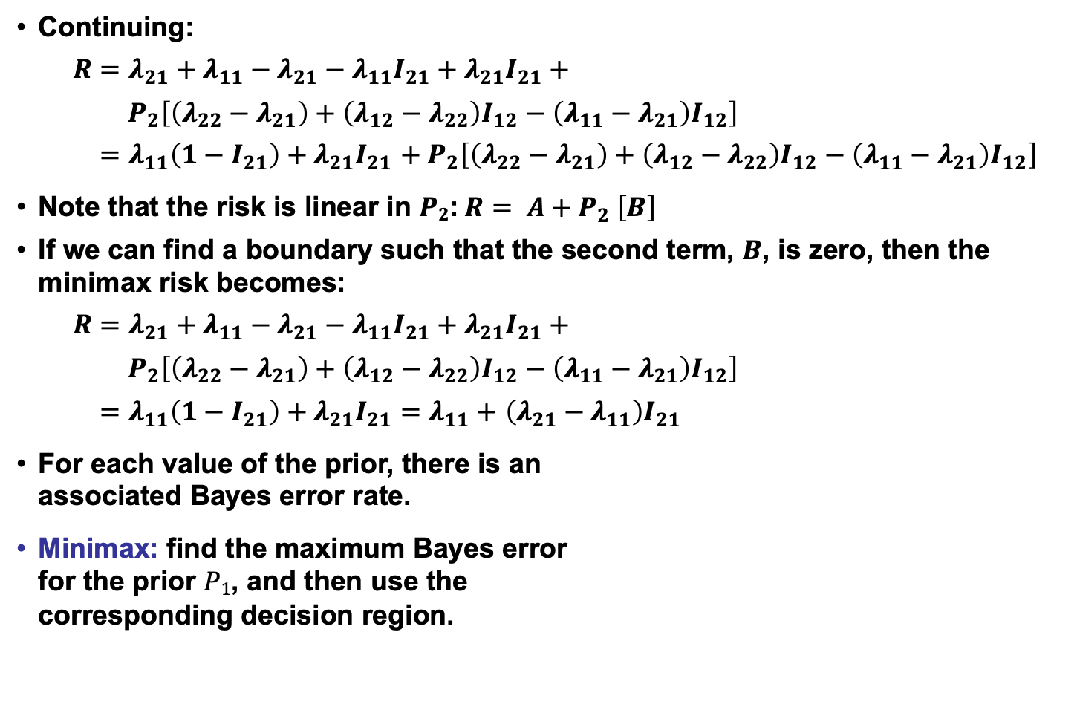
Minimax Criterion (Cont.)
Continuing:
$R=$ $λ_{21}+λ_{11}−λ_{21}−λ_{11}I_{21}+λ_{21}I_{21}+$
$P_{2}\left[\left(λ_{22}−λ_{21}\right)+\left(λ_{12}−λ_{22}\right)I_{12}−\left(λ_{11}−λ_{21}\right)I_{12}\right]$
$=$ $λ_{11}\left(1−I_{21}\right)+λ_{21}I_{21}$ ${+ P}_{2}\left[\left(λ_{22}−λ_{21}\right)+\left(λ_{12}−λ_{22}\right)I_{12}−\left(λ_{11}−λ_{21}\right)I_{12}\right]$
Note that the risk is linear in $P2$:$R= A{+ P}_{2}\left[B\right]$
If we can find a boundary such that the second term, $B$, is zero, then the minimax risk becomes:
$R=$ $λ_{21}+λ_{11}−λ_{21}−λ_{11}I_{21}+λ_{21}I_{21}+$
$P_{2}\left[\left(λ_{22}−λ_{21}\right)+\left(λ_{12}−λ_{22}\right)I_{12}−\left(λ_{11}−λ_{21}\right)I_{12}\right]$
$=$ $λ_{11}\left(1−I_{21}\right)+λ_{21}I_{21}=$ $λ_{11}+$ $\left(λ_{21}−λ_{11}\right)I_{21}$
For each value of the prior, there is an associated Bayes error rate.
Minimax: find the maximum Bayes error for the prior $P1$, and then use the corresponding decision region.

Slide 21

Neyman-Pearson Criterion
Guarantee the total risk is less than some fixed constant (or cost).
Minimize the risk subject to the constraint:
$$\int{R\left(α_{i} | x\right)ⅆx< constant}$$
(e.g., must not misclassify more than 1% of salmon as sea bass).
Typically must adjust boundaries numerically.
For some distributions (e.g., Gaussian), analytical solutions do exist.

