Slide 1
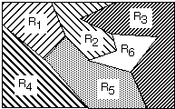
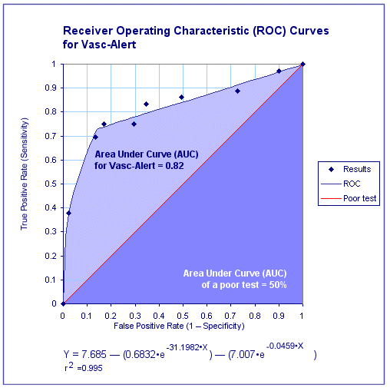
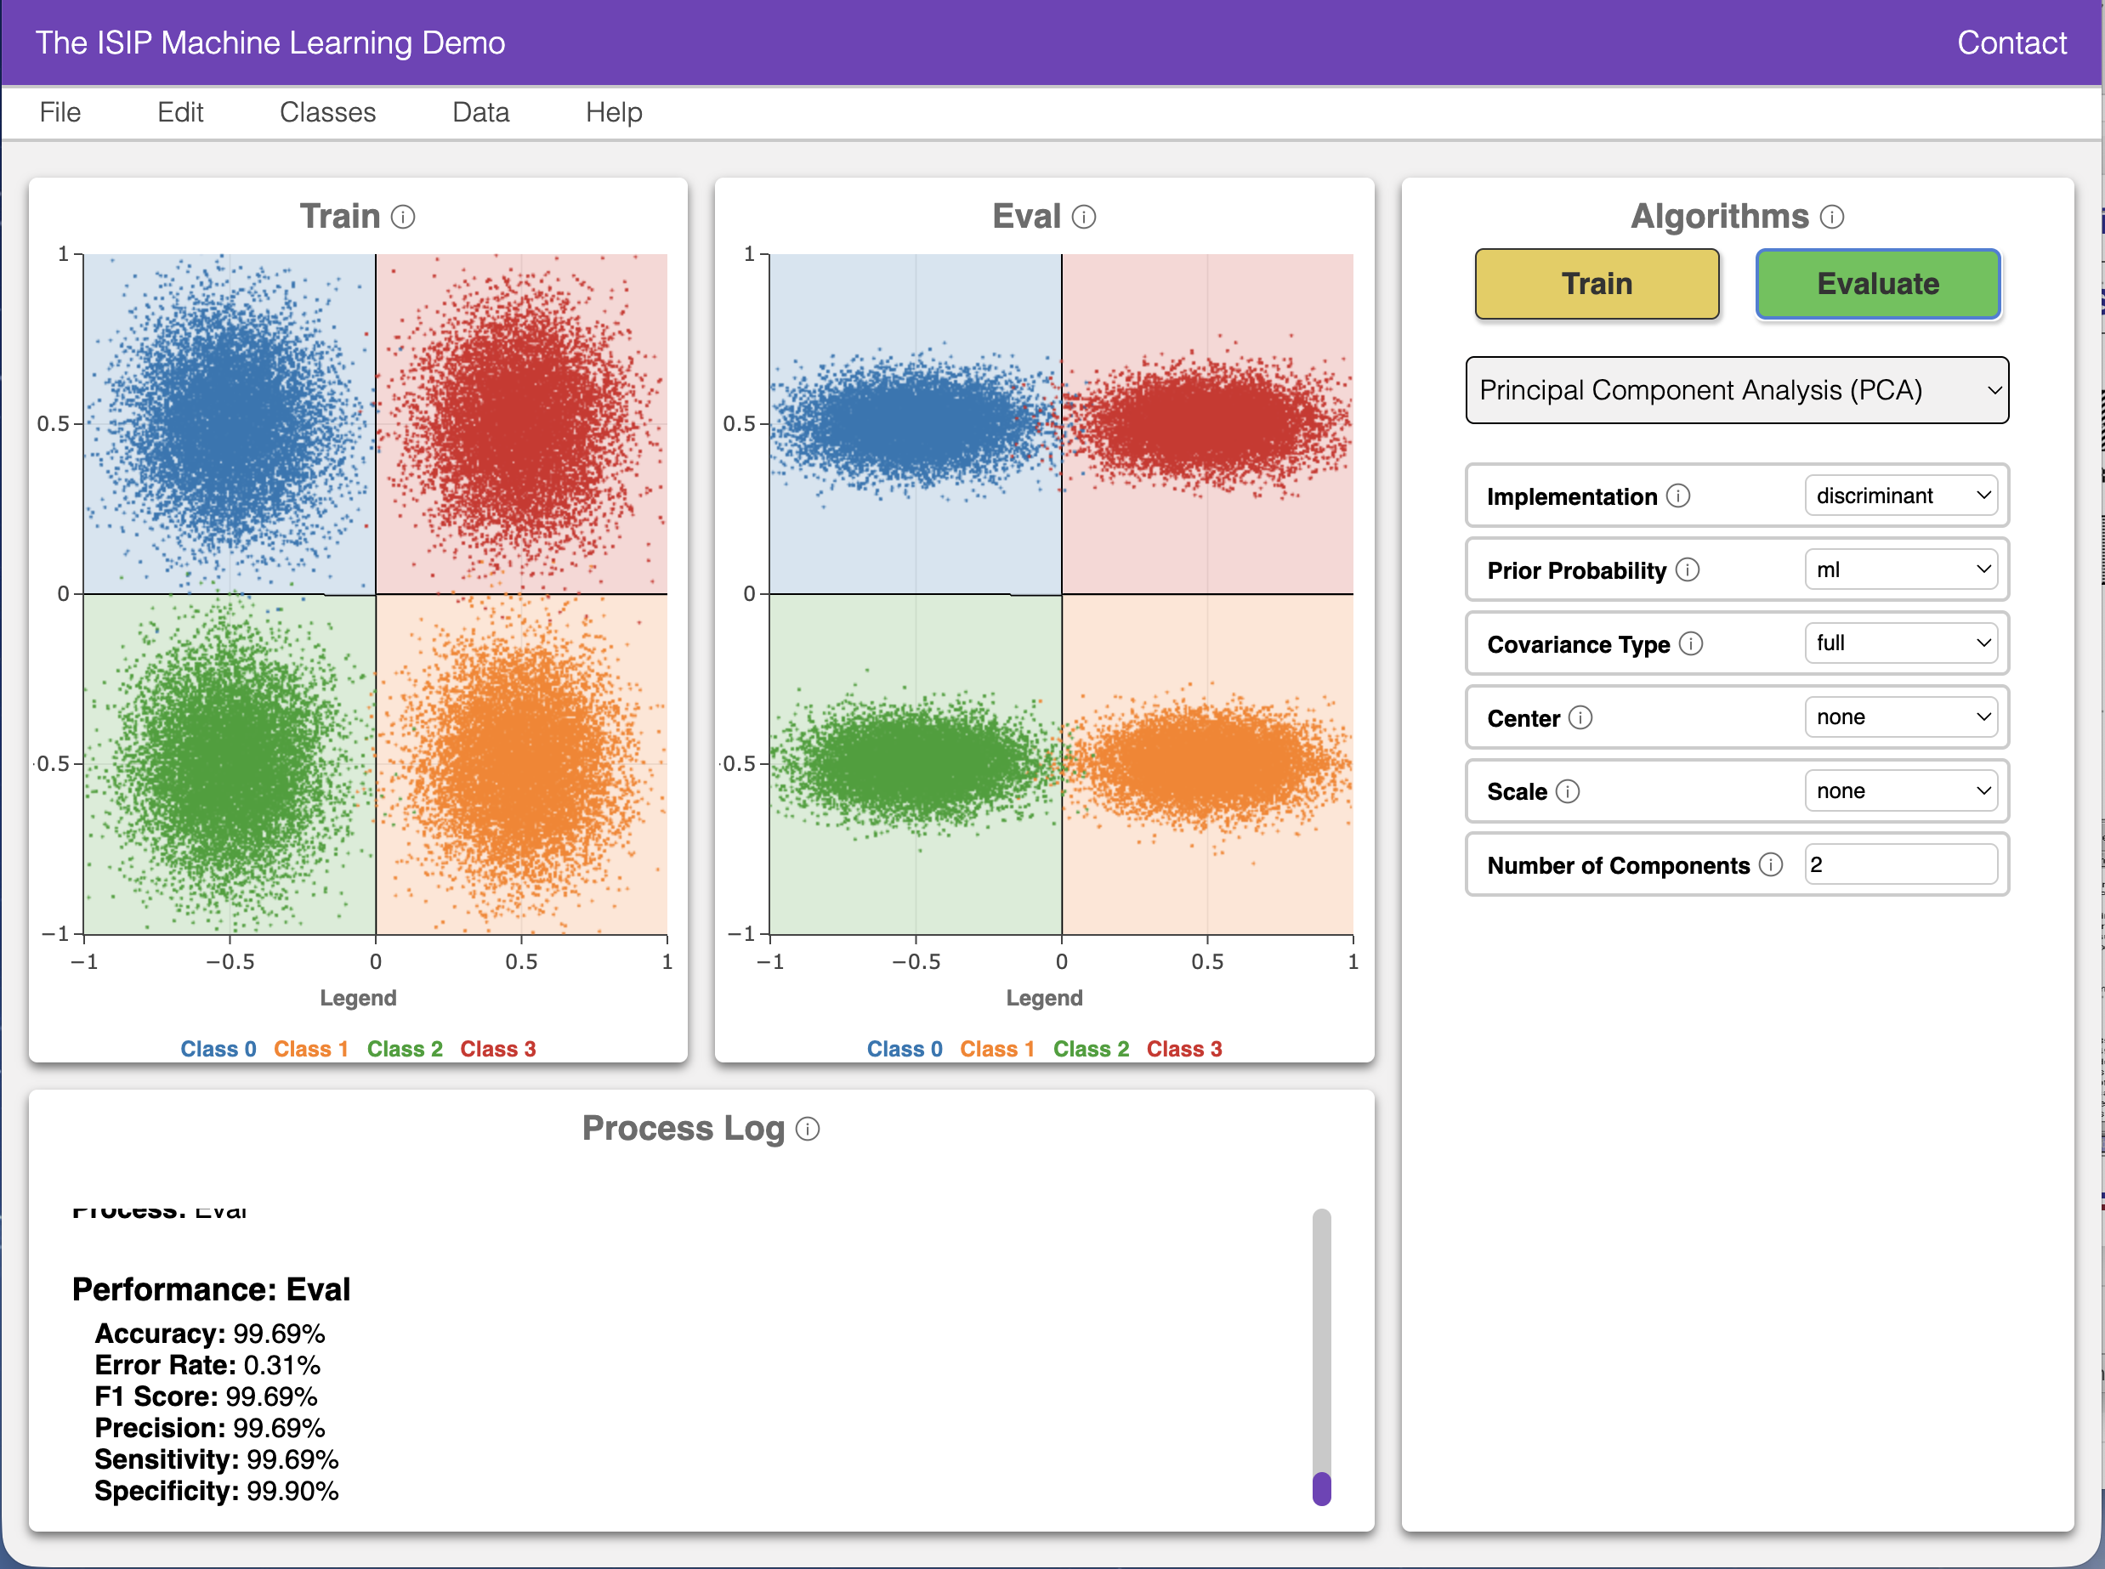
Lecture 03: Machine Learning Demonstrations
• Objectives:
Multivariate Gaussian Distributions
Euclidean Distance Metrics
Decision Surfaces
Discriminant Functions
Gaussian Classifiers
Nonlinear Decision Surfaces
Machine Learning Algorithms
• Resources:
The ISIP Machine Learning Demo
Textbook (Sections 2.1-2.4)
DHS: Chapter 2
MurphK: Gaussian Classifiers

Slide 2
ISIP Machine Learning Demo (IMLD)
There are many excellent resources on the Internet that demonstrate pattern recognition concepts.
There are many Python, MATLAB and C++ toolboxes that implement state of the art algorithms.
One such resource is the ISIP Machine Learning Demo (IMLD) that lets you quickly explore how a variety of algorithms process the same data.
Users can create data sets with the application, save them to disk, or upload new data sets.
Users can select from a variety of machine learning algorithms.
Users can test generalization by creating training and open-set evaluation sets.
….
The application is written in Python using PyQT5, PyQtGraph and the Python machine learning package SciKit-Learn.
New: Client/server web–based app.
New: Includes quantum machine learning algorithms.

Slide 3
Summary
IMLD: a nice intuitive tool that lets you create data, save data, upload data, and evaluate a wide variety of machine learning algorithms.
Multivariate Gaussian Distributions: specified by a mean vector and a covariance matrix. Often visualized using support regions and scatter plots.
Discriminant Functions: a mathematical function we use to classify data.
Gaussian Classifiers: data represented by multivariate Gaussian distributions can be classified using simple decisions surfaces that are easy to visualize.
Terminology:
Principal Components Analysis (PCA): Often associated with a pooled covariance matrix; often refers to Analysis of Variance (ANOVA)
Class-Dependent PCA, Class-Independent PCA, Variance-Weighted PCA, Shrinkage: It all depends on what assumptions you make about the covariance matrix and how you compute the covariance matrix
Quadratic Discriminant Analysis: Essentially class-dependent PCA

